Slide 1
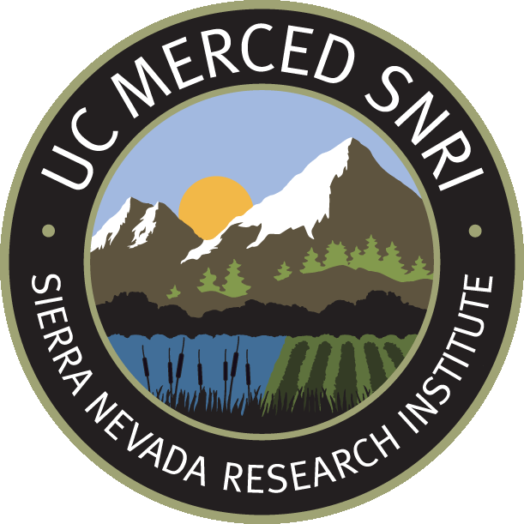
Sierra Nevada & California’s water
Roger Bales
Professor & Director
Sierra Nevada Research Institute
UC Merced
NASA-MODIS satellite image

Slide 2
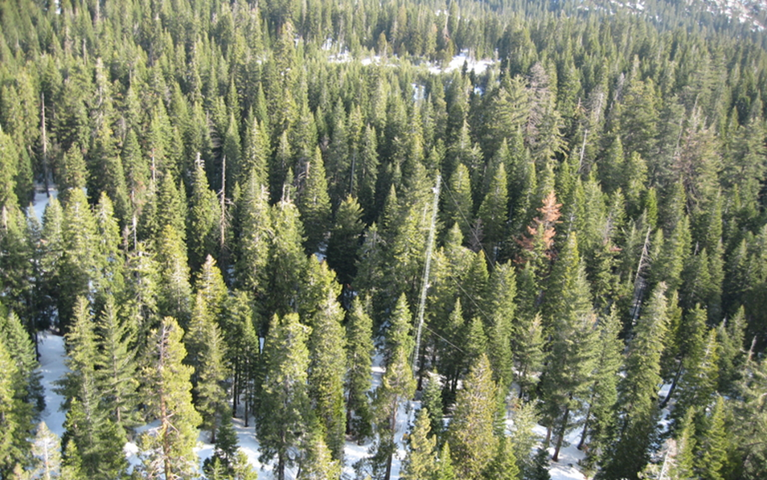
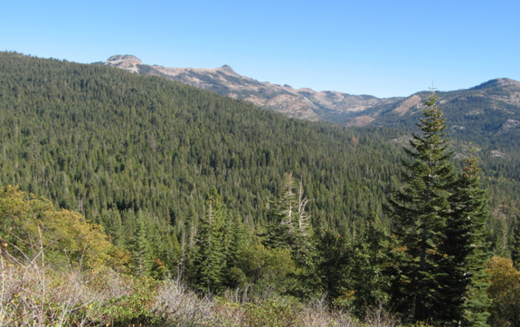
Fast facts (estimates)
About 2/3 of the precipitation that falls on the Sierra Nevada is evaporated/transpired by vegetation & 1/3 runs out in rivers
In an average year, the Sierra Nevada receives 27% of the state’s annual precipitation & provides more than 60% of the state’s consumptive use of water

Slide 3
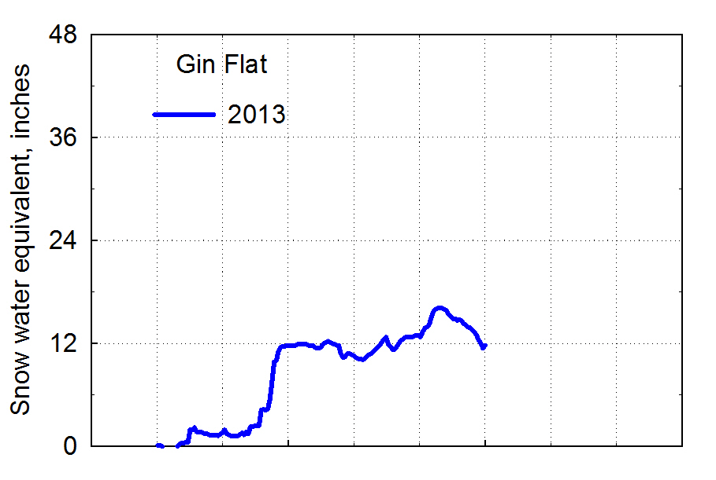
Merced River basin snowpack
This is an index value, not a basin-wide snow amount
O N D J F M A M J

Slide 4
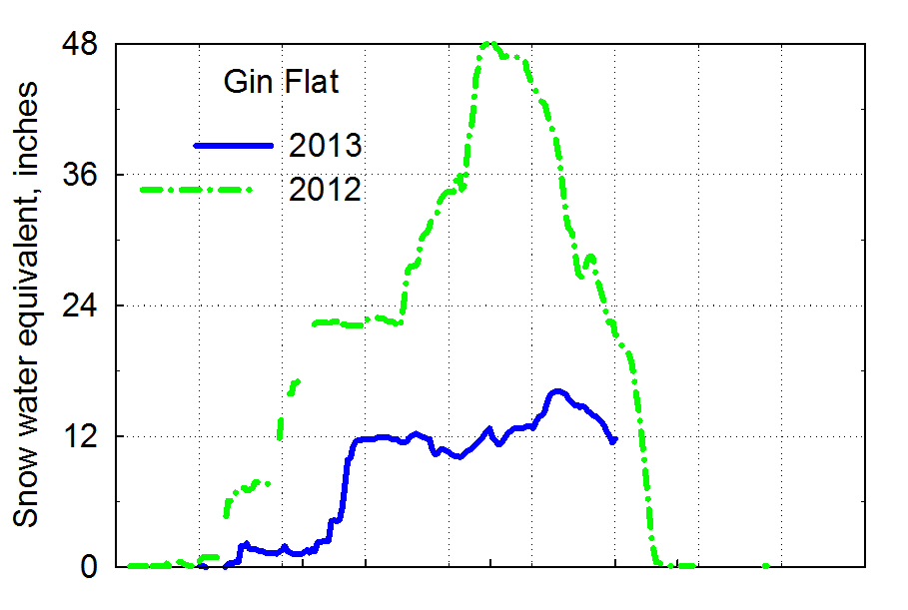
Merced River basin snowpack
2011
O N D J F M A M J

Slide 5
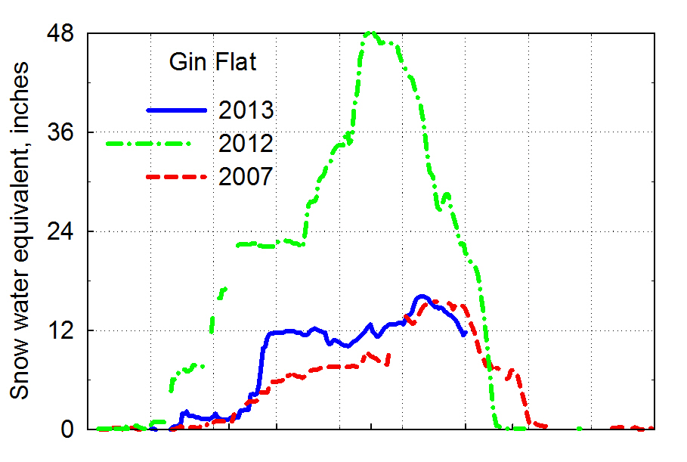
Merced River basin snowpack
2011
O N D J F M A M J

Slide 6
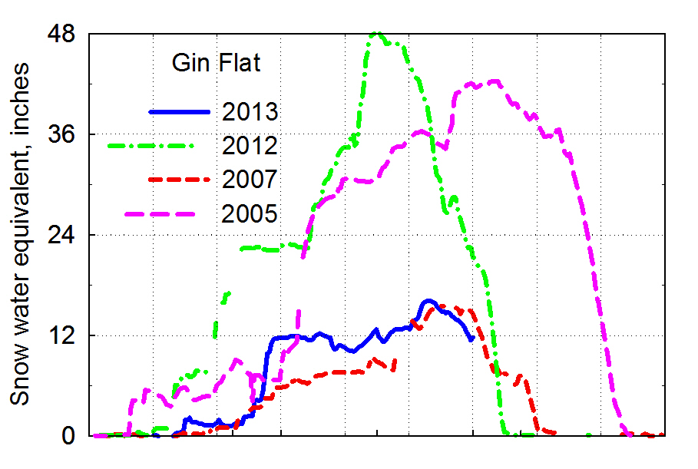
Merced River basin snowpack
2011
O N D J F M A M J

Slide 7
Merced River streamflow
Note that there is considerable interannual variability
Dry years tend to be over-forecast
Wet years tend to be under-forecast
About 75% of the forecasts are within +20% of observed

Slide 8
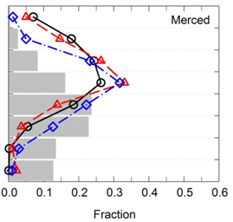
What elevations provide the most snowmelt?
13,000
12,000
11,000
10,000
9000
8000
7000
6000
5000
Fraction of snowmelt
Based on SNRI research

Slide 9
Making a water-secure world – the three I’s
INFRASTRUCTURE to store, transport & treat water
Stronger & more-adaptable INSTITUTIONS
HARD
SOFT
Better & more-accessible INFORMATION
Water security: the reliable availability of an acceptable quantity & quality of water for health, livelihoods & production, coupled w/ an acceptable level of water-related risks

Slide 10
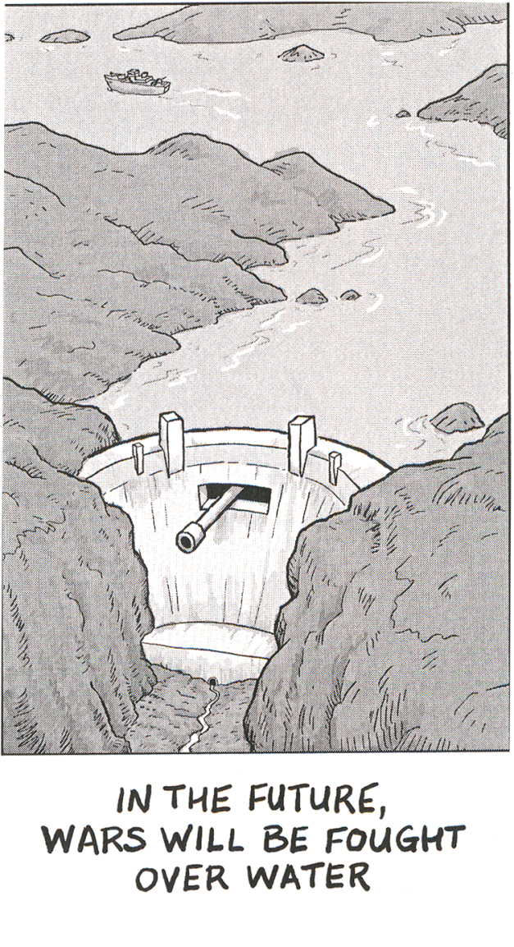
Water security lies at the heart of adaptation to climate change
Includes both:
‘hard’ options to capture & control water
‘soft’ tools to manage demand as well as increase supply, e.g. water allocation, conservation, efficiency & land-use planning
Madden, The Beast
General feeling in the water community that soft opportunities will be insufficient
SNRI is addressing knowledge gaps around water security & sustainability

Slide 11
Observations as a foundation for water security

Slide 12
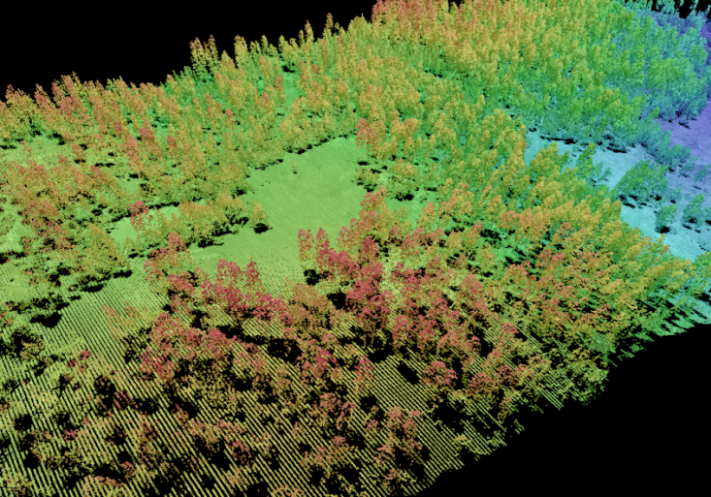
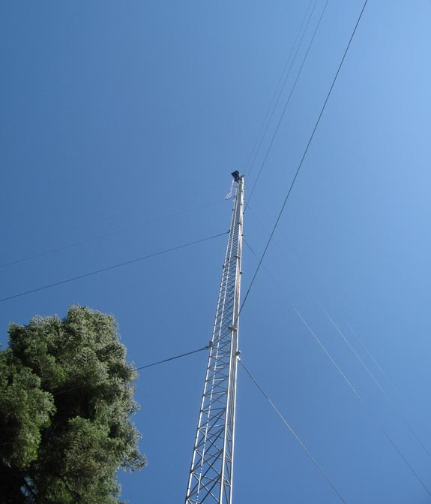
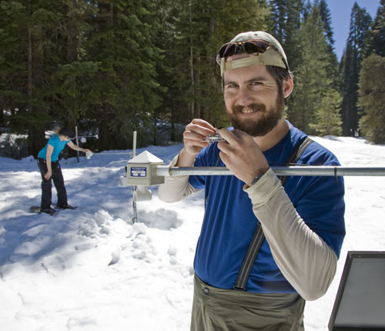
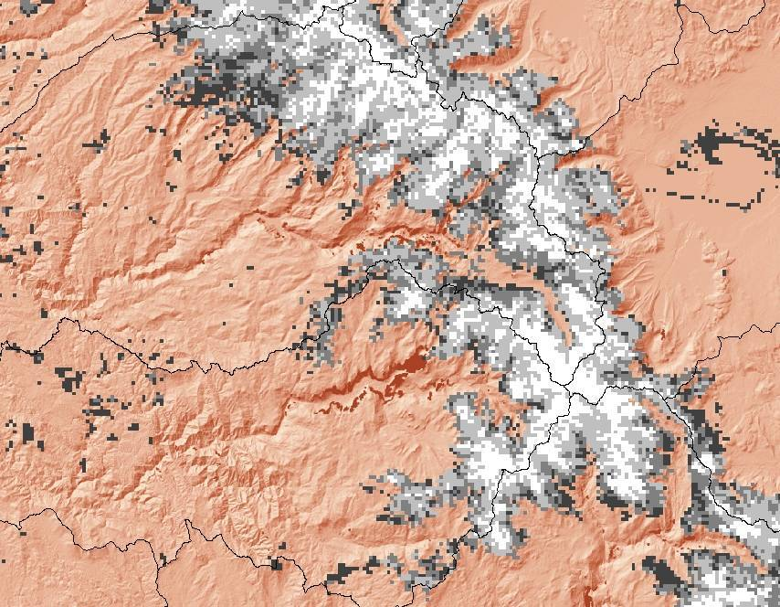
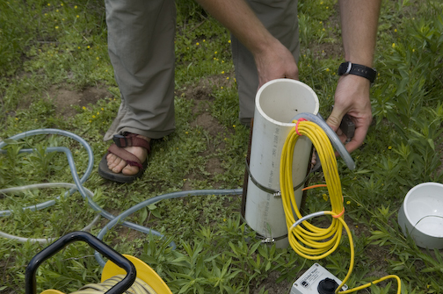
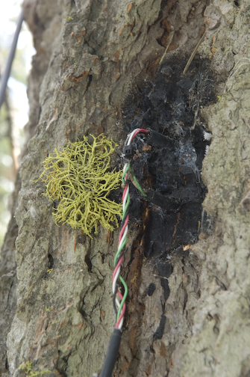
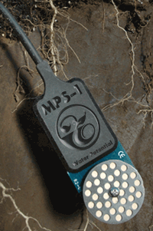
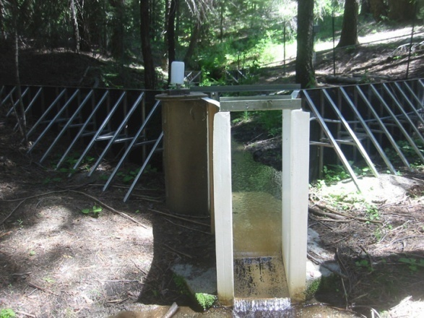
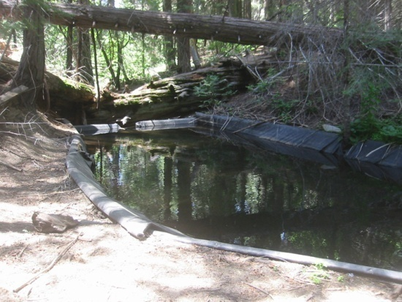
A new generation of integrated measurements
lidar
eddy correlation
embedded sensor networks
isotopes & ions
satellite snowcover
low-cost sensors
sap flow
sediment

Slide 13
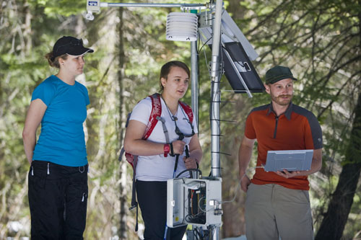
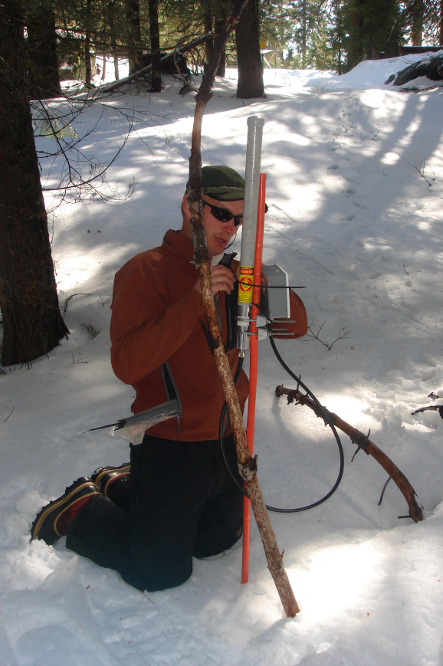
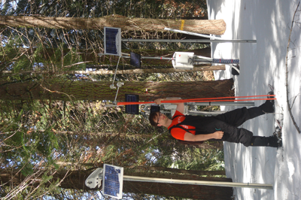
Wireless embedded sensor network nodes
Sensor node
Hopper node

Slide 14
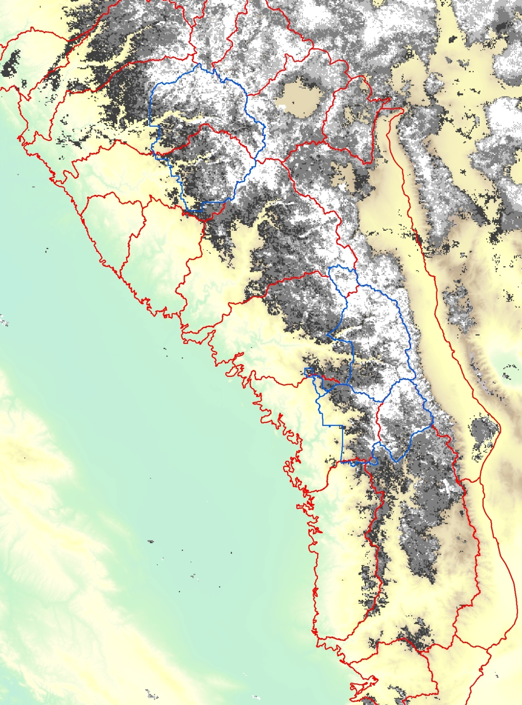
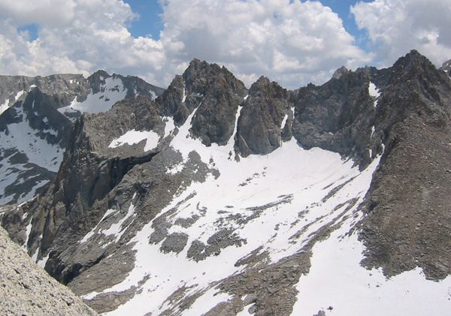
Sierra Nevada fractional snow covered area (SCA) from MODIS satellite
SCA is binned into 4 classes for ease of viewing
Pixel size: 500 m
Data available for 2000-present, continuing in future
Jan 6, 2007

Slide 15
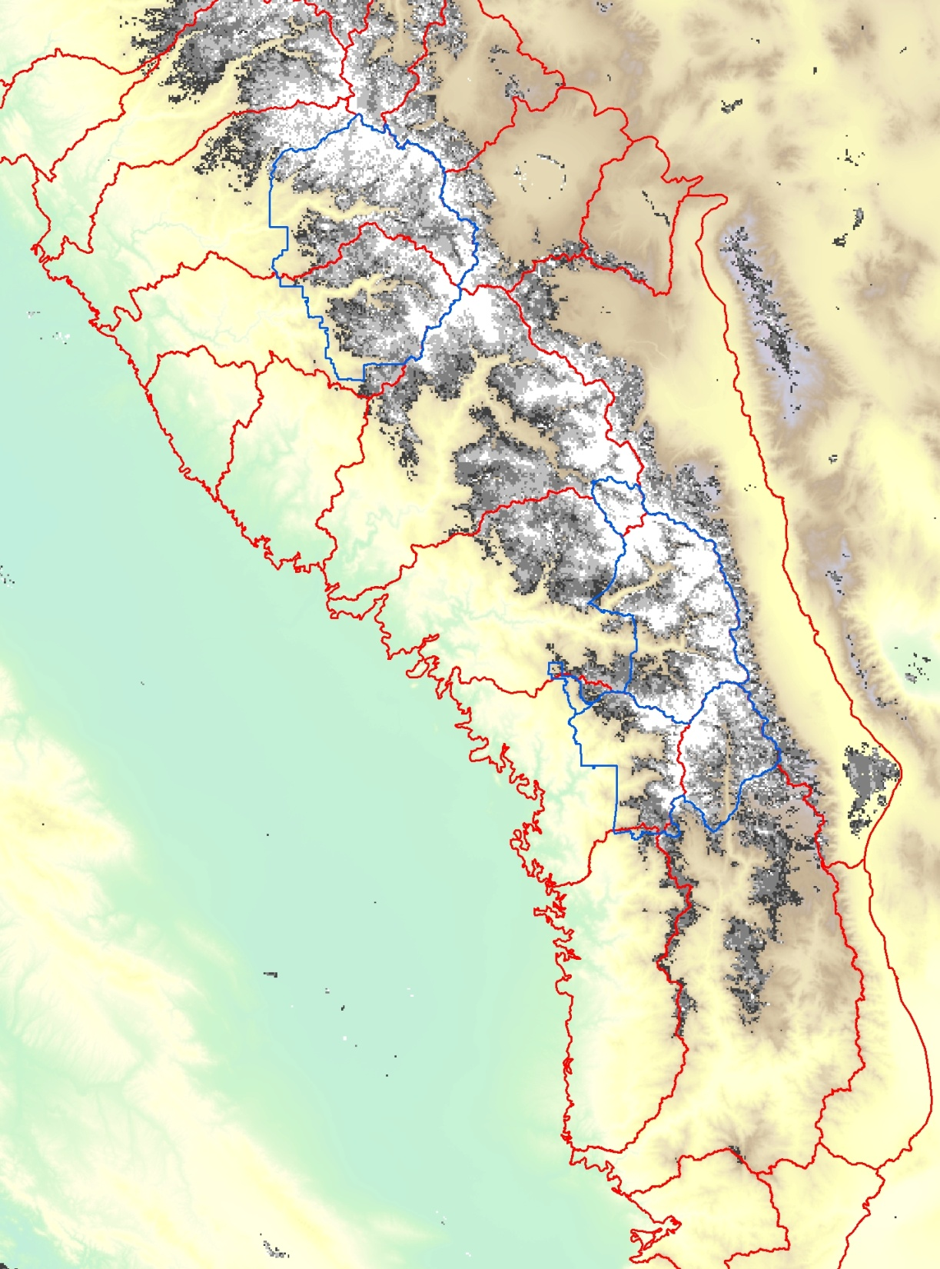
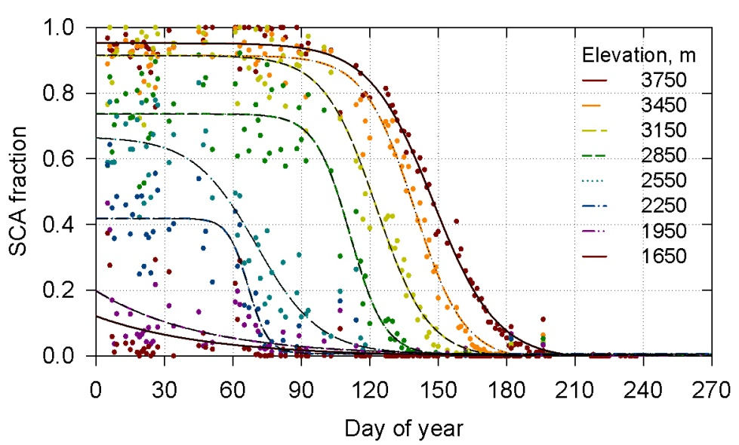
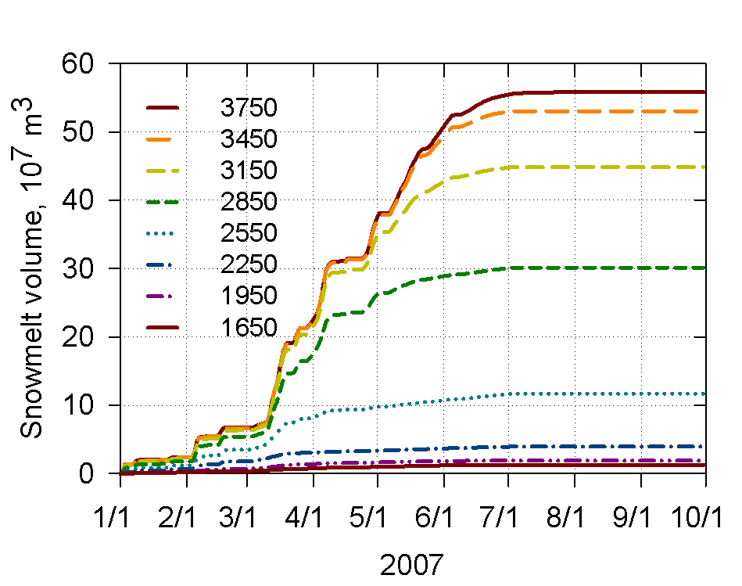
Merced basin SCA & snowmelt volume – 2007
Mar 16

Slide 16
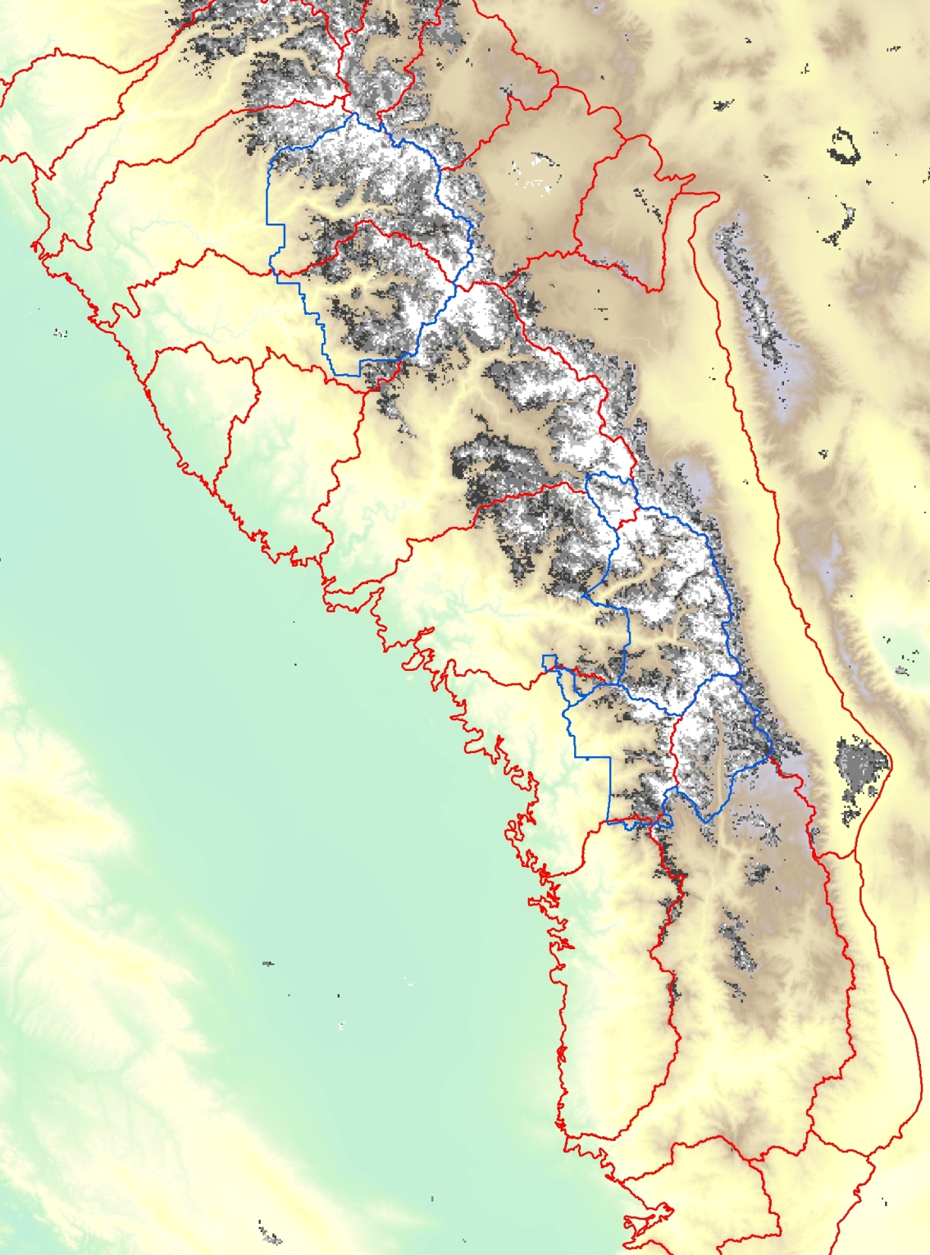
Merced basin SCA & snowmelt volume – 2007
Apr 3

Slide 17
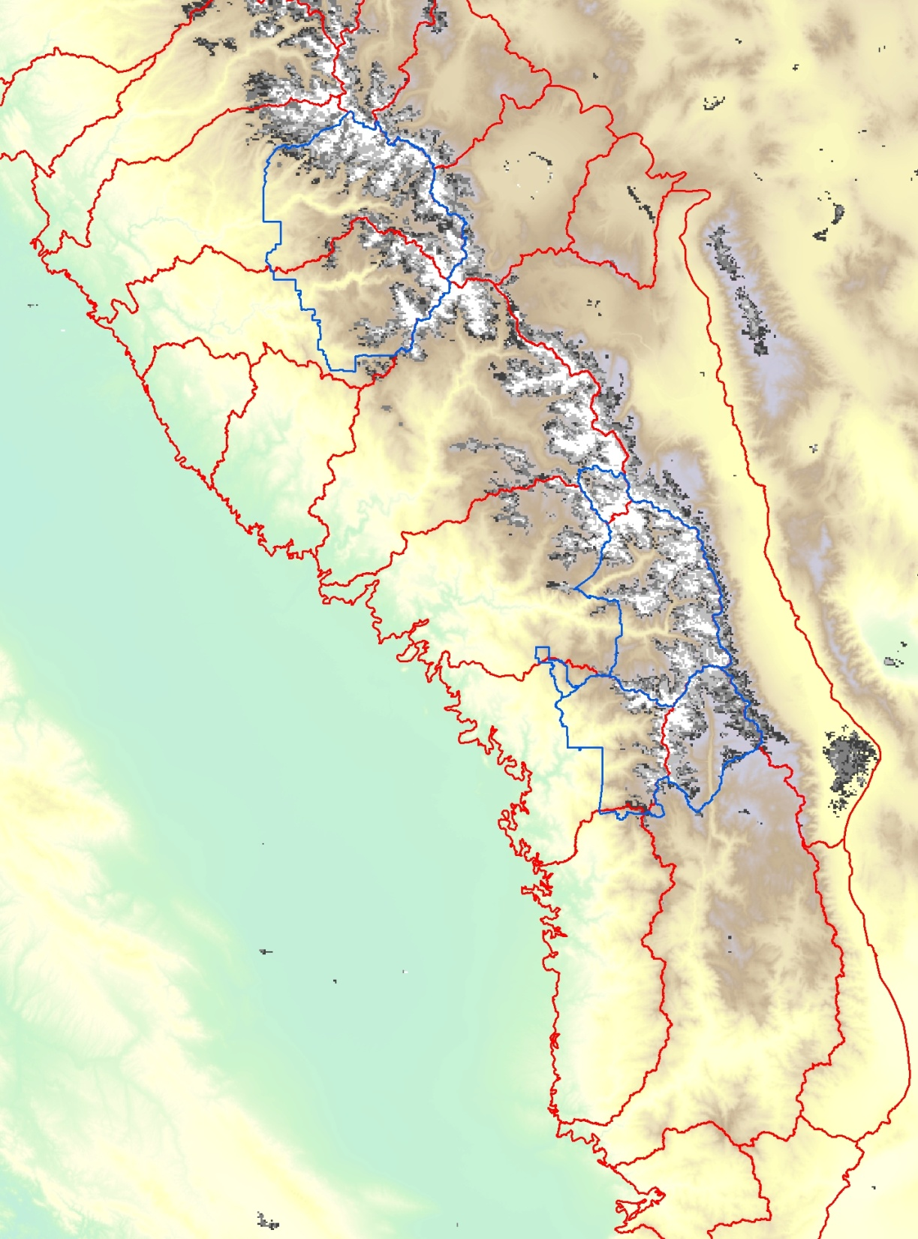
Merced basin SCA & snowmelt volume – 2007
May 7

Slide 18
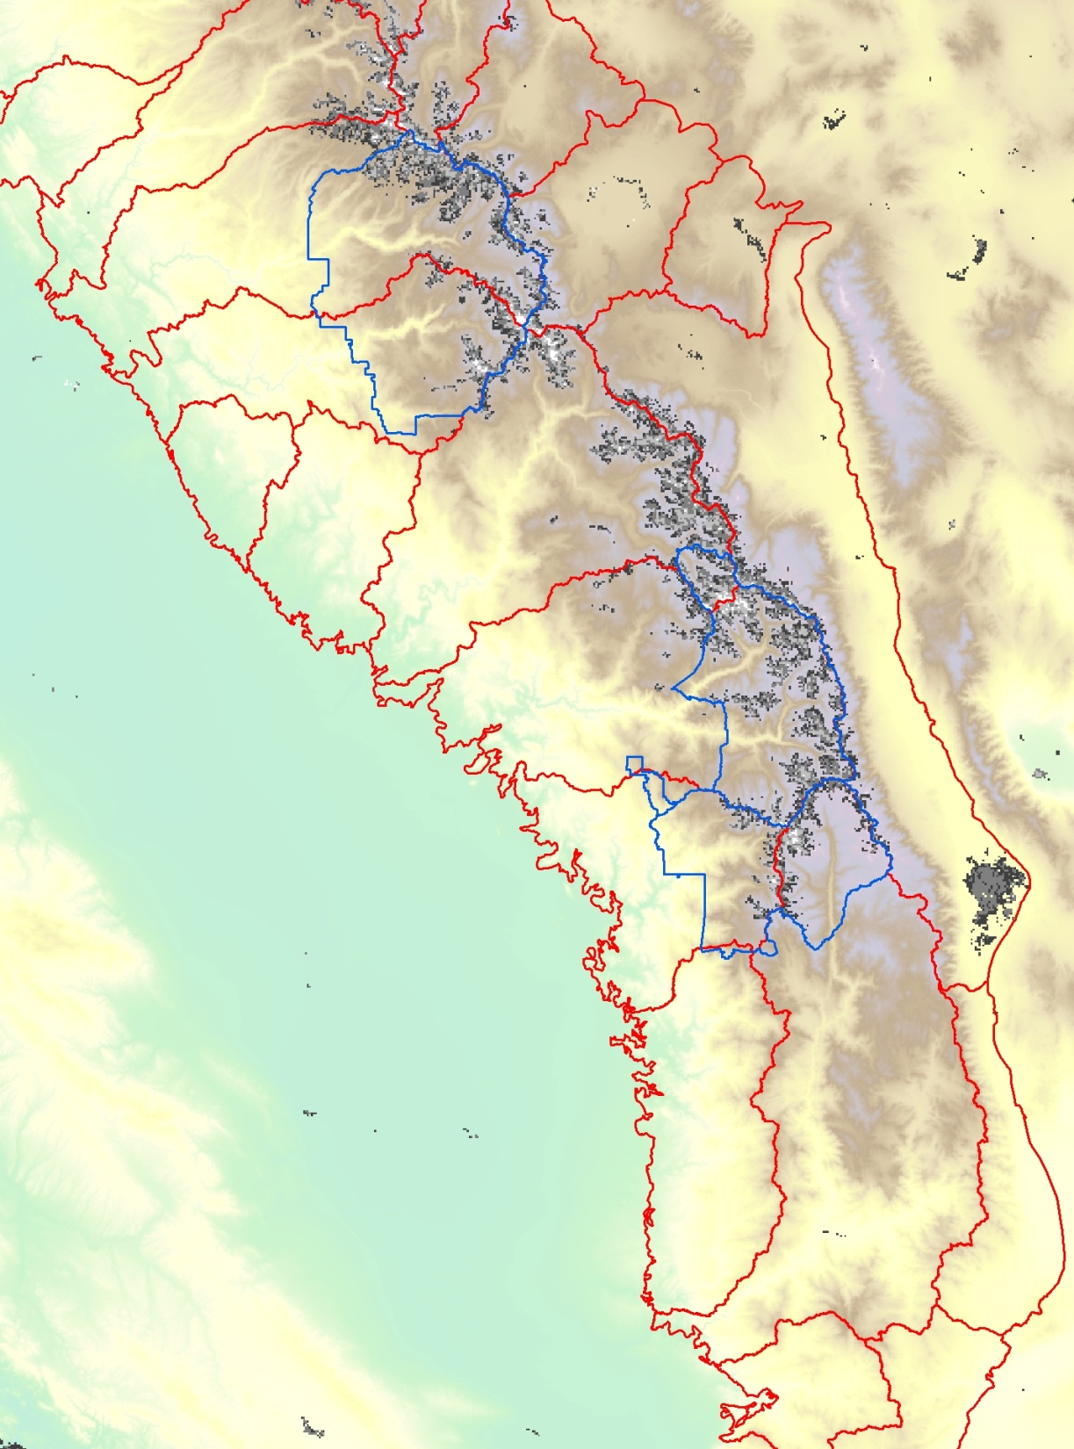
Merced basin SCA & snowmelt volume – 2007
May 28

Slide 19
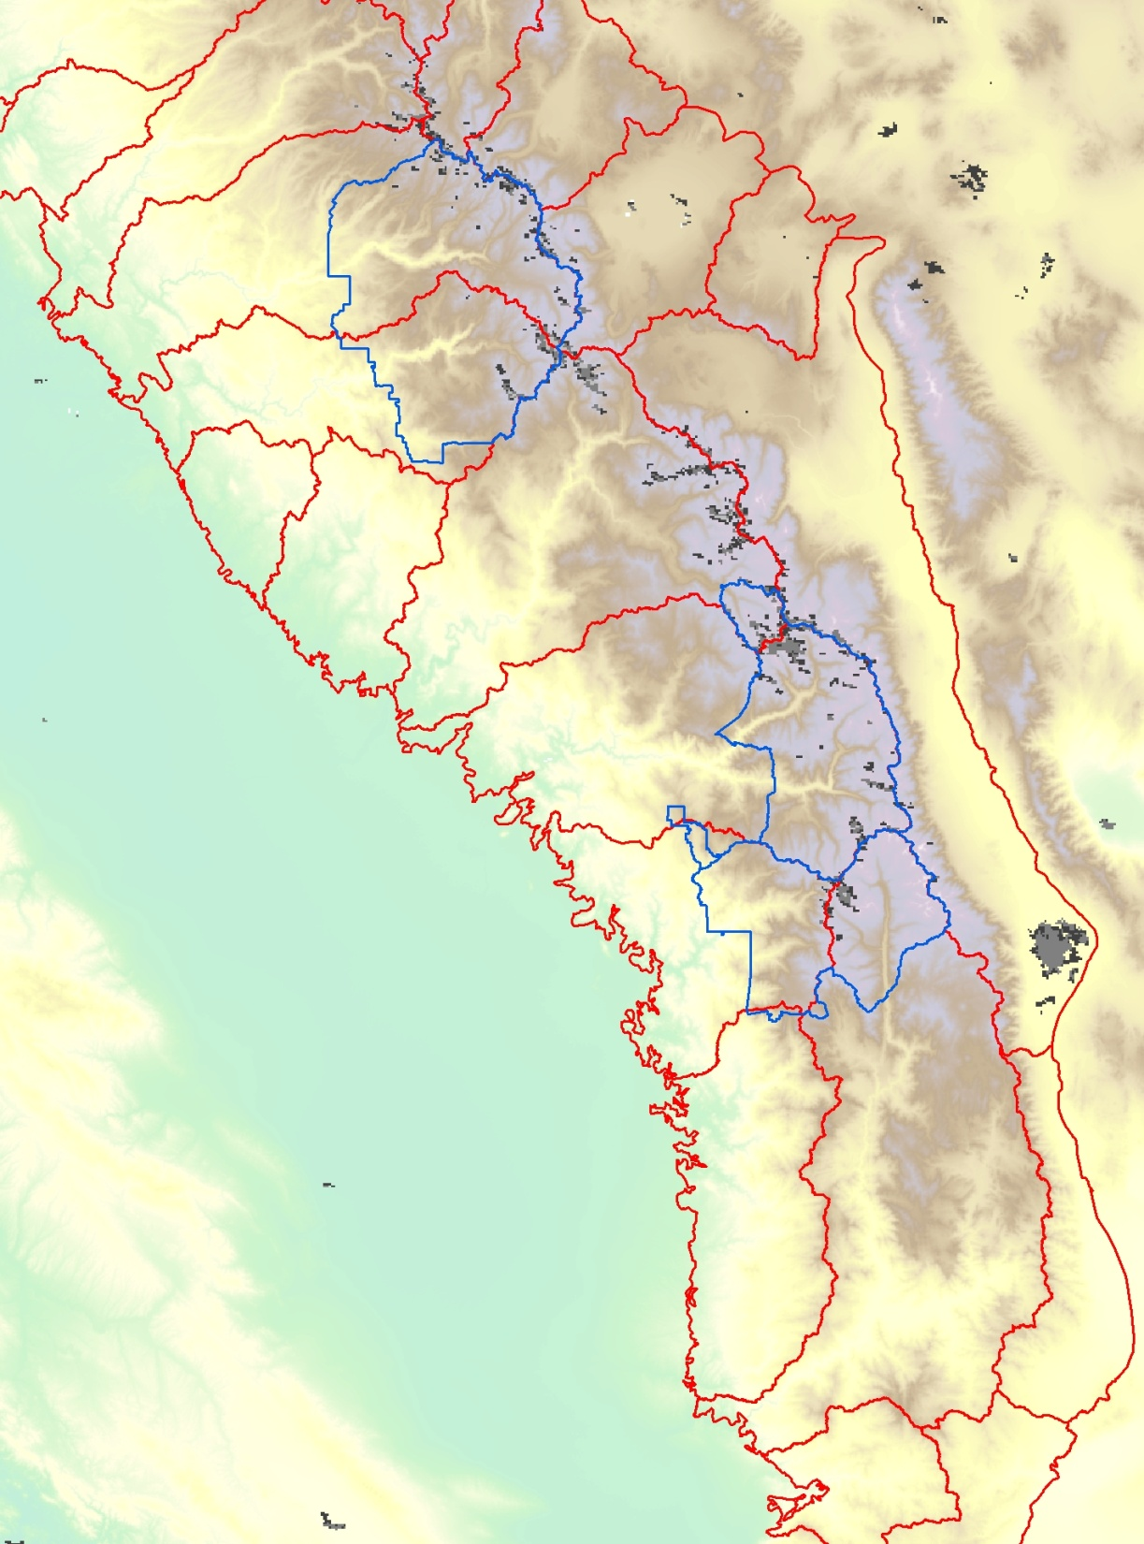
Merced basin SCA & snowmelt volume – 2007
Jun 16

Slide 20
Envisioning a new water information system for California

