Slide 1
Update from the Papuga Lab
CZO Weekly Meeting
11/5/2014
Shirley A. Papuga
Santa Catalina Mountains & Jemez River Basin
Critical Zone Observatory

Slide 2
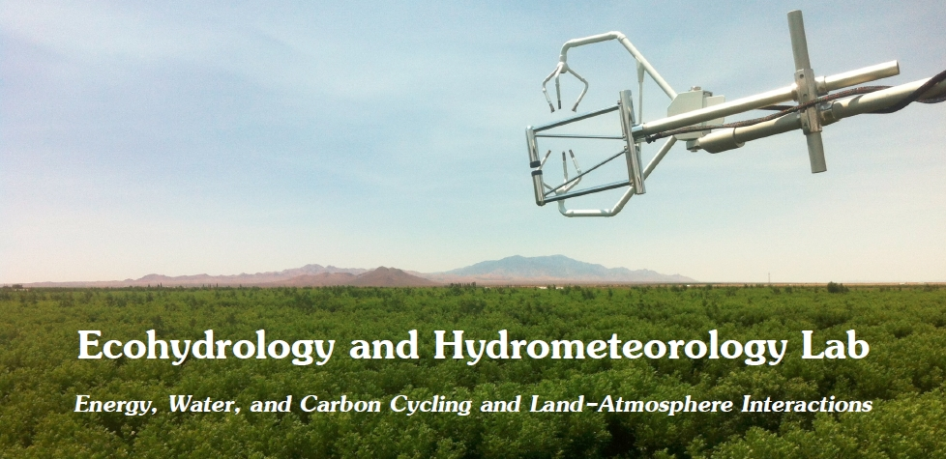
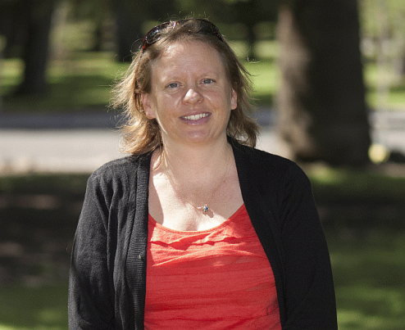
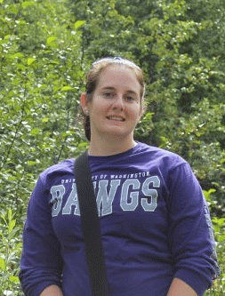
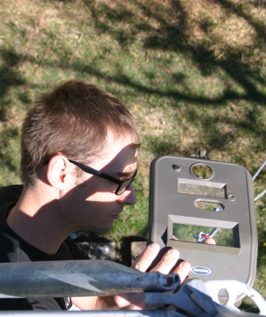
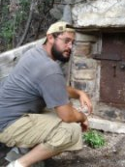
Shirley Papuga
…with eddy covariance, on glaciers, with endangered species, in creosotebush, with phenocams, in pecan orchards, using MATLAB®, with stable isotopes...
Zack, PhD
Ami, MS
Daphne, MS
Daniel, BEng
Adam, BS
Rachel, BS
Matt, MS

Slide 3
Daniel Wilcox
Senior in Chemical Engineering
CZO Undergraduate since Summer 2013
NASA Space Grant Intern 2013 – 2014 Academic Year
Took a break this summer from CZO to work at a mine
Organizes data from Catalina and Jemez Met Stations (~6 total)
Maintains phenocams at Bigelow
Organizes photos from Jemez and Bigelow phenocams
Extracts information from Jemez and Bigelow phenocams
Recently organizing sap flow data from Marshall Gulch
Started an independent project:
“Understory Growth Dynamics Following High Severity Burn
in a Mixed-Conifer Ecosystem”
working with Tyson Swetnam using data from phenocams, met stations, and Orem/Pelletier terrestrial LiDAR scans
Santa Catalina Mountains & Jemez River Basin
Critical Zone Observatory

Slide 4
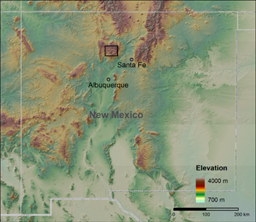
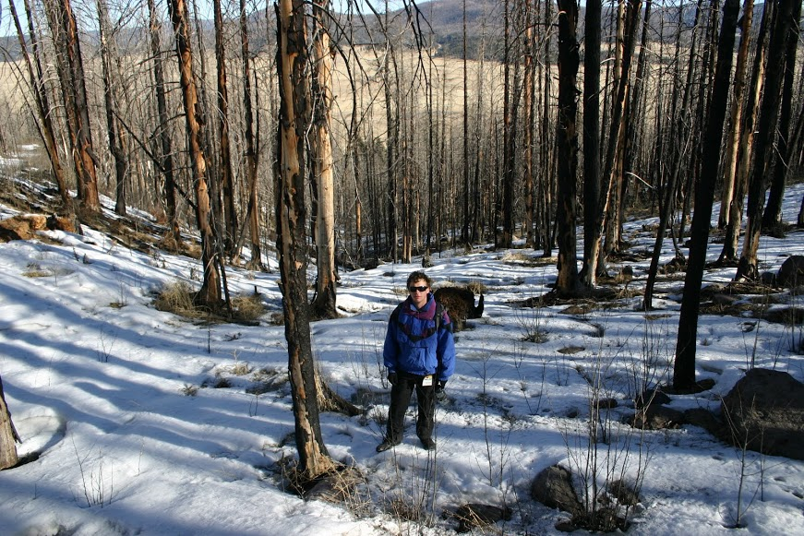
Spring 2014
Map Credit: Matej Durcik
Two adjacent mixed-conifer watersheds impacted by the 2011 Las Conchas Fire, Jemez Mountains, NM
Elevation: 2664 m – 2934 m
Annual Precipitation: 670 mm
Santa Catalina Mountains & Jemez River Basin
Critical Zone Observatory

Slide 5
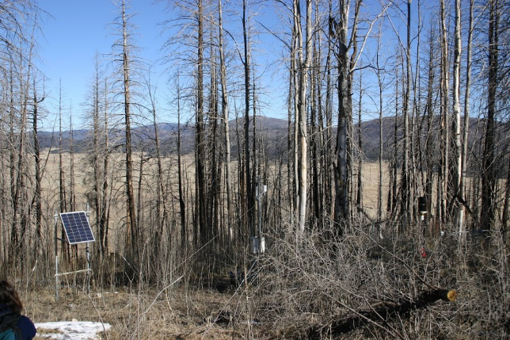
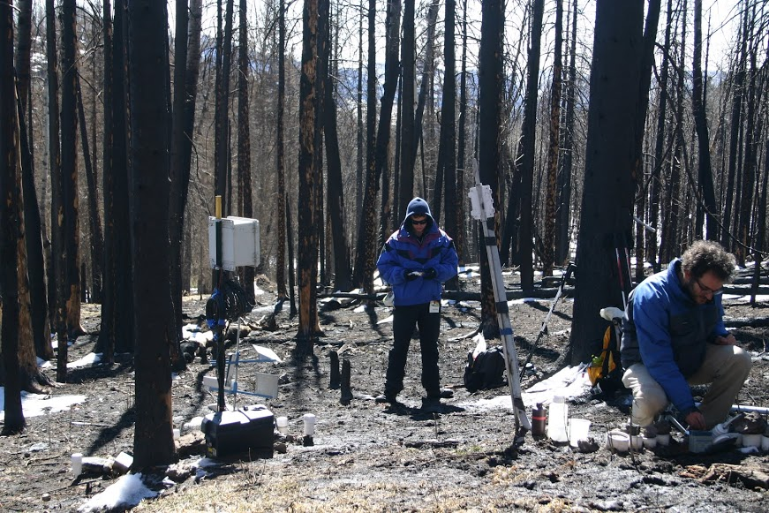
Meteorological stations at the top and bottom of the watershed measure “ecohydrological” variables such as precipitation and air temperature every 30 minutes
Sensors in soil pits make measurements of soil temperature and soil moisture at three different depths every 10 minutes
Jemez Helpers: Bhaskar Mitra, Scott Compton, Mark Losleben, Kate Condon
Santa Catalina Mountains & Jemez River Basin
Critical Zone Observatory

Slide 6
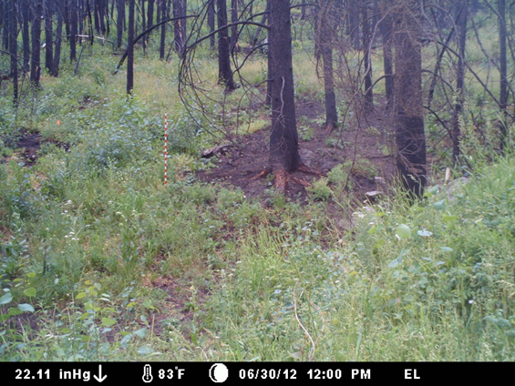
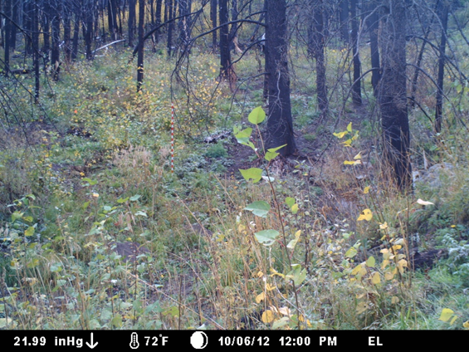
10 “phenocams” were installed at different elevations and aspects (slope directions)
cameras took hourly images for one year post-fire
Cameras allowed observation of vegetation at any desired time throughout the year
From the images, a total greenness index was calculated based on the RGB values of the pixels:
Early Season (June)
Aspen
Late Season (Oct)
$$I_{g}=2×green −red−blue$$
http://youtu.be/iTe5oj8rqHA
(Richardson et al 2007)
Santa Catalina Mountains & Jemez River Basin
Critical Zone Observatory
Notes:
Greenness index; a measure of the greenness in a photo based on pixel RGB values. Greenness of a photo is taken as an average of the greenness values of every pixel in the photograph.

Slide 7
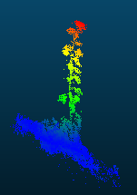
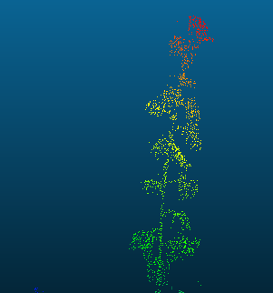
Within the same watershed as the phenocams, Caitlin Orem and Jon Pelletier performed four post-fire terrestrial LiDAR Scans
LiDAR: Sweep a laser over an area to get a 2D mesh of distances[ combining multiple scans gives a 3D point cloud
Point clouds were visualized and analyzed using CloudCompare software
Compare scans done at different times to visualize changes in the landscape
An aspen seedling in the point cloud
Santa Catalina Mountains & Jemez River Basin
Critical Zone Observatory
Data collected by Caitlin Orem, Jon Pelletier (UA Geology).

Slide 8
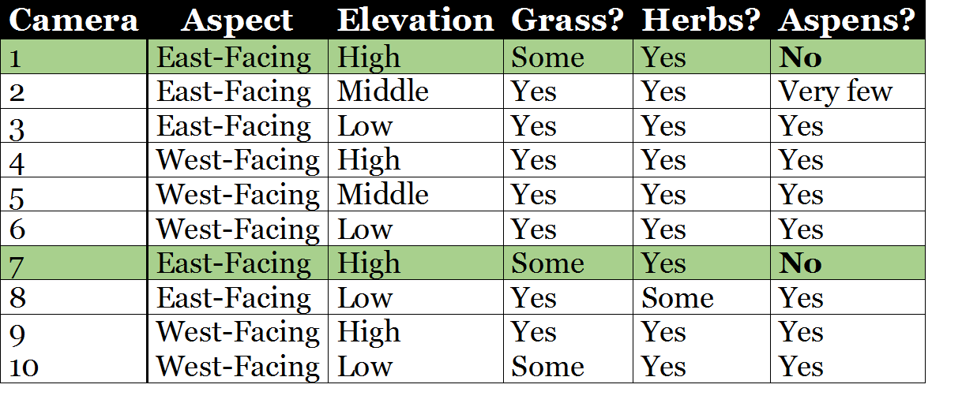
The cameras show that vegetation understory growth was not uniform across the watershed.
Aspens were seen in all sites except the two higher-elevation east-facing ones.
Santa Catalina Mountains & Jemez River Basin
Critical Zone Observatory

Slide 9
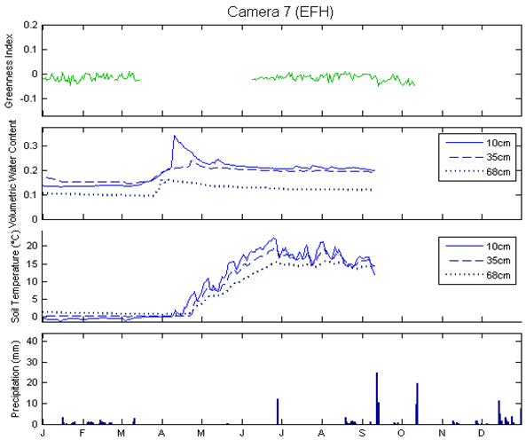
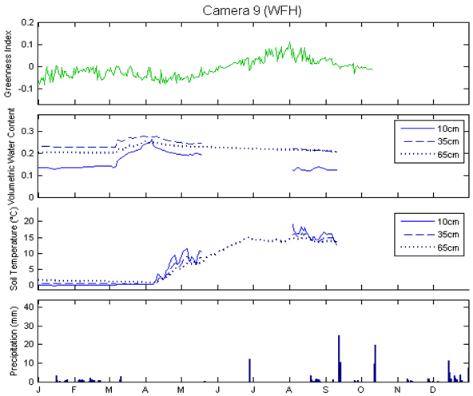
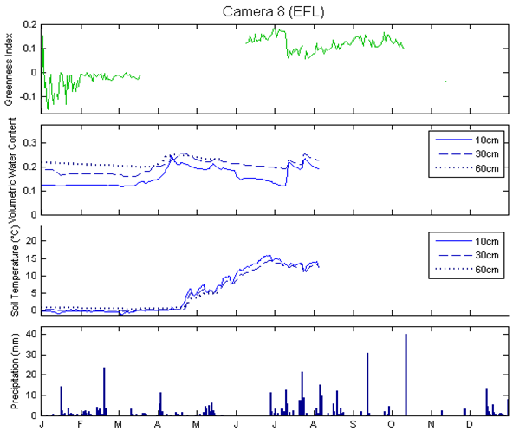
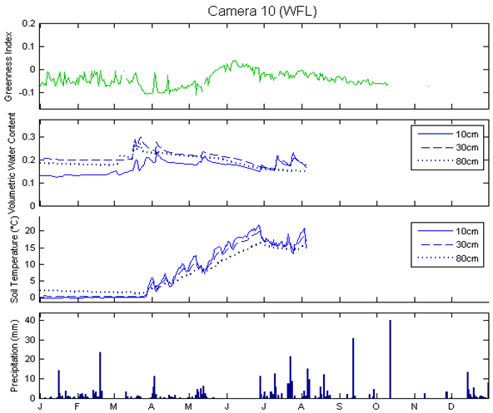
East Facing – High Elevation
West Facing – High Elevation
Greenness appears to peak earlier at lower sites
Greenness
Soil Moisture
Soil Temperature
Precipitation
All sites got moisture from snowmelt
East Facing – Low Elevation
West Facing – Low Elevation
Only lower sites got moisture from monsoon
Day of Year
Day of Year
Santa Catalina Mountains & Jemez River Basin
Critical Zone Observatory
Notes:
DON’T Mention Holes

Slide 10
East Facing – High
East Facing – Low
West Facing – High
West Facing – Low
10-cm Soil Temp
East Facing – High
East Facing – Low
West Facing – High
West Facing – Low
10-cm Soil Moisture
Normalized Greenness
West facing veg dynamics correlated with soil temperature
East facing high veg dynamics don’t appear to correlate with soil temperature or moisture
Santa Catalina Mountains & Jemez River Basin
Critical Zone Observatory

Slide 11
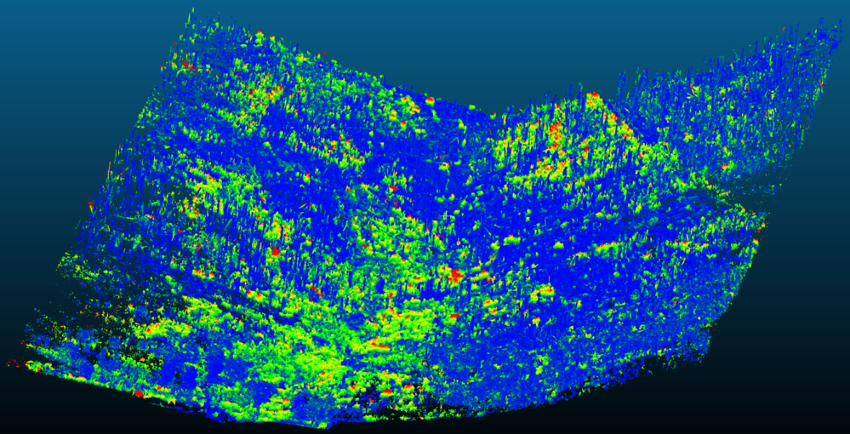
Difference between two
Scans: 9/25/11 and
9/25/12
Vegetation dynamics look different when considered on the larger scale
Vegetation appears to be more successful at the point of convergence, especially lower in the watershed
West-facing aspect appears more successful than east-facing
Santa Catalina Mountains & Jemez River Basin
Critical Zone Observatory

Slide 12
EFH
Santa Catalina Mountains & Jemez River Basin
Critical Zone Observatory

Slide 13
EFM
Santa Catalina Mountains & Jemez River Basin
Critical Zone Observatory

Slide 14
EFL
Santa Catalina Mountains & Jemez River Basin
Critical Zone Observatory

Slide 15
WFH
Santa Catalina Mountains & Jemez River Basin
Critical Zone Observatory

Slide 16
WFM
Santa Catalina Mountains & Jemez River Basin
Critical Zone Observatory

Slide 17
WFL
Santa Catalina Mountains & Jemez River Basin
Critical Zone Observatory

Slide 18
Divide LiDAR image into 6 “transects” using CloudCompare
estimate the point of convergence in watershed to delineate aspect
estimate elevational divisions by looking at the scan from above and splitting ~ evenly into six sections
Classify points in the clouds as ground or vegetation using LAStools
Calculate vegetation density using MATLAB
divide each transect into a series of 10cm×10cm squares
count number of squares with any points in them
count number of squares with vegetation points in them
vegetation density = vegetation count / point count
Santa Catalina Mountains & Jemez River Basin
Critical Zone Observatory

Slide 19
North (Low Elevation)
South (High Elevation)
Aspect | High | Middle | Low
East-Facing | 0.45 | 0.38 | 0.58
West-Facing | 0.31 | 0.40 | 0.75
9/24/2011
Santa Catalina Mountains & Jemez River Basin
Critical Zone Observatory

Slide 20
South (High Elevation)
North (Low Elevation)
Aspect | High | Middle | Low
East-Facing | 0.65 | 0.58 | 0.73
West-Facing | 0.52 | 0.70 | 0.90
9/24/2012
Santa Catalina Mountains & Jemez River Basin
Critical Zone Observatory

Slide 21
South (High Elevation)
North (Low Elevation)
Difference
Aspect | High | Middle | Low
East-Facing | 0.20 | 0.20 | 0.15
West-Facing | 0.21 | 0.30 | 0.15
Santa Catalina Mountains & Jemez River Basin
Critical Zone Observatory

Slide 22
WFM
Santa Catalina Mountains & Jemez River Basin
Critical Zone Observatory

Slide 23
South (High Elevation)
North (Low Elevation)
Santa Catalina Mountains & Jemez River Basin
Critical Zone Observatory
Santa Catalina Mountains & Jemez River Basin
Critical Zone Observatory

Slide 24
Daniel - Moving forward
Develop cleaner classification of “vegetation” by removing tree trunks
Develop more sophisticated method for division into 6 “transects”
Using LiDAR data, quantify relationships between aspect, elevation and calculated vegetation density at 10cm x 10cm scale; additional possibility of using a solar model to also look at radiation relationships at 10cm x 10cm scale
Develop empirical relationship between phenocam greenness and LiDAR vegetation density to build daily vegetation density that can be linked to meteorological data
Quantify aspen recovery within the LiDAR “transects”
Santa Catalina Mountains & Jemez River Basin
Critical Zone Observatory
Notes:
Greenness at high elevation east facing sites did not appear to be either temperature or moisture controlled
These were also the sites where aspen were not found in the phenocam images
Overall east facing and lower elevation sites had the most difficulty with any vegetation recovery.

Slide 25
Rachel Wehr
Junior in SWES
Working on my NSF CAREER Project since Spring 2014
Took a break this summer to work at organic farms
1st place Earth Week Poster – Spring 2014
2nd place RISE Poster – Fall 2014
Started an independent project:
“Interannual Variability of Soil Moisture Dynamics in a
Semiarid Shrubland with Bimodal Precipitation Patterns”
We expect to see changes in the frequency and magnitude of precipitation, which could have major implications for soil water resources and the vegetation that depends on those resources. The objective of her study was to analyze how the frequency and timing of precipitation in winter and summer seasons influences soil moisture, so that we can understand how changes in our precipitation regime might influence our native ecosystems and the feedback to the climate system.
Now working on extending this research to the Marshall Gulch / Mt Lemmon area…
Santa Catalina Mountains & Jemez River Basin
Critical Zone Observatory

Slide 26
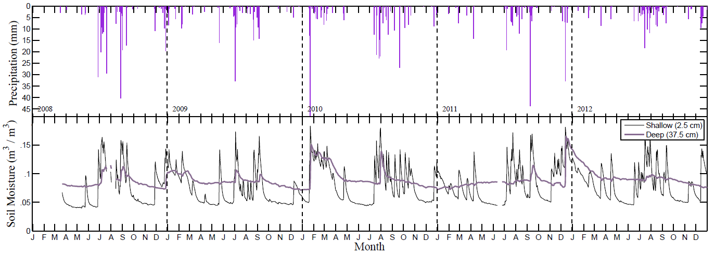
Winter and summer precip
Surface soil moisture responds to all storms, deep moisture to larger storms or series of storms
Santa Catalina Mountains & Jemez River Basin
Critical Zone Observatory

Slide 27
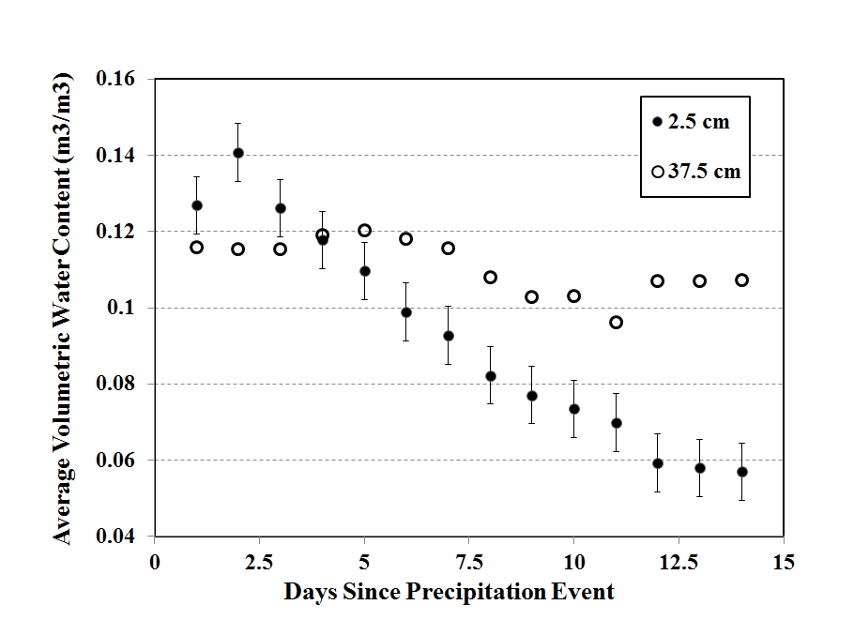
Surface moisture leaves the system quickly, deep moisture persists
Santa Catalina Mountains & Jemez River Basin
Critical Zone Observatory

Slide 28
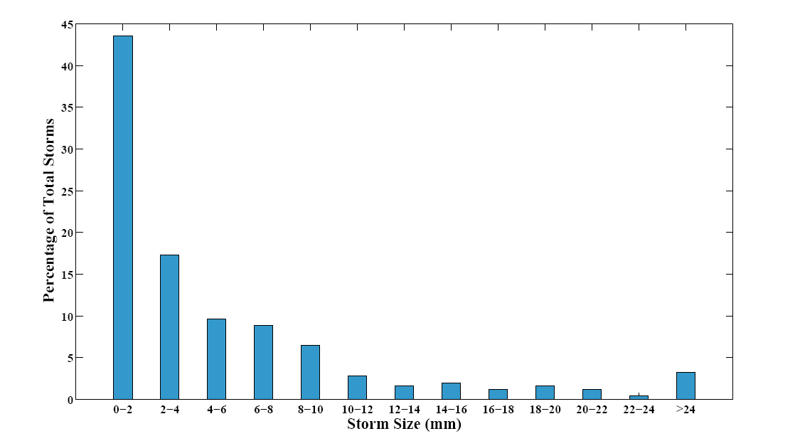
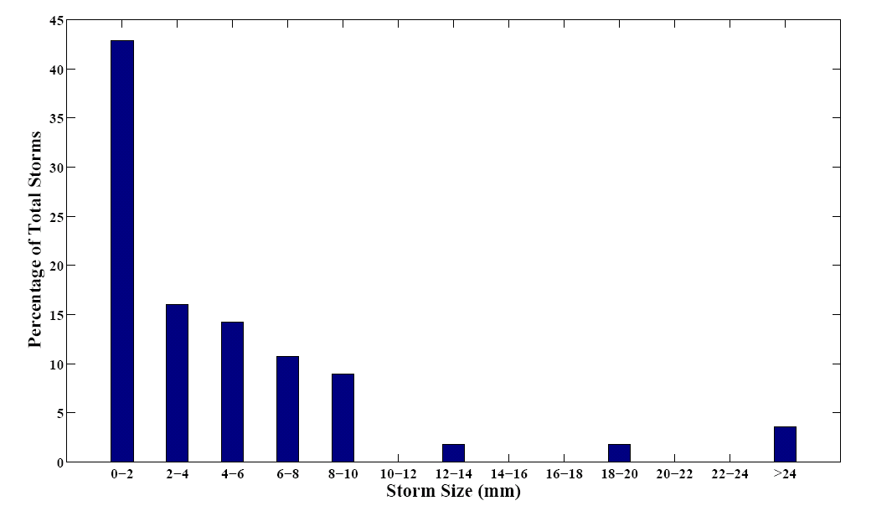
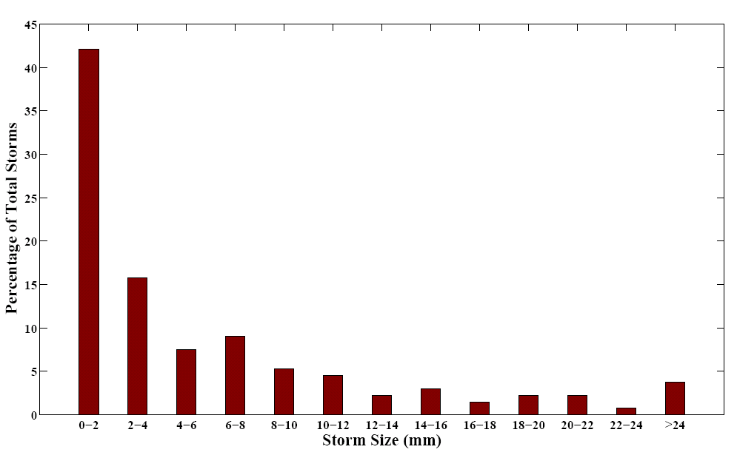
Winter
Summer
Most storms are small; large storms mostly in the summer
Santa Catalina Mountains & Jemez River Basin
Critical Zone Observatory

Slide 29
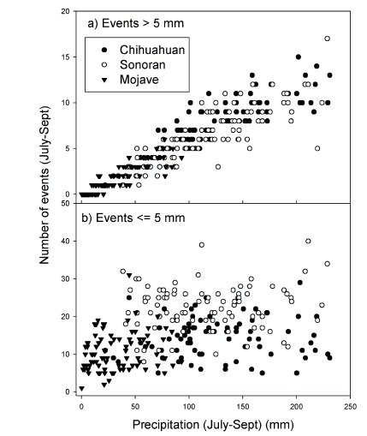
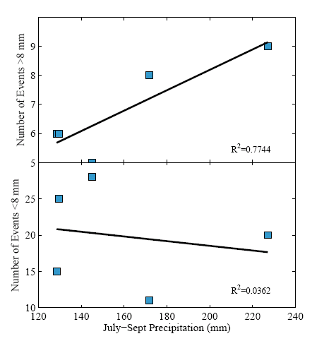
From Huxman et al. 2004
small storms occur anytime; large storms occur in yrs of high precip
Santa Catalina Mountains & Jemez River Basin
Critical Zone Observatory

Slide 30
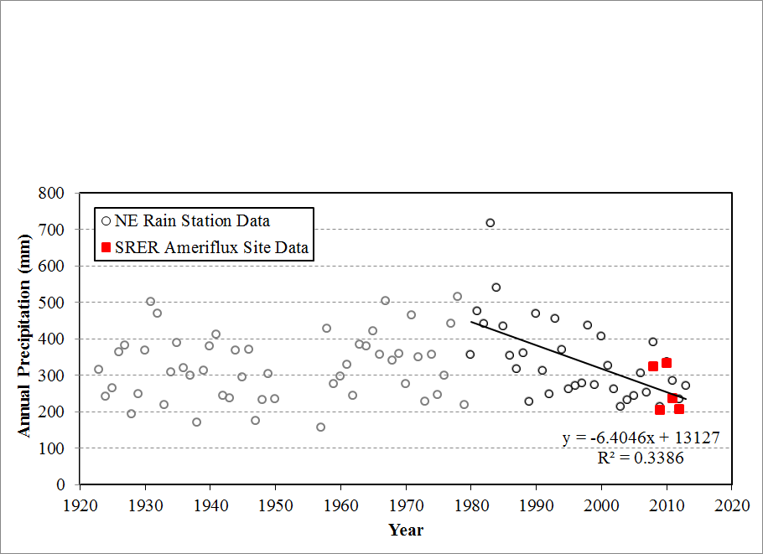
Long term precip data from: http://ag.arizona.edu/SRER/data.html
Annual precip decreasing over last 30 years
Santa Catalina Mountains & Jemez River Basin
Critical Zone Observatory

Slide 31
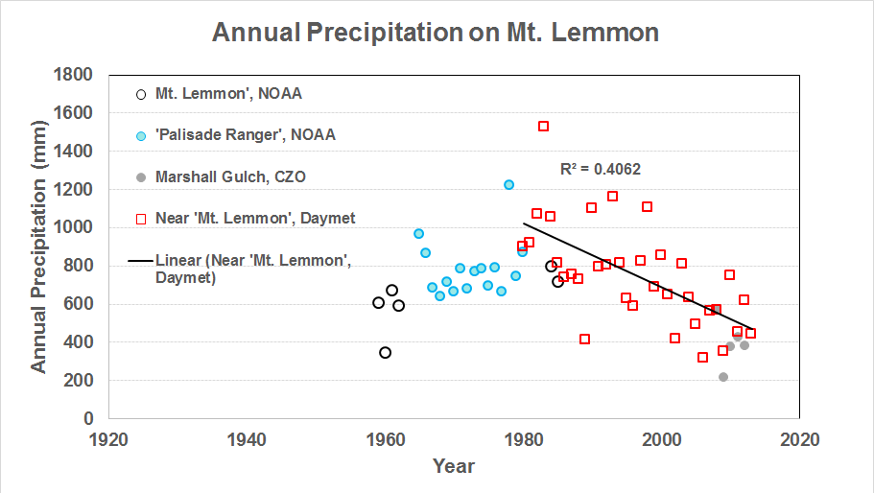
We see the same trend on Mt Lemmon!
Santa Catalina Mountains & Jemez River Basin
Critical Zone Observatory

Slide 32
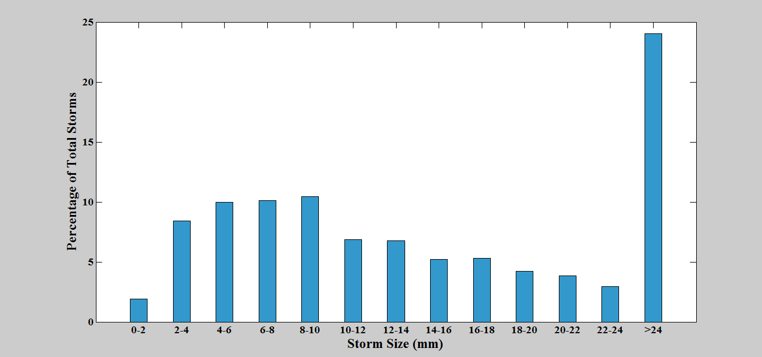
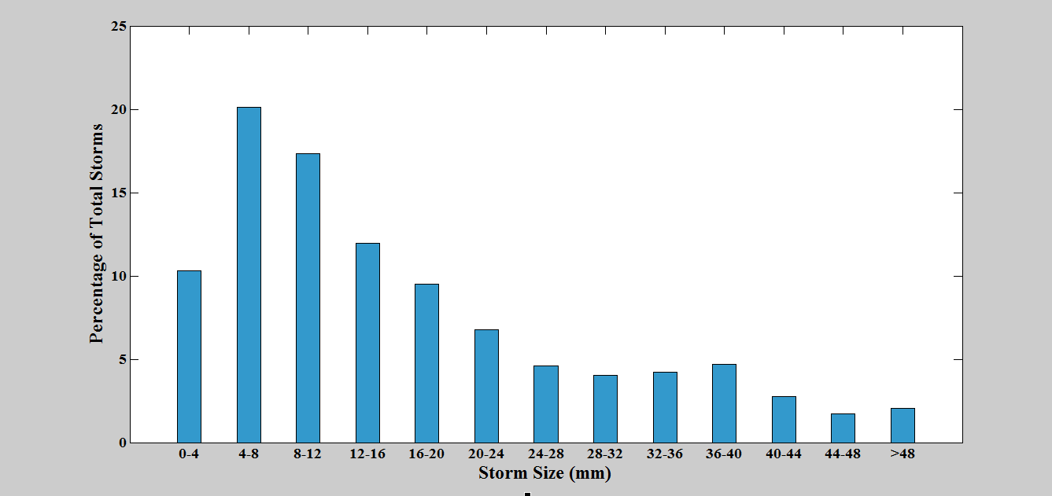
Daymet data suggests storm sizes are different here…
Santa Catalina Mountains & Jemez River Basin
Critical Zone Observatory

Slide 33
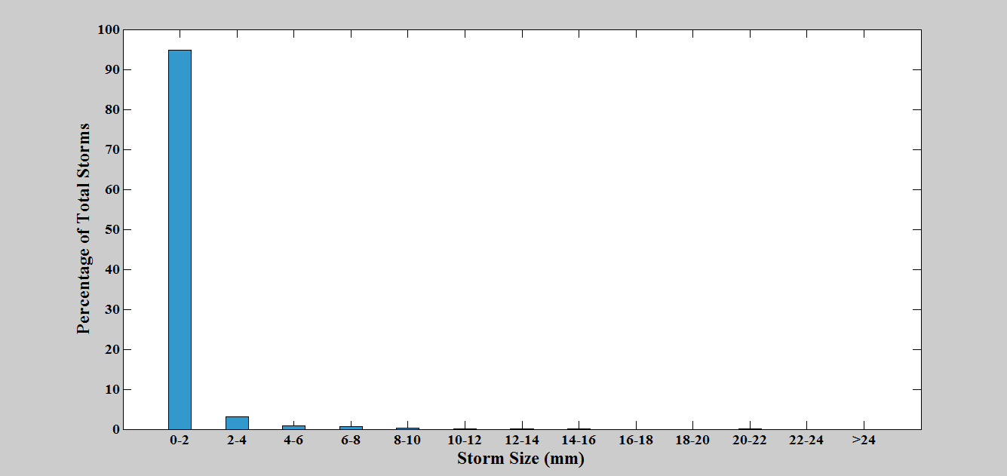
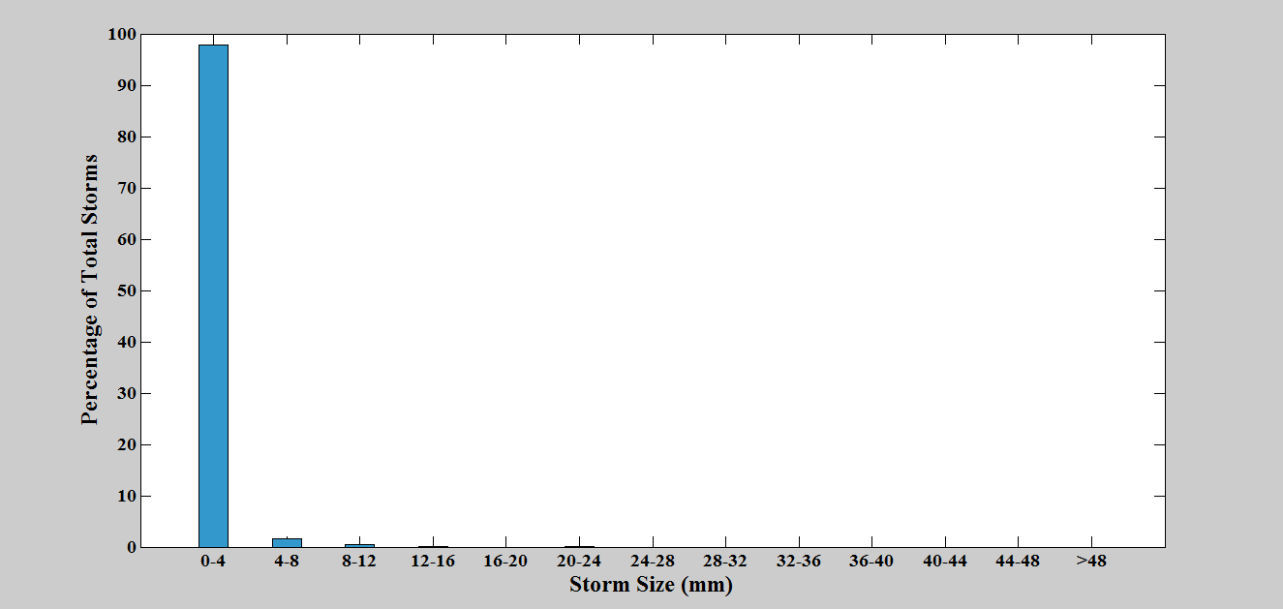
Marshall Gulch data say otherwise?…
Santa Catalina Mountains & Jemez River Basin
Critical Zone Observatory

Slide 34
Rachel - Moving forward
Understanding why Marshall Gulch and Daymet are so different – can we get precip/soil moisture from Mt Bigelow (5 years)?
Looking for other “long term” precip data sources
Finish making the same plots (Drydown, summer/winter frequency plots, summer annual verse number of storm size) )for Mt Lemmon as we have for SRER Creosote
Draft manuscript with implications for plant-water interactions under shifting precipitation regimes that influence soil moisture dynamics (link to transpiration studies)
Santa Catalina Mountains & Jemez River Basin
Critical Zone Observatory
Notes:
Greenness at high elevation east facing sites did not appear to be either temperature or moisture controlled
These were also the sites where aspen were not found in the phenocam images
Overall east facing and lower elevation sites had the most difficulty with any vegetation recovery.

Slide 35
More…
Finishing final draft of:
Mitra, B., Papuga, S.A., and T. Swetnam. Observations of species-specific shifts from energy-limited to water-limited transpiration in subalpine mixed-conifer: a seasonal analysis, in prep for submission to Water Resources Research.
Finishing final draft of:
Swetish, J.B.^{BS}, Papuga, S.A., Litvak, M.E., Mitra, B. and D. Wilcox^{BS}. Influence of understory greenness on trace gas and energy exchange in forested ecosystems, in prep for submission to Geophysical Research Letters.
Santa Catalina Mountains & Jemez River Basin
Critical Zone Observatory
Notes:
Greenness at high elevation east facing sites did not appear to be either temperature or moisture controlled
These were also the sites where aspen were not found in the phenocam images
Overall east facing and lower elevation sites had the most difficulty with any vegetation recovery.

Slide 36
They hired a computer science undergrad to do this (incorporating met data)…it would be great to do something like this for our CZO, and potentially put up at Flandrau…
http://jornada-dev.nmsu.edu/phenocam
Santa Catalina Mountains & Jemez River Basin
Critical Zone Observatory
Santa Catalina Mountains & Jemez River Basin
Critical Zone Observatory

Slide 37
Twitter?
At least 4 other CZOs have Twitter accounts:
Reynold’s Creek
Luquillo
IML
Southern Sierra
Could we have one of our postdocs do this to promote our work?
Santa Catalina Mountains & Jemez River Basin
Critical Zone Observatory

