Slide 1
Where Does
Gasoline Go?
Don Haas, Ph.D.
The Paleontological Research Institution & its Museum of the Earth
dad55@cornell.edu

Slide 2
A quick look at one kind of CO2 source...
Americans burn 391 million gallons of gasoline on the average day.
That’s a more than a gallon per person per day.
Um, wow.
* https://www.eia.gov/tools/faqs/faq.php?id=23&t=10

Slide 3
I’m going to throw around some big numbers…
So…

Slide 4
(a brief interruption to talk about scale)
Place zero, 1 thousand, 1 million, and 1 billion on the line below.
Zero
One trillion
Everything goes in the first 1/1000 of the length of the line!

Slide 5
Most of us don’t have a good understanding of scale
(because it’s hard to understand)
A thousand seconds is about 17 minutes.
A million seconds is about 12 days.
A billion seconds is about 32 years.
A trillion seconds is about 32,000 years.
Homo sapiens (us!) have been around for about 10 trillion seconds (and maybe not quite that long).

Slide 6
Where’s it go?
Americans burn 391 million gallons of gasoline on the average day.
That’s a more than a gallon per person per day.
Um, wow.

Slide 7
Where’s it go?
A gallon of gas weighs a little over 6 pounds.
If you use 10 gallons a week, where does that 60 pounds of gasoline go?

Slide 8
Where’s it go?
We know that matter can neither be created nor destroyed...
...only changed in form.

Slide 9
What is gasoline?
It’s a complex mixture of hydrocarbons, chemical compounds made of hydrogen and carbon.
On average, it’s chemical formula is something like this: C8H18.

Slide 10
And?
What do you get when you burn C8H18?
Carbon dioxide (CO2), and water (H2O).
And energy, of course.

Slide 11
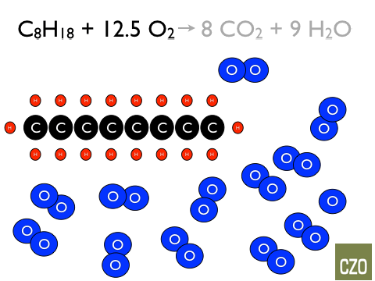

Slide 13
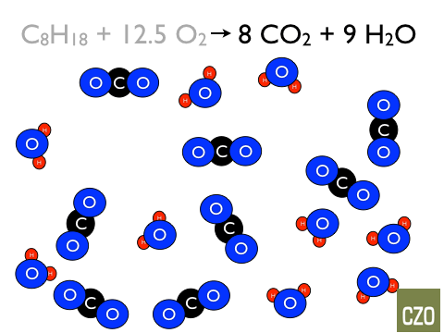

Slide 14
So?
The resulting carbon dioxide (CO2) and water (H2O)...
... weighs more than the gasoline we started with!
(Because the reaction used oxygen from the air, not just the gasoline)!

Slide 15
So?
Burning this six pound gallon of gasoline yields 19 pounds of CO2!
Um, wow.

Slide 16
How many balloons is that?
A gallon of gas is pretty easy to picture.
And it doesn’t seem weird to think that it weighs six pounds.
But nineteen pounds of an invisible gas, like carbon dioxide, is a bit harder to understand.

Slide 17
How many balloons is that?
An inflated balloon weighs more than an empty one, because the air (or other gas) inside it does weigh something.
So, how many gallon-sized balloons would it take to hold 19 pounds of carbon dioxide?

Slide 18
What do you think?
How many gallon-sized balloons would it take to hold 19 pounds of carbon-dioxide?
If you can, get a balloon. If not, use your imagination.
Hold it empty and think about how much it weighs.
Fill it up. Think about how much it weighs now.

Slide 19
How many?
It doesn’t weigh very much, does it?
What are some things that weigh about 19 pounds?
Here comes the answer in balloons...
About 1100.

Slide 20
How many?
# of balloons | 1100
# of people here | 110
Balloons/person | 10
There were 90 students and 20 educators at the 2017 Buffalo Youth Climate Summit.

Slide 22
That’s 100, so let’s do that 10 more times...

Slide 24
200

Slide 26
300

Slide 28
400

Slide 30
500

Slide 32
600

Slide 34
700

Slide 36
800

Slide 38
900

Slide 40
1000

Slide 42
1100
That’s a lot of balloons!
from one gallon of gas...
How many balloons’ worth of O2 did that take?

Slide 43
So?
Burning this six pound gallon of gasoline yields 19 pounds of CO2!
Um, wow.

Slide 44
So?
Remember that Americans burn 391 million gallons of gasoline a day.
That’s over 7 billion pounds of CO2 produced every day just from burning gasoline.
Um, wow.

Slide 45
And…
A gallon of gasoline is about 87% carbon by weight.
That means there’s about 5.5 pounds of carbon in a gallon of gas.
Um, wow.

Slide 46
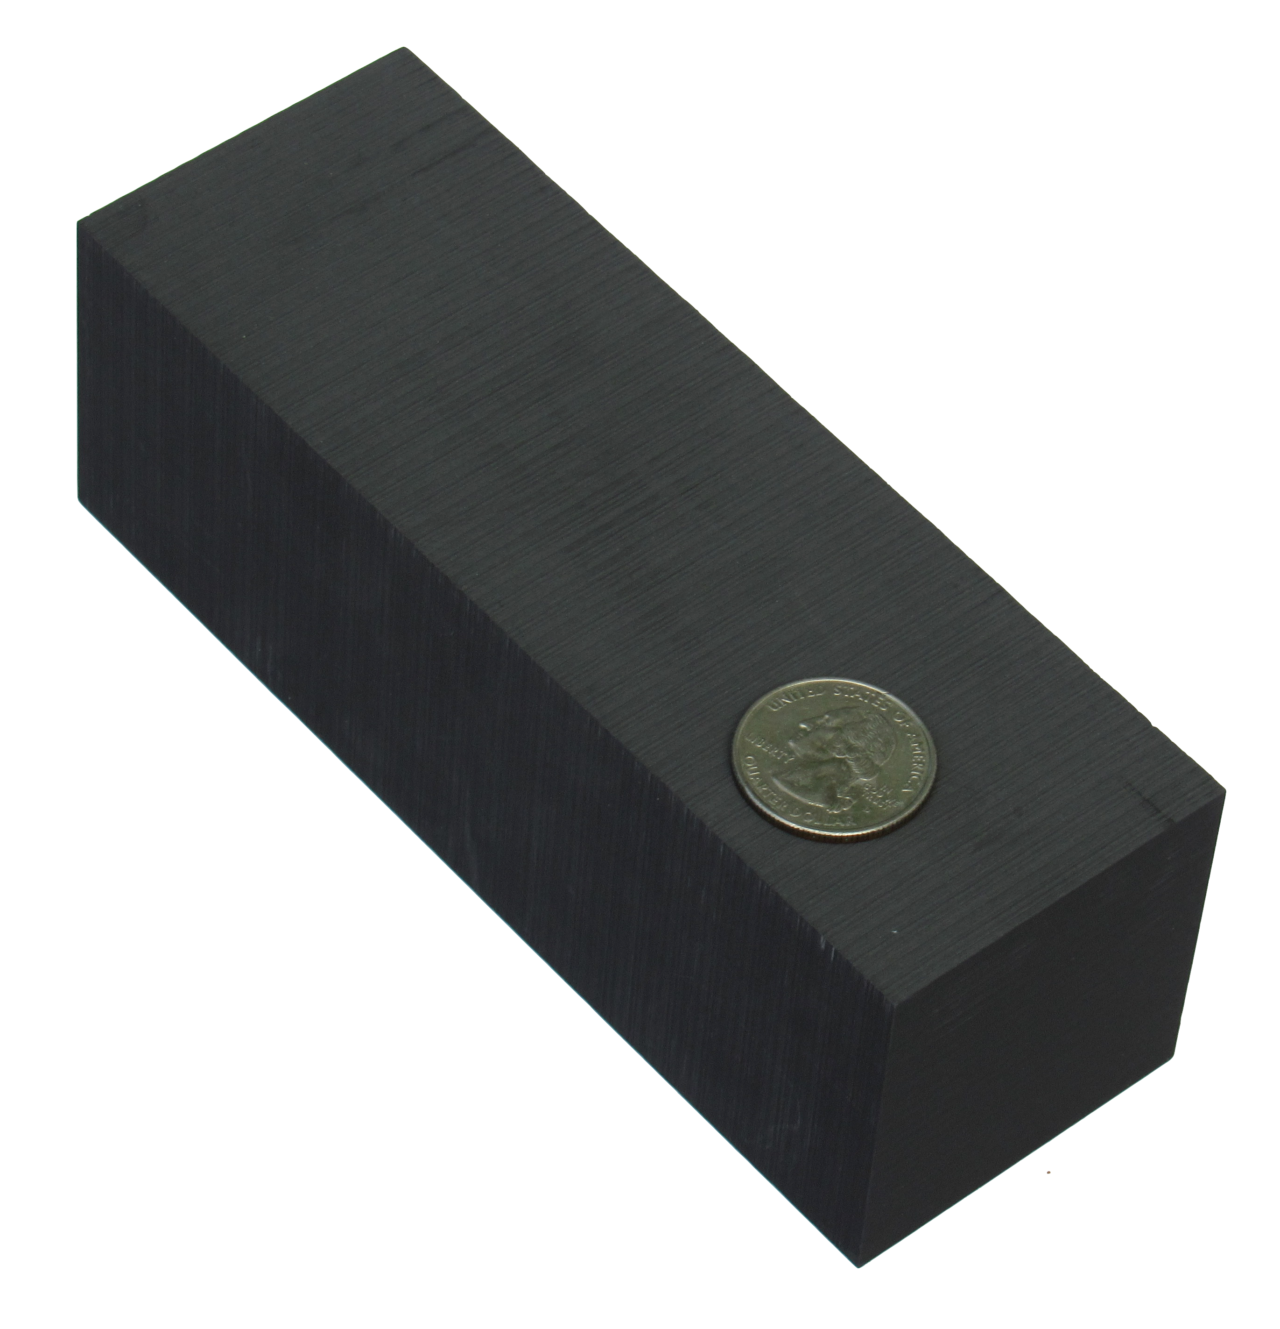
Here’s what that looks like:
A gallon of gasoline is about 87% carbon by weight.
That means there’s about 5.5 pounds of carbon in a gallon of gas.
Pure graphite is pure carbon.
The quarter is intended to show scale. This block is 2” x 2” x 6”.

Slide 47
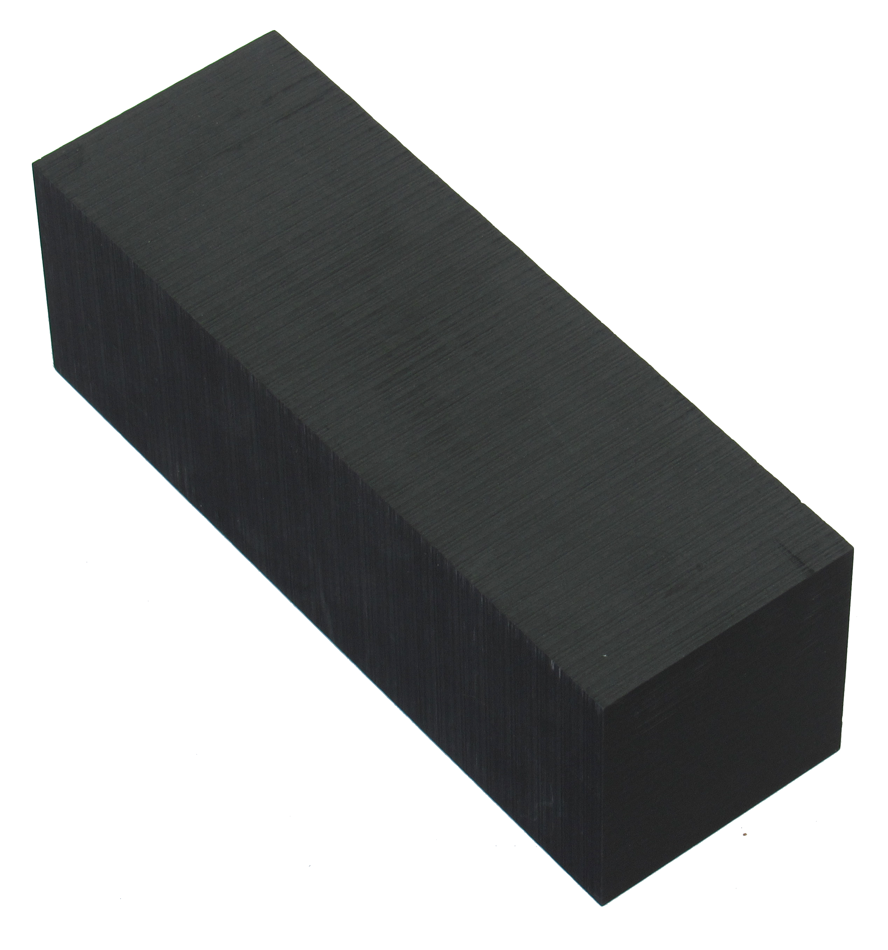
Here’s what that looks like:
The quarter is intended to show scale. This block is 2” x 2” x 6”.
This block isn’t big enough.
I meant to order a 6” x 6” x 2” block.
Oops.
This is what 5.5 pounds of solid carbon looks like.

Slide 48
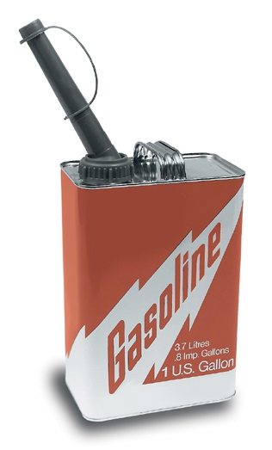
Here’s what that looks like:
About 5.5 pounds of that is carbon.
1 gallon weighs ~ 6 pounds

Slide 49
How much do you have to plant or grow to take that carbon back out of the air?
Wood is 45% - 50% carbon.
So…
11 pounds of wood needs to be grown to sequester each gallon of gasoline we burn.
Um, wow.

Slide 50
How much do you have to plant or grow to take that carbon back out of the air?
11 pounds of wood needs to be grown to sequester each gallon of gasoline we burn.
And it can’t be allowed to burn or decay.
A standard 8 foot 2x4 weighs 11 pounds.

Slide 51
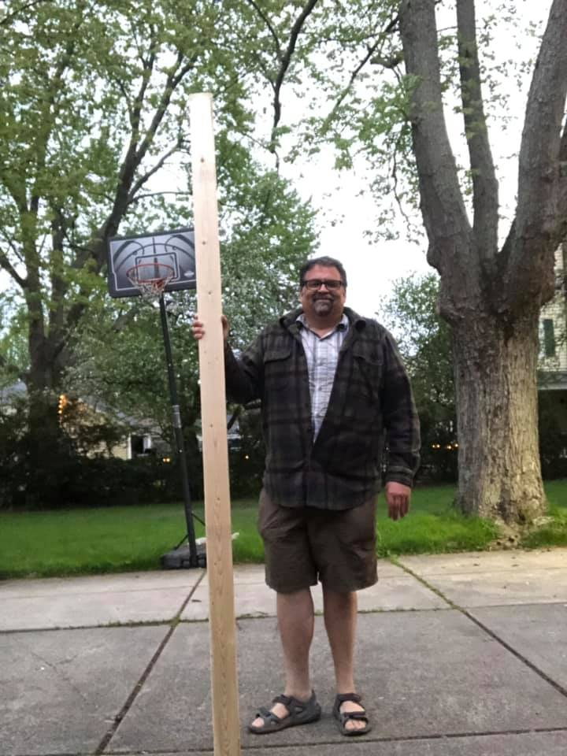
How much do you have to plant or grow to take that carbon back out of the air?
11 pounds of wood needs to be grown to sequester each gallon of gasoline we burn.
A standard 8 foot 2x4 weighs 11 pounds.

Slide 52
How much do you have to plant or grow to take that carbon back out of the air?
We need to grow a 2x4’s worth of wood for each of the 390 million gallons of gas we burn everyday.
390 million 2x4s a day.
11 pounds x 390 million = 4,290,000,000 pounds of wood, every day.
That’s more than 1.5 trillion pounds a year.

Slide 53
So?
Hey! That’s 4 billion pounds!
And, we burn about 2 million tons of coal a day.
The chemistry and mathematics are similar.
I updated this slide in 2017. I cut the numbers by a third. That’s good news.
That yields close to 6 million tons (or 12 billion pounds) of CO2!
Um. Wow.

Slide 54
And...
We burn about 75,000 million cubic feet (mcf) of natural gas on the average day.
While natural gas produces less CO2 per unit of energy when compared to other fossil fuels, that still yields about 4,000 tons (8 million pounds of CO2) for the typical day.
And natural gas’s primary component, methane, is a powerful greenhouse gas that leaks to the atmosphere along the pipeline.

Slide 55
So?
Is it realistic to assume that changing atmospheric chemistry to this extent can be done without consequences?
What do we do?

Slide 56
Use less energy.
A lot less...

Slide 57
This isn’t a good place to stop.
The content of the presentation, so far, has been astonishing. That’s intentional.
It’s the start of an intentional sequence:
Astonish
Alarm
Nurture courage and hope

Slide 58
Directions you might go from here…
Work on hope and courage:
http://bit.ly/Fire-and-brimstone
Continue on in this presentation to learn more about the carbon cycle.
(Then work on hope and courage).

Slide 59
We’ve been talking about the carbon cycle
Or a piece of it, anyway.

Slide 60
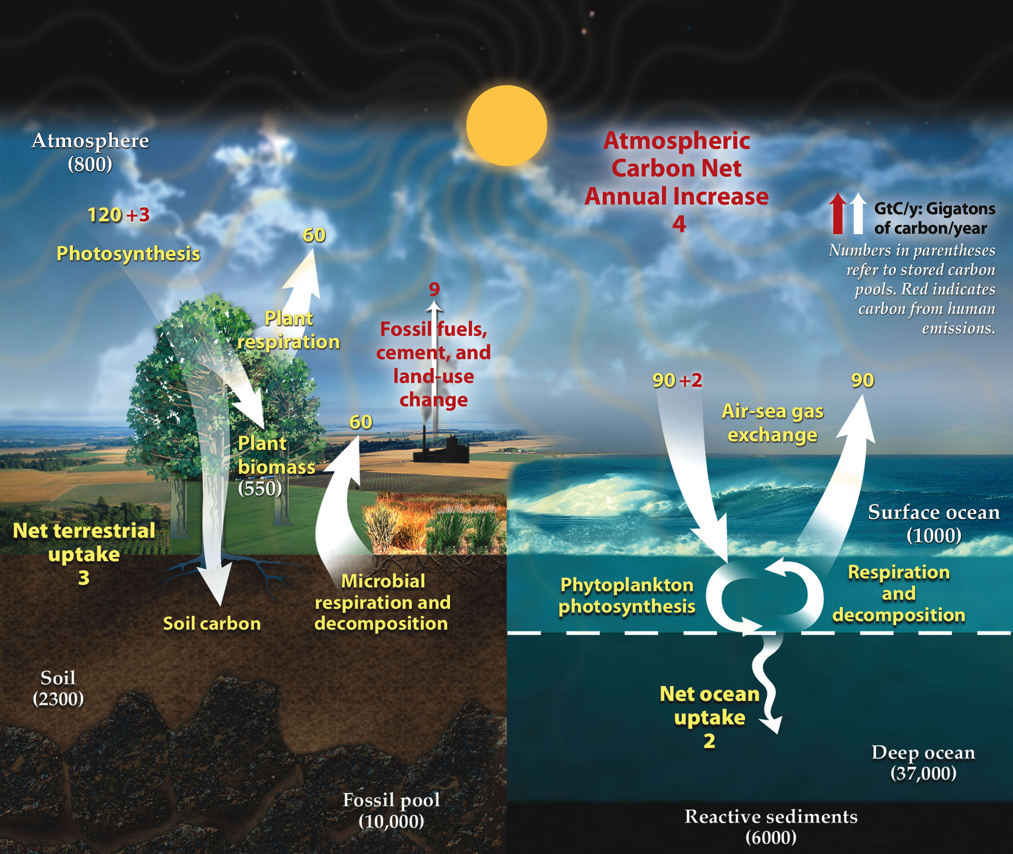
We’ve been talking about the carbon cycle
US DOE. Climate Placemat: Energy-Climate Nexus, US Department of Energy Office of Science. (p. 1)
https://public.ornl.gov/site/gallery/detail.cfm?id=445&topic=&citation=&general=carbon&restsection=BERPublicc

Slide 61
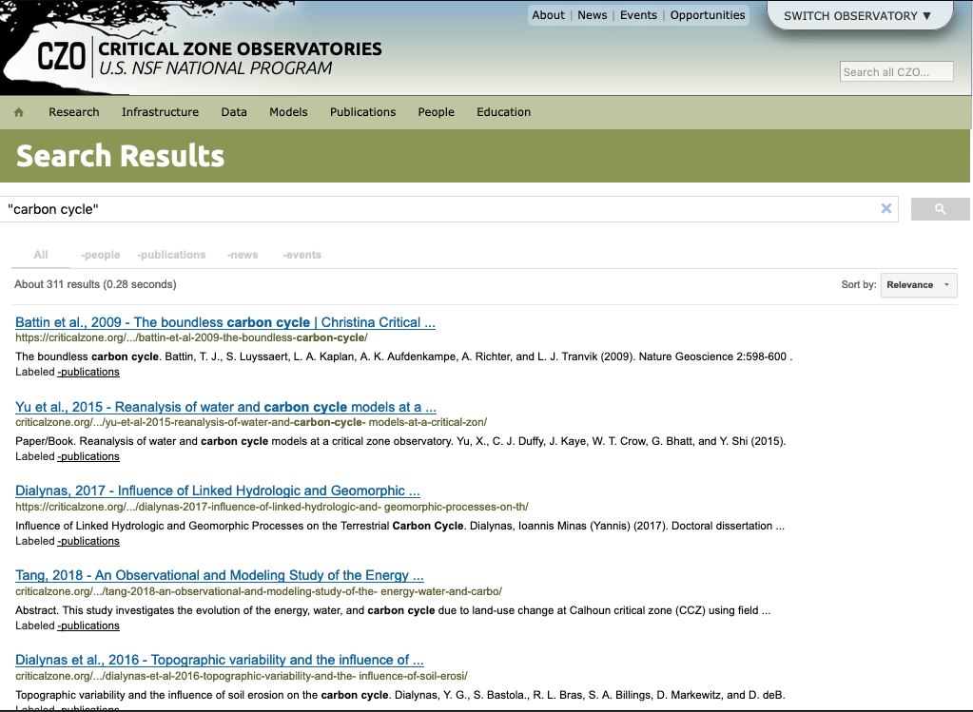
The carbon cycle is an important area of study for CZ scientists.

Slide 62
The carbon cycle is an important area of study for CZ scientists.

Slide 63
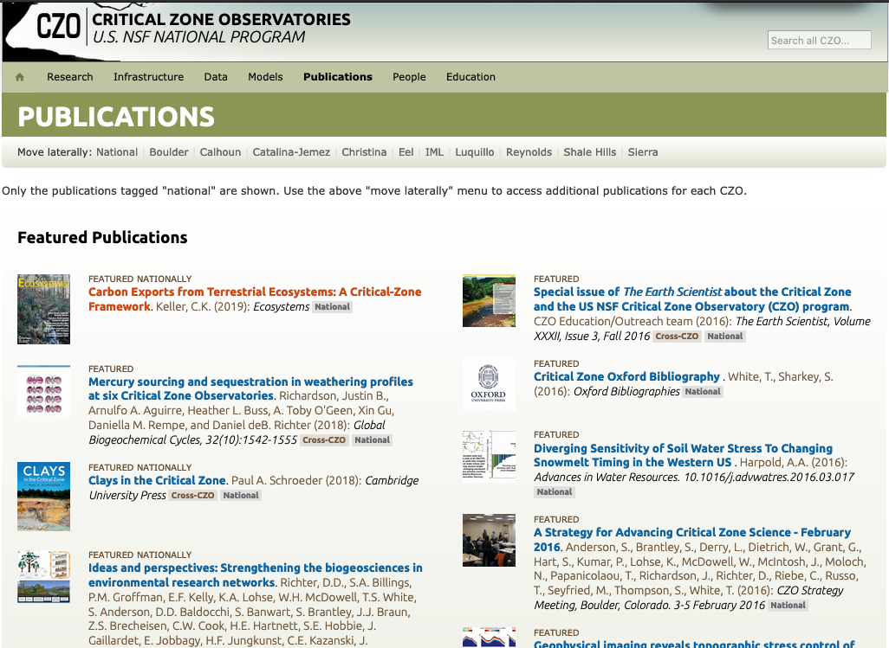
The carbon cycle is an important area of study for CZ scientists.

Slide 64
The carbon cycle is an important area of study for CZ scientists.

Slide 65
Resources for learning about the carbon cycle
An interactive diagram, with embedded videos explaining different parts of the carbon cycle:
https://www.sciencelearn.org.nz/image_maps/3-carbon-cycle
The Carbon Cycle Toolkit: (a more in depth look):
https://www.esrl.noaa.gov/gmd/education/carbon_toolkit/

Slide 66
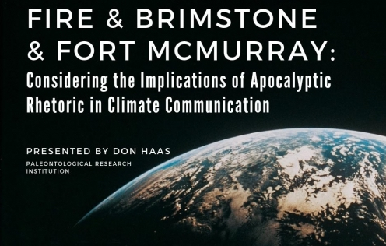

Slide 67
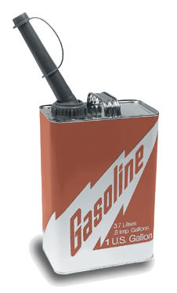
A gallon of gas weighs about 6 pounds and is 87% carbon by weight.
About 5.5 pounds of that is carbon.
Pure graphite is pure carbon.
A block of graphite
2” x 6” x 6”
weighs about 5.5 pounds.
(Quarter for scale)
1 gallon weighs ~ 6 pounds

Slide 68
Q: How much wood do you need to grow to offset burning a gallon of gasoline?
A: 11 pounds.
The weight of a standard 8 foot 2 x 4.
We burn over 390 million gallons of gasoline in the US everyday.

