Slide 1
CZO Integrated Data Management
Web services, CZO data publication system prototype, demo
Ilya Zaslavsky
SDSC

Slide 2
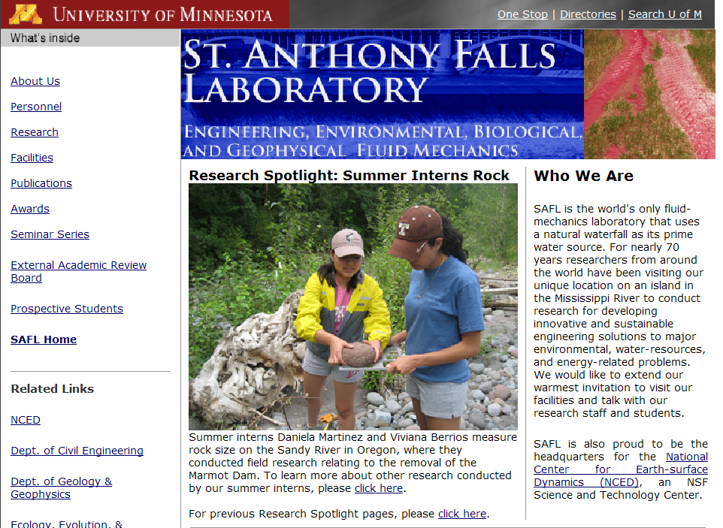
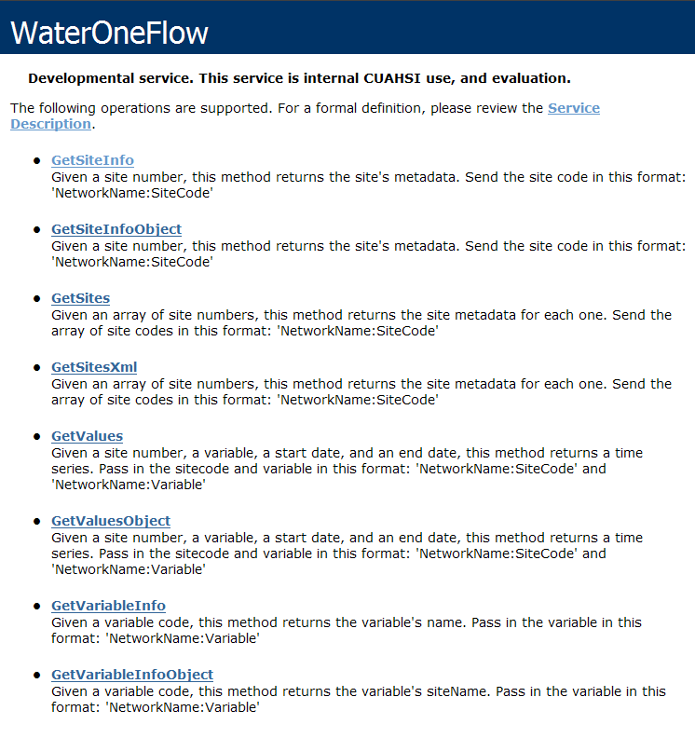
Why web services for water data
http://www.safl.umn.edu/
http://his.safl.umn.edu/SAFLMC/cuahsi_1_0.asmx
Uses Hypertext Markup Language (HTML)
Uses WaterML
(a Markup Language for water data)

Slide 3
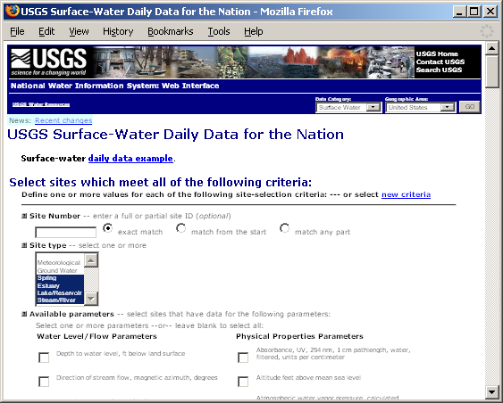
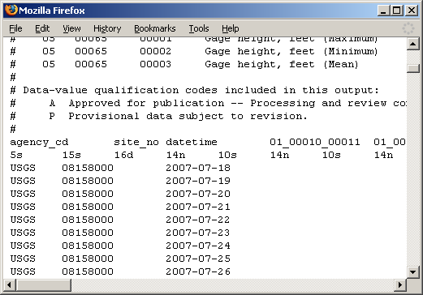
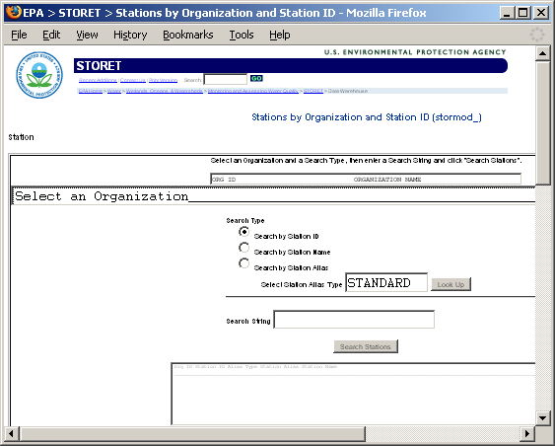
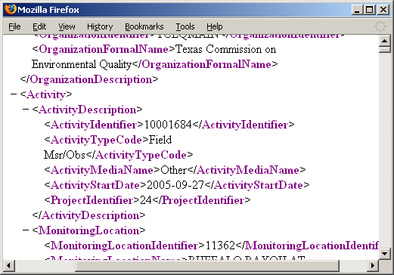
Getting Water Data (the old way)
Different Query Pages
Different Query Responses

Slide 4
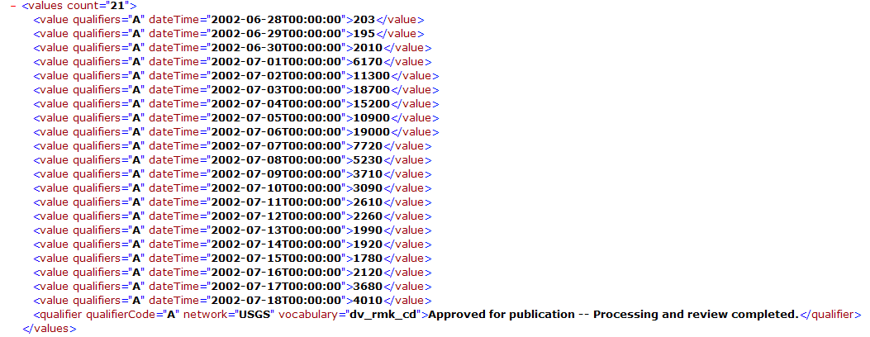
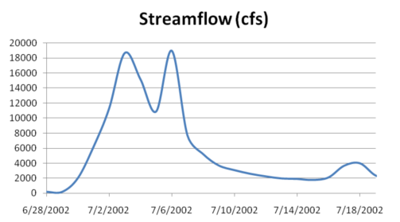
WaterML as a Web Language
Discharge of the San Marcos River at Luling, June 28 - July 18, 2002
Streamflow data in WaterML language

Slide 5
WaterML and WaterOneFlow
DEC
Site Codes
GetSites
GetSiteInfo
GetVariableInfo
GetValues
Data
Variable Codes
UVM
USGS
Data
Date Ranges
Data
WaterML
Data
Repositories
WaterOneFlow
Web Service
Client
TRANSFORM
EXTRACT
LOAD
WaterML is an XML language for communicating water data
WaterOneFlow is a set of web services based on WaterML

Slide 6
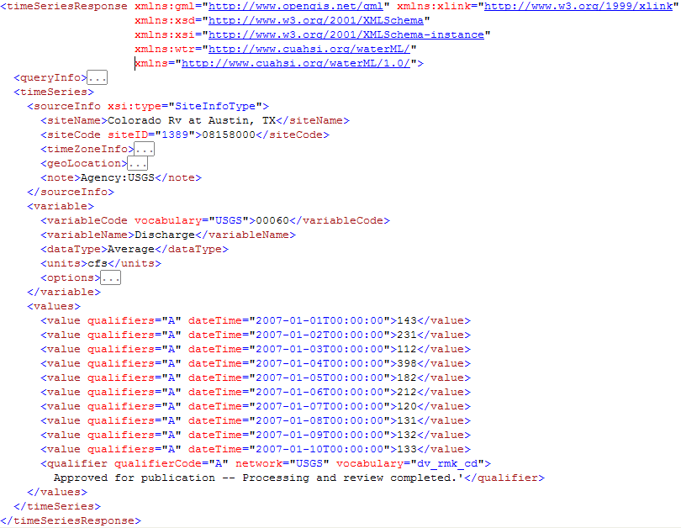

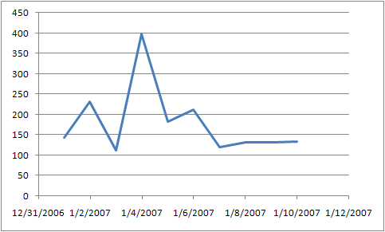
WaterML includes location, variables, and time series
location
variable
time series

Slide 7




International Standardization of WaterML
OGC/WMO Hydrology Domain Working Group
http://external.opengis.org/twiki_public/bin/view/HydrologyDWG/WebHome
Towards an agreed upon - feature model
- observations model
- semantics
- service stack
Expressed as WaterML 2.0
By organizing - Interoperability Experiments and pilots,
standard design activities, webinars…
First OGC/WMO HydroDWG workshop : at Ispra, Italy, March 15-18, 2010

Slide 8
OGC/WMO Hydrology DWG
Interoperability Experiments:
  Groundwater (ongoing: USGS, CanadianGS, CUAHSI, CSIRO, several companies)
  Surface Water (to start June’10: France, Germany, CSIRO, CUAHSI, several companies)
  Water Quality (USGS, EPA, others)
  Forecasting (together with NWS, MetOcean DWG)
  Water Use (USGS)
WaterML 2.0 – to be submitted by June
Harmonization report – done
Coordination with WMO (MOU signed)
Next meeting: Silver Spring (at NOAA), June 15, 8am-12
Talks by USGS, NOAA, Unidata; also WaterML and IE
Next meeting: Silver Spring (at NOAA), June 15, 8am-12
Talks by USGS, NOAA, Unidata; also WaterML and IE

Slide 9
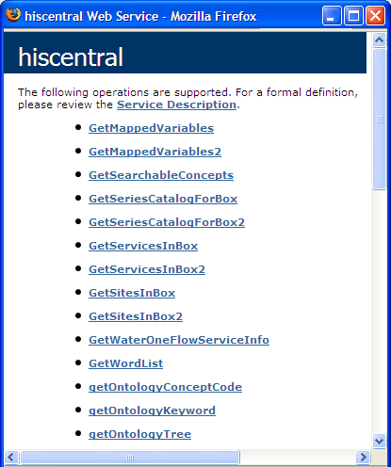
HIS Central Services
HICentral
Web Service
Service registry and metadata catalog
  Networks
  Sites
  Variables
  Search Keywords
Does not store actual observation data
Example: GetSitesInBox query function
Notes:
HIS is not just for people who want to get data. It can also be used to help publish data. HIS includes tools to assist with the entire chain of data publication, from storing data streamed in from sensors, to analyzing the data, to publishing the data with WaterOneFlow.
9

Slide 10
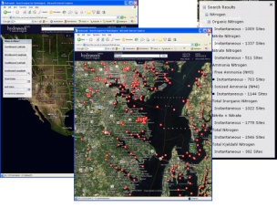

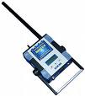
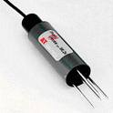
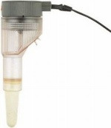
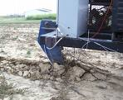
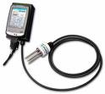



CZO Data Publication System
CZO Data Repository and Indexing (CZO Central)
Standard CZO Services
CZO Web-based
Data Discovery
System
CZO Desktop
Applications
CZO Metadata
Ontology
Controlled vocabularies
Archive
Harvester
CZO
Desktop
Matlab
R
Standard CZO data display formats
Web site
Web site
Web site
Excel
ArcGIS
Local CZO DB
Local CZO DB
Local CZO DB
Modeling (OpenMI)
Spatial, hydrologic, geophysical, geochemical, imagery, spectral…
Notes:
Hydrologic Information System Service Oriented Architecture

Slide 11
CZO Data Publication Model
Relies on individual CZO data management systems to generate display files
  Display file is modeled on LTER data file, and allows adding series-level and data value-level attributes as defined in CUAHSI Observations Data Model
When additional display files are generated and placed at CZO web sites, they are picked up and automatically ingested in a CZO repository at SDSC
The time series in the files are then automatically exposed as water data services (WaterML-compliant web services used by CUAHSI HIS)
These services are available for data discovery and analysis by a variety of applications: CZO Desktop (a version of HydroDesktop), Google Earth, etc.
A non-intrusive system: no change in how one would normally publish data on CZO web sites; no additional software/hardware needed.
Can be a good model for the community wishing to publish their data in an easy and inexpensive way
  note the NSF requirement for data management plans with every proposal from October 2010

Slide 12
Comparison of publication models
CUAHSI HIS:
  Install a HydroServer, then:
  This is done by local data managers
CZO:
  Manage your own data system, and generate display files
Attach Blank ODM Database
Transform Raw Data
Done behind the scenes
Load Data into Database
Community Water Data Repository
Wrap Database with Web Service
Register Web Service
Harvest catalog, tag variables
Tag variables, in rare cases
Download Data
Download Data

Slide 13
Format of display file
A sample file: http://culter.colorado.edu/exec/.extracttoolA?gre4solu.nc
Components of measurement: where (location), when (datetime), what (attribute), how (method), who (investigator) + value
  \doc (title, abstract, investigator, var names, etc.)
\header
  DEFAULT_PARAMETER (pertains to entire file unless overridden)
  Column headers (define each column – i.e. time series or group of time series)
COL4. label=VariableName, value=pH, units=pH units, missing value indicator=-9999
\data
  GREEN LAKE 4,820311,,6.4,18,88.51,0.40,,114.77,24.68,21.75,10.23,
  25.389,,58.296,83.200,,,,,,,,,,,,,,,,,,

Slide 14
How the prototype works - DEMO
Data preprocessing:
  Manually entered one site (Green Lake 4); coordinates approximate
  31 variables were mapped to CUAHSI variable CV
Main system components:
  FolderWatchService
    When a new file arrives, the service passes it to DataInterpreter
  DataInterpreter: reads the file line by line
    So far, ignoring \log and \doc sesctions
    Parses the \header section; uses column names to obtain ODM variableIDs
    Parses the \data block: for each line, compute datetime (or default to date + 12am); insert a row in datavalues table for each value
  CZOCentral Harvester process
    Retrieves metadata from ODM and adds it to the metadata catalog; the data are then made available via CZO_BOULDER service

Slide 15
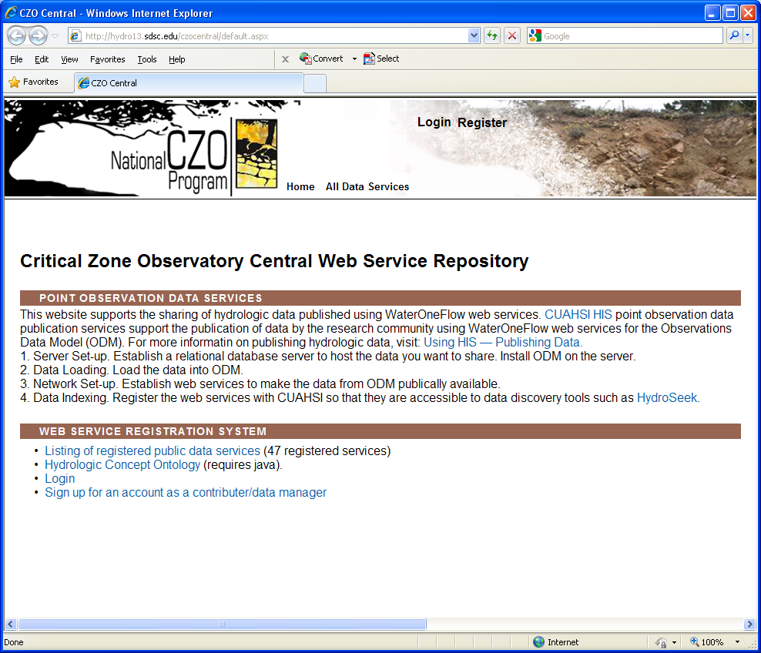
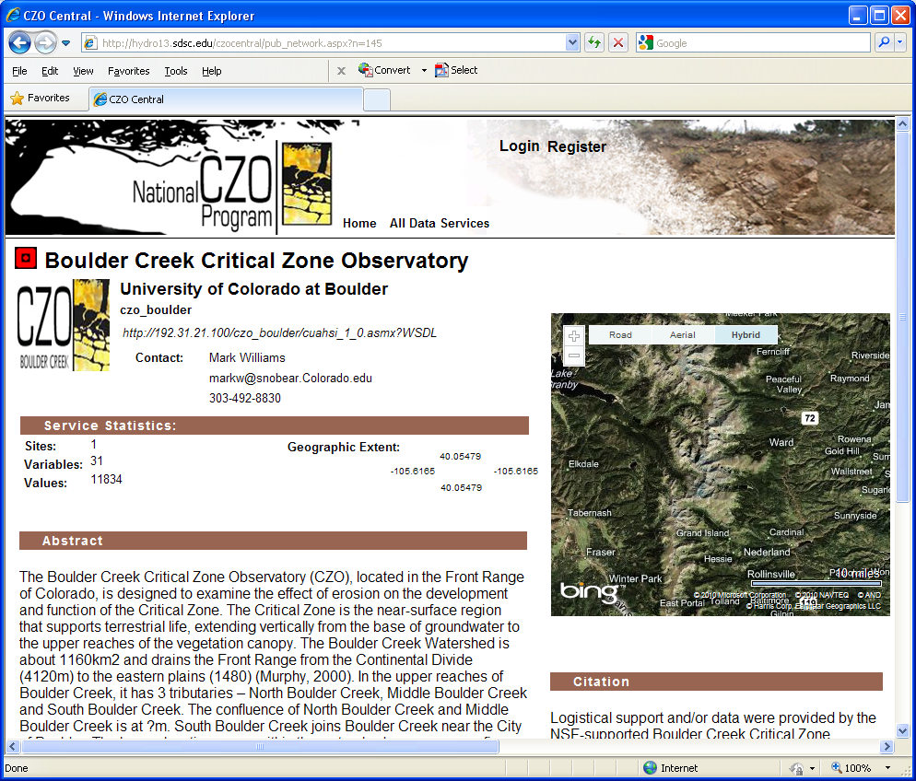
CZO display file is automatically ingested in CZO data repository, a service is updated, making new data available
CZO Central web service registry
Boulder Creek CZO web service

Slide 16
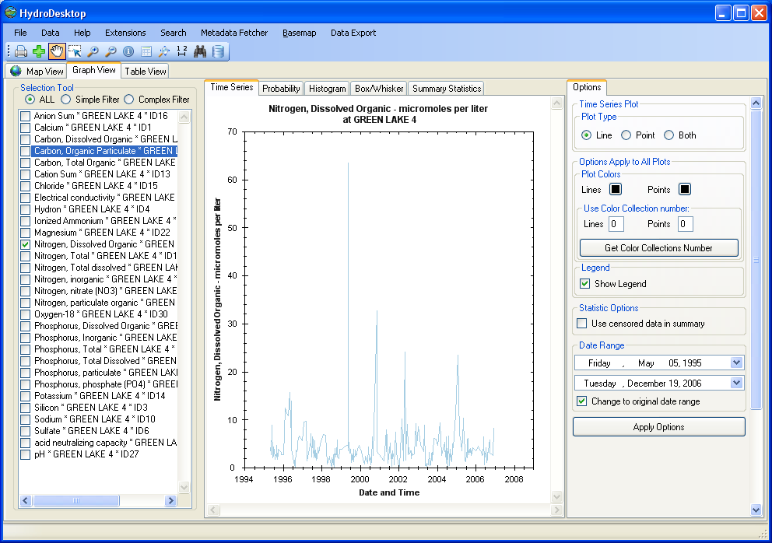
Working with CZO Time Series Data
Once CZO web service is updated and registered in CZO Central, it can be discovered in HydroDesktop (CZODesktop), an open source application with rich mapping and time series analysis capabilities
HydroDesktop, showing one of 31 newly ingested time series

Slide 17
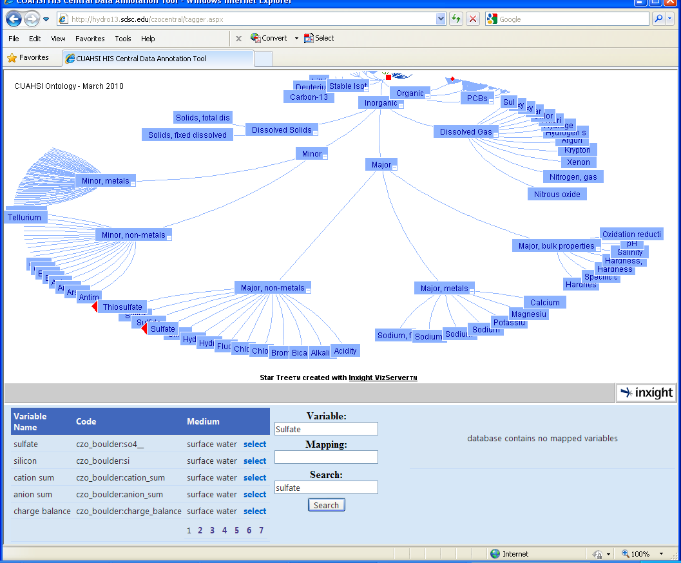
Another way to find CZO data- using hydrologic ontology
Time series can be also discovered by keywords, once variables are associated with concepts in hydrologic ontology. The tagger application is available as part of CZO Web Service Registry

Slide 18
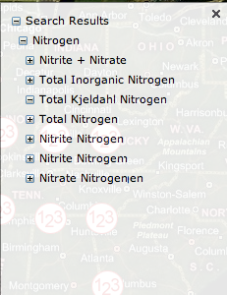
Managing Varying Semantics
In measurement units…
acre feet | acre-feet
micrograms per kilogram | micrograms per kilgram
FTU | NTU
mho | Siemens
ppm | mg/kg
In parameter names…
Nitrogen: e.g. NWIS parameter # 625 is labeled ‘ammonia + organic nitrogen‘, Kjeldahl method is used for determination but not mentioned in parameter description. In STORET this parameter is referred to as Kjeldahl Nitrogen.
And: Dissloved oxygen

Slide 19
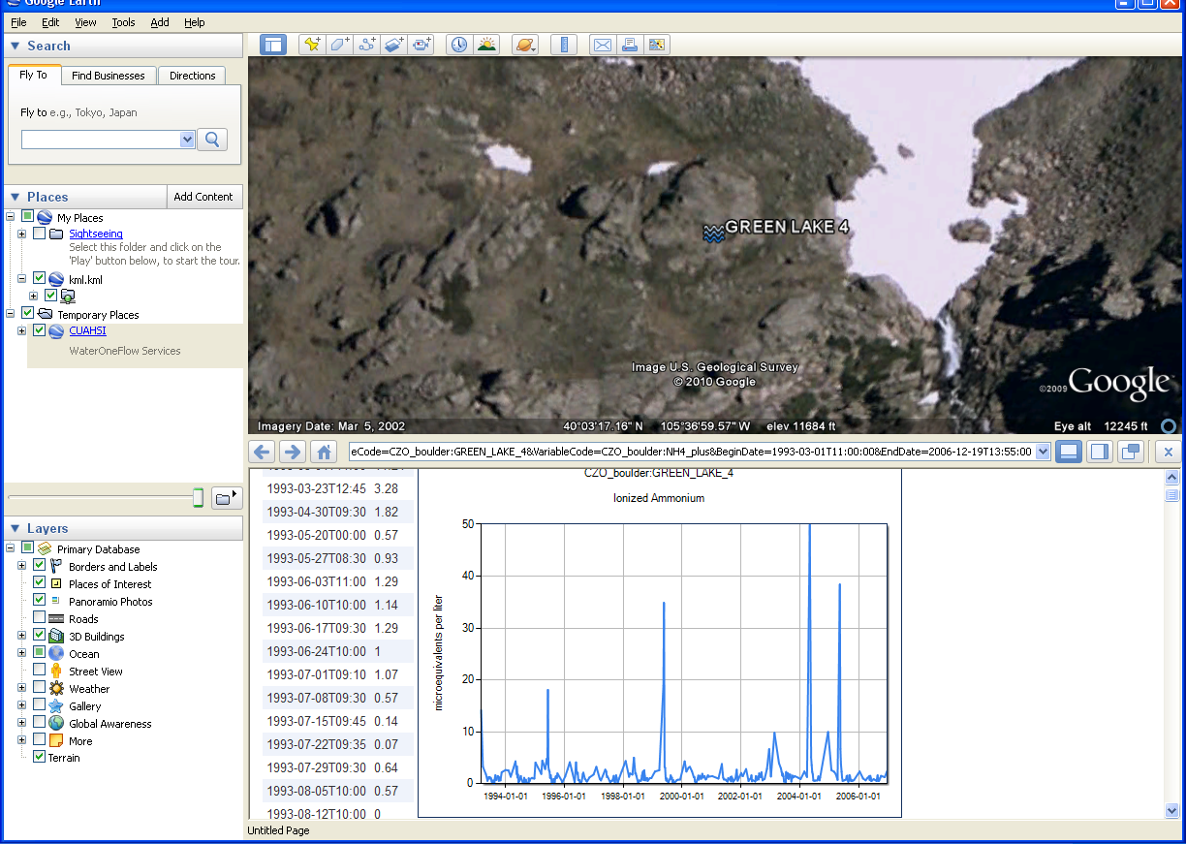
Visualizing CZO time series web services in Google Earth

Slide 20
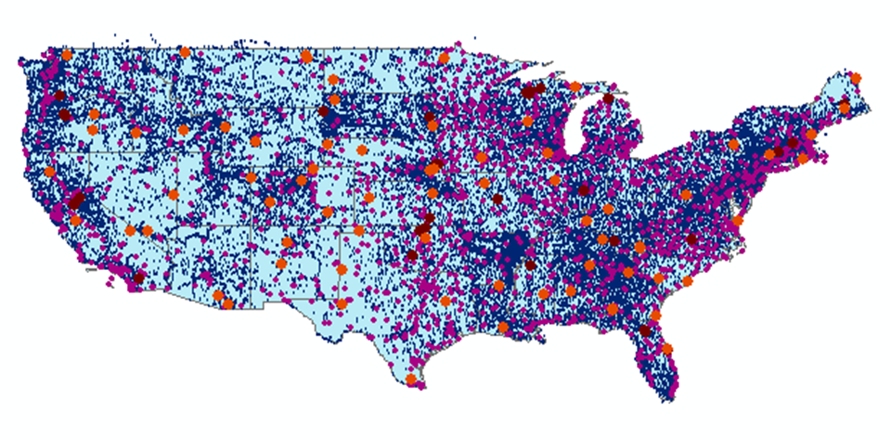
Registered Water Data Services, April 2010
Map Integrating NWIS, STORET, & Climatic Sites
47 services
13,200+ variables
1.8 million sites
22.9 million series
4.7 billion data values
(96% of them searchable)
The largest water data
catalog in the world

Slide 21
Federal Agency Water Data Services at HISCentral (04/2010)
Network Name | Site Count | Value Count | Earliest Observation | Notes
NWISDV | 32147 | 303843342 | 1/1/1900 | WaterML-compliant GetValues service from NWIS, catalog ingested
EPA | 362645 | 78076394 | 1/1/1900 | SOAP wrapper over WQX services, catalog harvested
NWISUV | 11987 | 83033376 | 60 DAYS | WaterML-compliant GetValues Service, catalog ingested
NCDC ISH | 11555 | 3000000* | 1/1/2005 | WaterML-compliant GetValues service from NCDC, catalog harvested
NCDC ISD | 24770 | 18165478 | 1/1/1892 | WaterML-compliant GetValues service from NCDC, catalog harvested
NWISIID | 369148 | 15501245 | 1/9/1867 | SOAP wrapper over NWIS web site, catalog harvested
NWISGW | 827200 | 8491383 | 1/1/1900 | SOAP wrapper over NWIS web site, catalog harvested
RIVERGAGES | 2206 | 263101295 | 1/1/2000 | WaterML compliant REST services from Army Corps of Engineers

Slide 22
Unresolved issues
Policies and best practices for generating display files and setting up data folders, and how we detect what is new
Update frequency
Semantic tagging (how automated)
How shall we handle situations when data are removed/overwritten?
Need more examples and test cases
What information in log files is needed
How to present data use agreements in services
How to deal with different types of data

Slide 23
Towards CZO Web Services Model
A CZO hub may serve any combination of time series, geochemical, geophysical, spatial data, each in a standard format
Alternately, CZO Central Registry and Repository can pull relevant display files and generate standard services (eventually, in the cloud)

Slide 24
Water Web Services Transition
(CUAHSI HIS Web Services 1.2)
Water Web Service
Water Web Data Service
Water Web Catalog Service
Water Web Ontology Service
Map Services
Water Quality Exchange Service
Processing Services
REST
WFS (Features)
WMS (Maps)
SOS (Sensor)
REST/SOAP
WFS (Features)
WMS (Maps)
Catalog
REST
REST
WFS (Features)
WMS (Maps)
SOS (Sensor)
REST
WPS
REST
WPS
Aligning CUAHSI Water Data Services model with OGC services, while keeping the semantics of information exchange as defined in WaterML

Slide 25
CZO Web Services Model
CZO Web Service
Time Series Service
CZO Catalog Service
CZO Ontology Service
Spatial Data Services
Geochemical
Geophysical…
Processing Services
. . .
REST
WFS (Features)
WMS (Maps)
SOS (Sensor)
REST/SOAP
WFS (Features)
WMS (Maps)
Catalog
REST
REST
WFS (Features)
WMS (Maps)
SOS (Sensor)
REST
WPS
REST
WPS
Each service declares its capabilities, which can be harvested and catalogued

