Slide 1
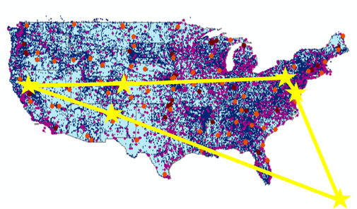

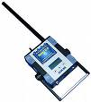
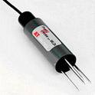
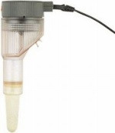
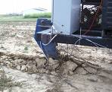
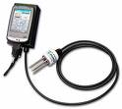
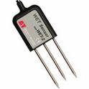

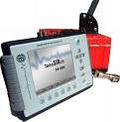
CZO Data Publication System
CZO Data Repository and Indexing (CZO Central)
External cross-project registries
CZO
Data Products
Standard CZO Services
DataNet
CZO Desktop
Applications
CZO Web-based
Data Discovery
System
CZO Metadata
Ontology
Shared vocabularies
Archive
Harvester
CZO
Desktop
Matlab
Standard CZO data display formats
R
Web site
Web site
Web site
Excel
ArcGIS
Local CZO DB
Local CZO DB
Local CZO DB
Modeling
Spatial, hydrologic, geophysical, geochemical, imagery, spectral…
Notes:
Hydrologic Information System Service Oriented Architecture

Slide 2
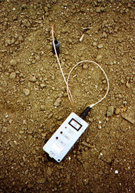
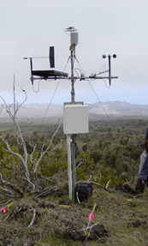
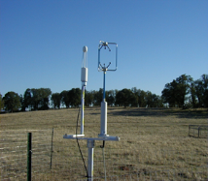
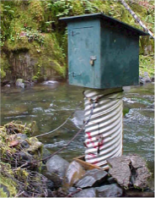
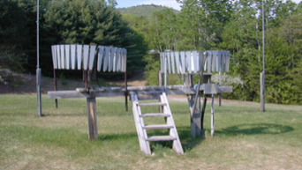
Status of the
prototype
Hydrologic and meteorological time series
CUAHSI HydroCatalog
Water data services
WaterML 1.x/2.0
CZO hydrologic themes
CZO Desktop
Applications
CZO Web-based
Data Discovery
System
CZO Metadata
Hydrologic Ontology
Shared vocabularies
Archive
Harvester
Hydro
Desktop
Matlab
Standard CZO data display formats
R
Web site
Web site
Web site
Excel
ArcGIS
Local CZO DB
Local CZO DB
Local CZO DB
OpenMI
Hydrologic and meteorological stations
Notes:
Hydrologic Information System Service Oriented Architecture

Slide 3
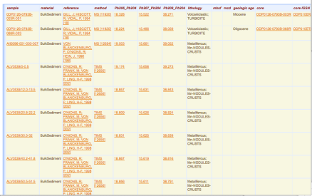
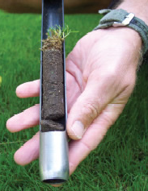
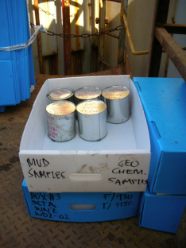
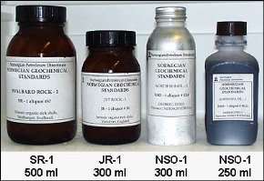

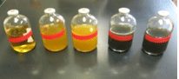
Geochemical Samples
EarthChem Data Engine & Portal
Geochemical web services, EarthChemML
Depth-resolved geochemistry
CZO Desktop
Applications
Metadata
IGSN management
Shared vocabularies
Archive
Harvester
CZO Web-based
Geochemical DB
CZO
Desktop
Matlab
Standard CZO data display formats
R
Web site
Web site
Web site
Excel
ArcGIS
Local CZO DB
Local CZO DB
Local CZO DB
Modeling
Geochemical samples
Notes:
Hydrologic Information System Service Oriented Architecture

Slide 4
Specifics of hydrologic data
Surface water
  Spatially sparse, time series, regular measurements, with gaps
  Timestamps important, accurate
  Different temporal aggregations, different retention policies, QA levels (from raw data to different levels of processing)
  Multi-parameter series; complex sites; multiple offsets
Groundwater level
  Spatially dense, but often a single observation
  Precise timestamp not critical (and sometimes approximate)
Precipitation time series
  Many 0s, often sparse storage model is better
Water quality
  Sparse in space and time
  Managing samples is different;
  Chemistry-analytical and biology-analytical
  Complex ontologies of parameters and methods

Slide 5
CZO Web Services Model
CZO Web Services
Time Series Service
CZO Catalog Service
CZO Ontology Service
Spatial Data Services
Geochemical
Geophysical…
Processing Services
. . .
REST/SOAP
WFS (Features)
WMS (Maps)
SOS (Sensor)
REST/SOAP
WFS (Features)
WMS (Maps)
Catalog
REST
WPS
REST
WFS (Features)
WMS (Maps)
SOS (Sensor)
REST
WFS (Features)
WMS (Maps)
SOS (Sensor)
REST
WPS
WaterML 2.0
EarthChemML, EML,
GeoSciML

Slide 6
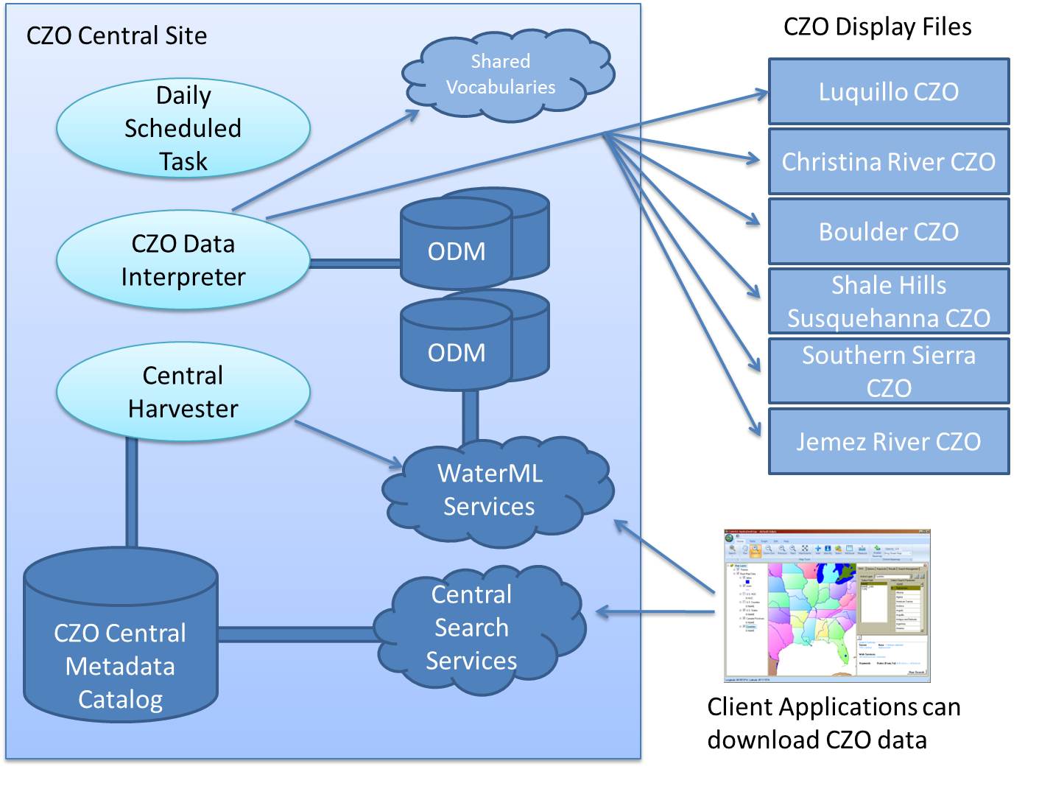
Extending CUAHSI HIS for CZO requirements
  New data publication model and Community Water Data Repository (at SDSC)
  Extended controlled vocabularies (at Utah State)
  HydroDesktop tuned to CZO data (at Idaho State)

Slide 7
CZO data publication model
(vis-à-vis CUAHSI HIS)
CUAHSI HIS:
  Install a HydroServer, then:
  This is done by local data managers
CZO:
  Manage your own data system, and generate display files
Attach Blank ODM Database
Transform Raw Data
Done behind the scenes
Load Data into Database
Community Water Data Repository
Wrap Database with Web Service
Register Web Service
Harvest catalog, tag variables
Tag variables, in rare cases
Download Data
Download Data

Slide 8
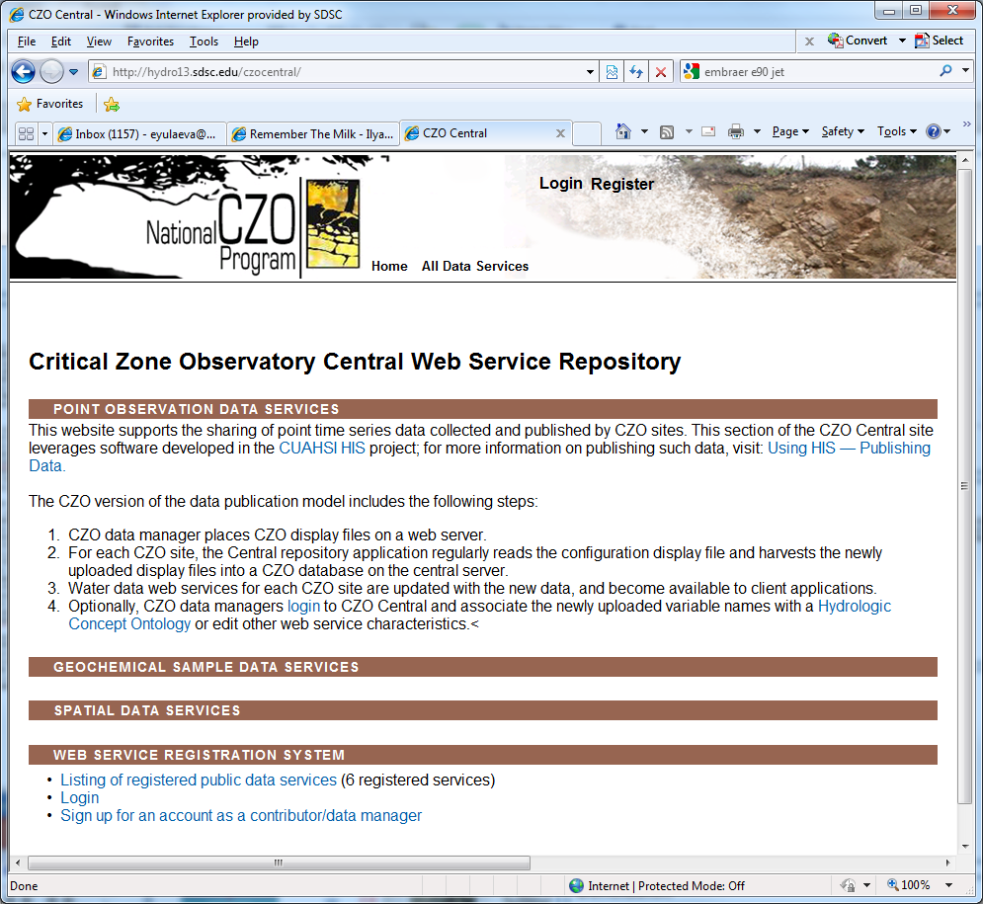

Slide 9
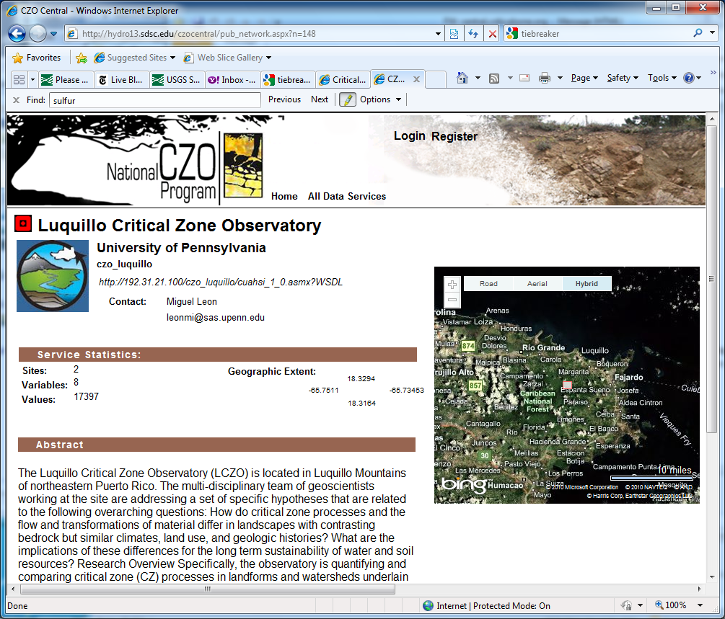
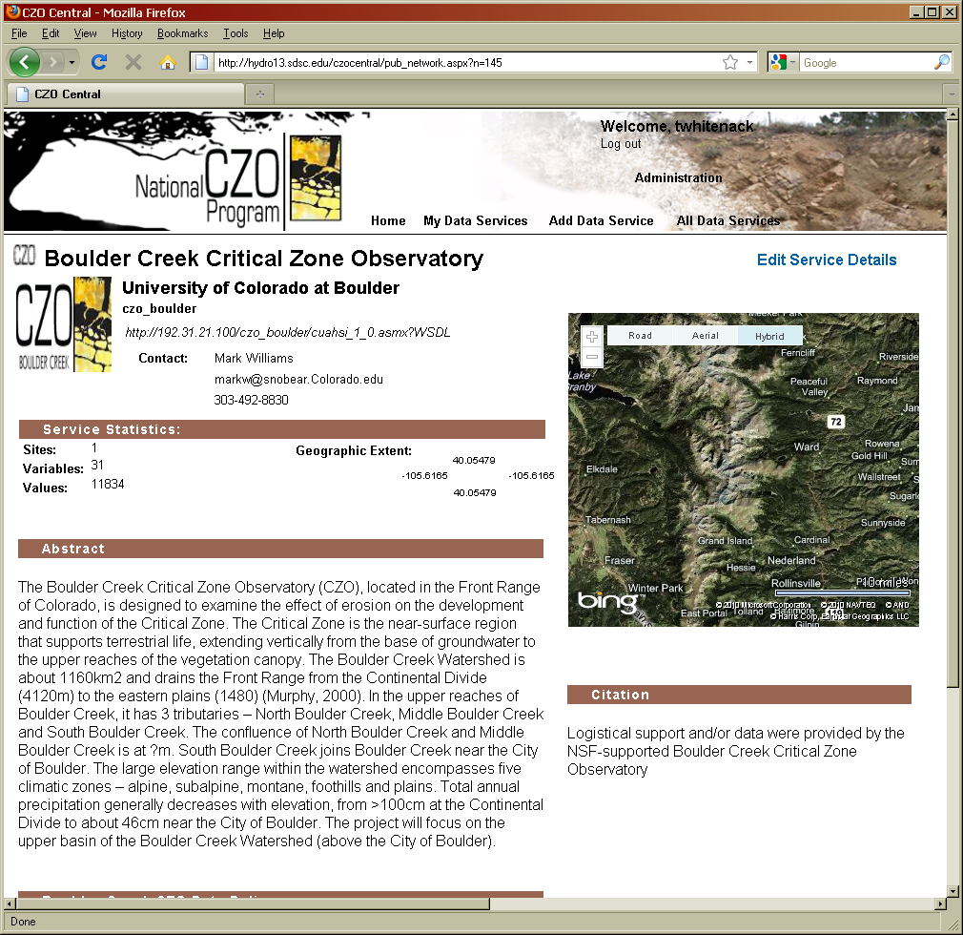
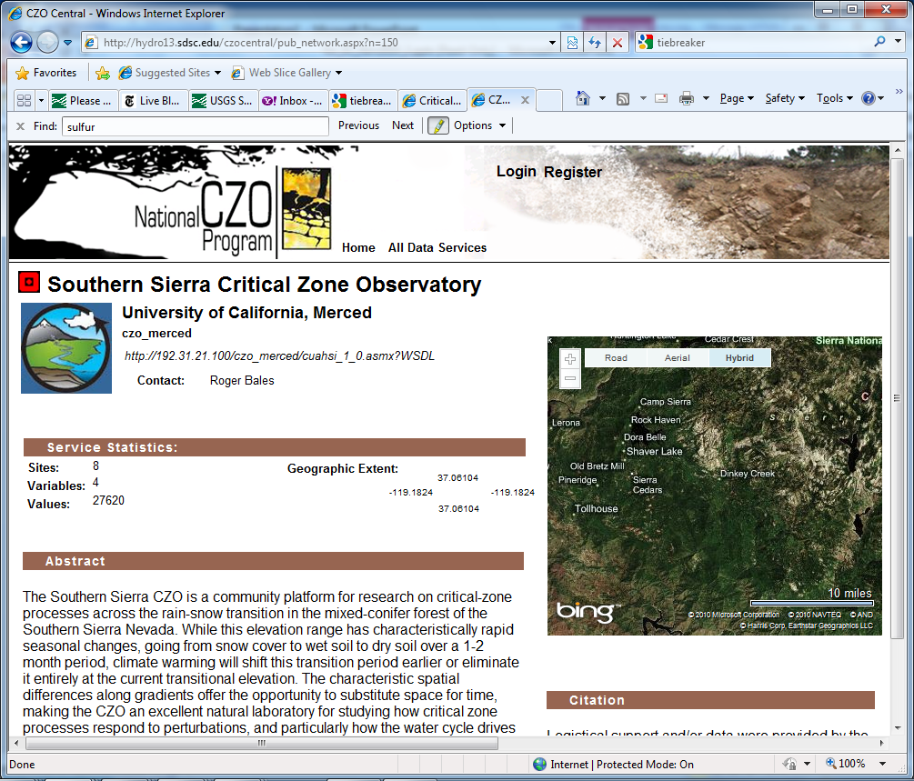
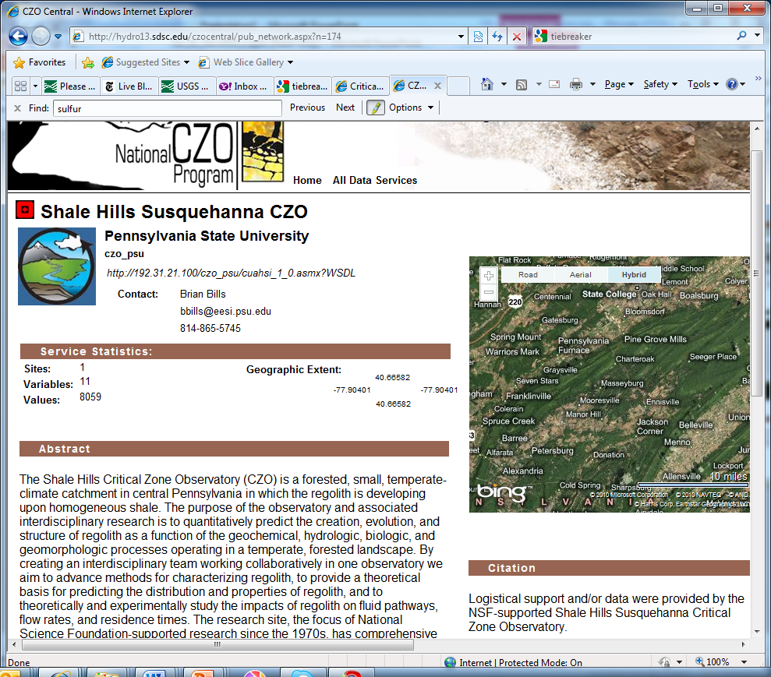
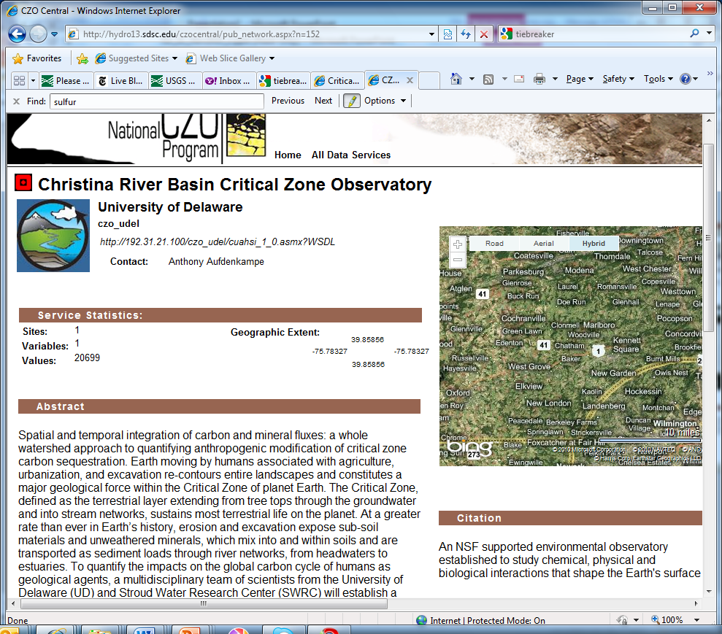
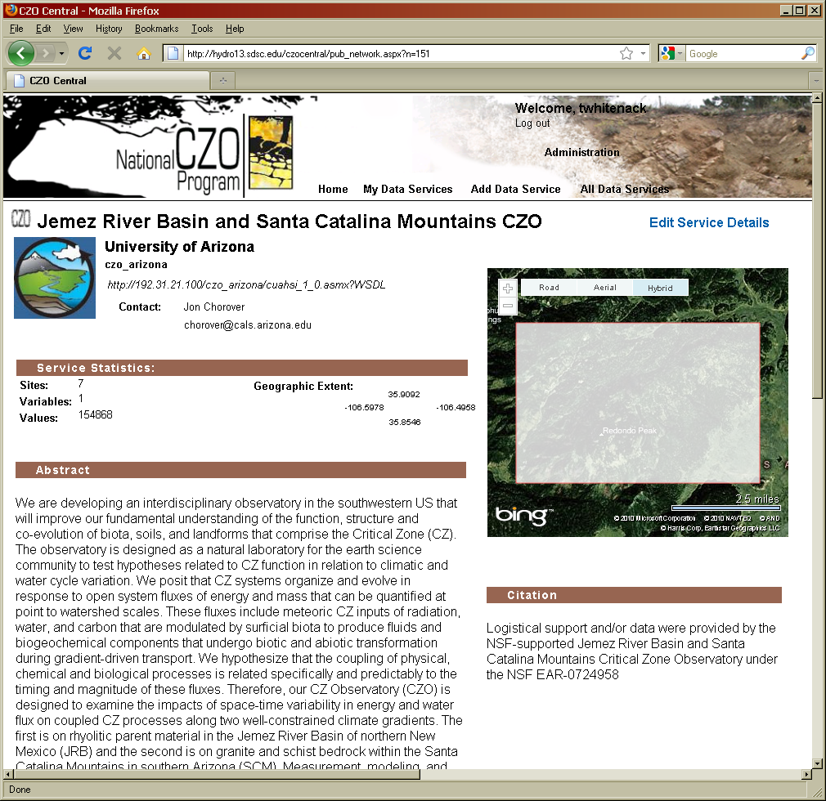
Individual CZO services at CZO Central

Slide 10
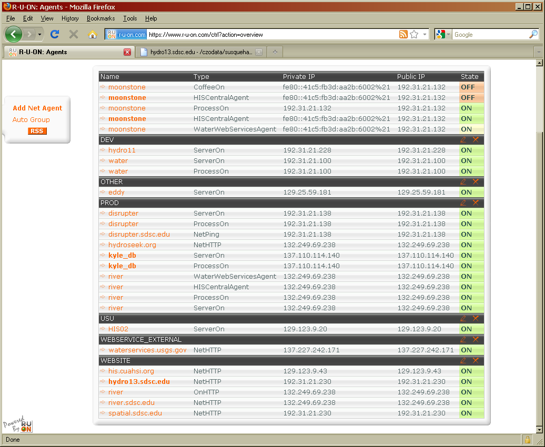
Initial server setup
Currently one CZO central machine and one DB server - extending to two machine setup
24/7 monitoring:
CZO DB Server
CZO Central

Slide 11
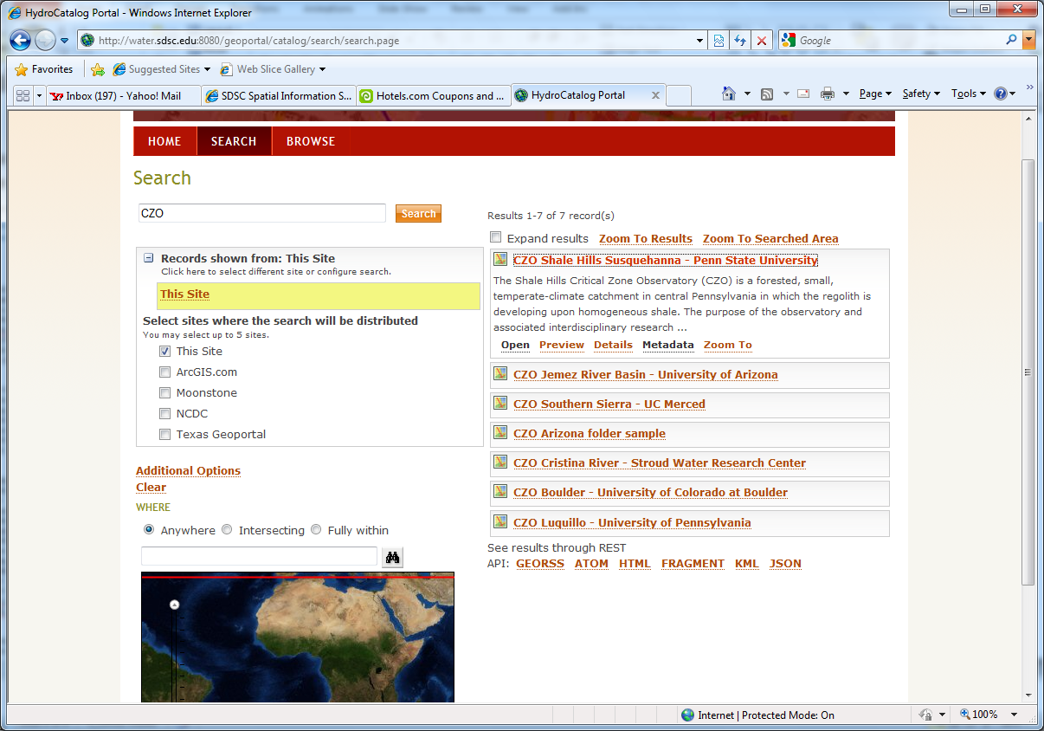

Slide 12

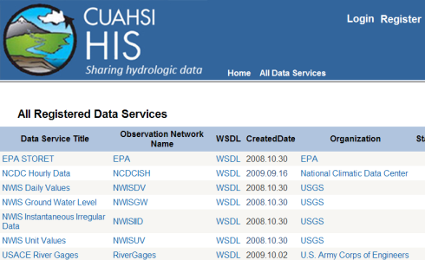
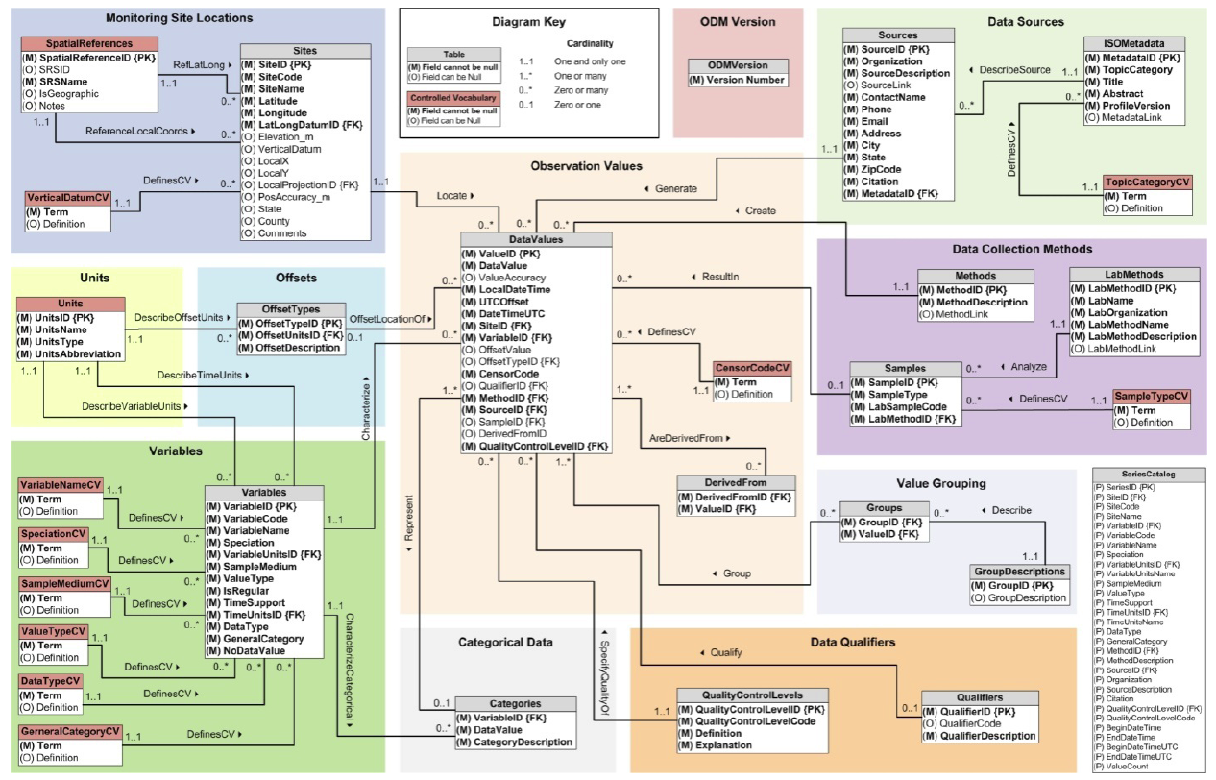
Federation of Catalog Services
A MetaCatalog at CUAHSI Program Office, Boston
CS/W
HIS
Central
CS/W
CS/W
CS/W
UTexas
USU
Notes:
Using OGC Catalog Services for the web a “Metacatalog” can be built at the CUAHSI Program Office by installing the ESRI Geoportal Software (now an open source software program) and registering CS/W endpoints in it from individual CUAHSI data collections, including HIS Central. The CUAHSI Metacatalog provides a single URL address that allows search across all CUAHSI collections. The metadata and data for those collections stay at the individual universities or are ingested into HIS Central and accessed from there.

Slide 13


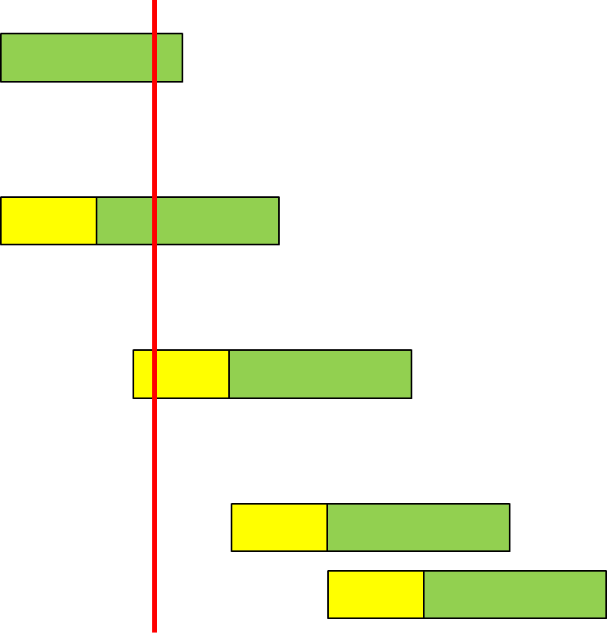
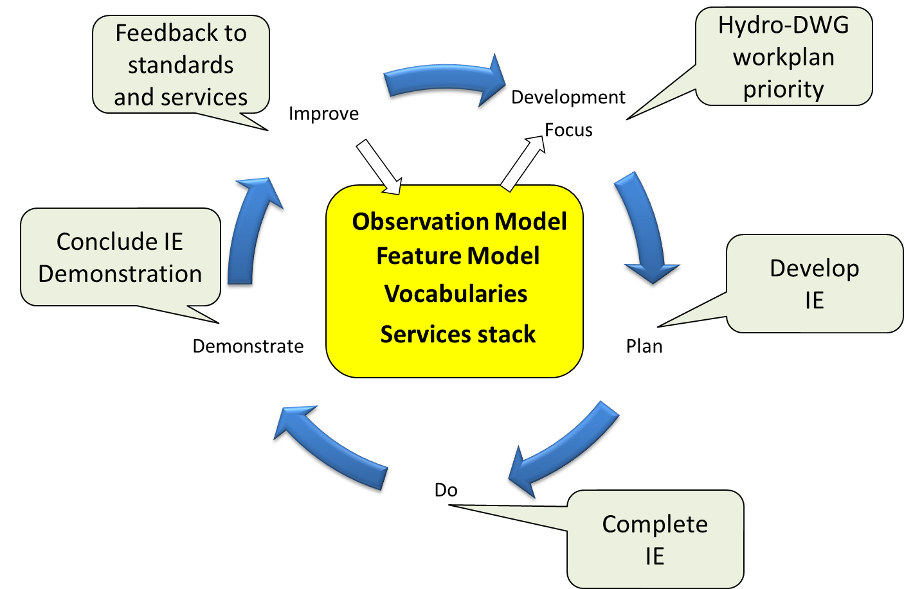
International Standardization of WaterML
Hydrology Domain Working Group
- working on WaterML 2.0
- organizing Interoperability Experiments focused
on different sub-domains of water
- towards an agreed upon feature model,
observation model, semantics and service stack
Timeline
WaterML 2 RFC
(Mar’11)
Iterative Development
Groundwater IE
  GSC+USGS
  Dec 09 – Dec 10
Surface Water IE
  CSIRO+many
  Jun 10 – Sep 11
Forecasting IE
  NWS+Deltares?
  Sep 11 – Sep 12?
Water Quality IE
Water Use IE
Nov’10
http://external.opengis.org/twiki_public/bin/view/HydrologyDWG/WebHome

Slide 14
Standards
O&M:
  Observation = act associated with a discrete time instant or period through which a number, term or other symbol is assigned to a phenomenon
  Phenomenon = property of an identifiable object, which is the feature of interest of the observation
  Observation uses a procedure (instrument, sensor, algorithm, etc.)
  Observation has a result = estimate of the value of some property of the feature of interest
Observation: featureOfInterest & observedProperty & procedure & result

Slide 15
SOS
Observation Offering: specified by instances of observation, observed property, procedure and feature of interest
Operations:
  getCapabilities (detailed info about Observation Offerings)
  describeSensor
  getObservation
  Also a few optional requests, incl. getFeatureOfInterest, getResult
There is an SOS Lite profile (Simon Jirka, Christoph Stasch)
Also: SOS Usage profile for the Hydrology Domain (Stefan Fuest)
Other:
  Sensor planning service; sensor alert service, sensor event service,

Slide 16
WaterML 2.0
WaterML 2.0 is an application schema of GML 3.2.1, which makes extensive use of the O&M specification (ISO 19156).
Describes:
  observations (what/when/where/how/results/context);
  time series (values/units/data types/data quality/accuracy/period of record/publisher and owner),
  observation processes (sensors/algorithms/models/manual methods),
  locations (stations and locations/operators/datums/types of observations/history/time zone/resources),
  grouping of measuring locations (i.e. networks),
  groupings of observations and time series.

Slide 17
How WaterML 2 restricts O&M
FOI of an observation can be a “spatial sampling feature” only (in most current cases, it is “WaterSamplingPoint”, which has a “shape” pointing to location or linking to respective representation of the point)
Result of an observation can be only TimeSeries as defined in WaterML2 (can be seen as a discrete coverage where the domain is a temporal axis and the range is all possible values of the ObservedProperty – usually represented as an ordered set of time-value pairs)
Observation procedure is restricted to WaterML2 “WaterObservationProcess” (types of processes include: sensor, algorithm, manual method, simulation, unknown)
Metadata is how it is described in “ObservationMetadata” (observation-specific metadata includes: intended sampling interval, status (e.g. validated, approved, provisional), sampled medium, maximum gap (determines whether two observations or series can be concatenated), and arbitrary name-value pairs for additional attributes (soft typed))

Slide 18
Some WaterML 2 discussion issues
Time series structures supported by WaterML 2.0, for different use cases.
  for a single parameter time series, from regular measurements with no missing observations to extremely irregular measurements, and also accommodating additional value-level metadata
  There are a few additional requirements, related to reporting timestamps for aggregate values and to reporting value accuracy/confidence.
  Additional encoding requirements apply to multiple-parameter time series (accommodating regular or irregular time gaps and missing parameters, large numbers of grouped parameters, fixed or variable sets of parameters, etc. – ideally returning grouped parameters for each timestamp “in close XML document proximity”.
  Lite encoding? Even lighter encoding?
Naming of classes. Currently the classes are named “WaterMonitoringObservation”, “WaterMonitoringPoint”, etc.
Dealing with missing values. It may be useful to distinguish missing values and absent values (absent = explicitly not found).
There are several vocabularies in use; they need to be harmonized for IEs to work. (out of scope for WaterML 2.0, but needs to be addressed at some level.)

Slide 19
Some SOS discussion issues
Making GetCapabilities response lightweight (compared to standard SOS usage where this request returns ObservationOfferings – which can be overwhelming for networks with large number of stations). In the proposed usage, FeatureOfInterest will be initially defined as the entire observation network.
Disambiguating key SOS terms such as procedure, observed property, feature of interest, offering.
Reconciling feature models: so far, SW IE is using the INSPIRE Hydrography data model. Need to see how it maps to NHD+.
SOS GetResults returning a lite version of time series (SOS allows this). GetResults is an optional SOS request, and can be customized to return just the values (almost no metadata)
Identifying some combination of WFS/WMS discovery calls, to compensate for GetCapabilities shortcomings (i.e. routing features via WFS GetFeature – though WFS aren’t fast either, and semantics needs to be settled).
Protocol support. SOS2 will provide both SOAP and REST (basically, the model we are moving to in HIS). In addition, exchange of CSV information should be supported (either based on SWE-Common or flat CSV files).
Better discovery support: retrieve sampling features given [station] name, code, HUC, other user-defined or standard polygon, bounding box, period of record, or other metadata; retrieve series given variables/location/POR; retrieve variables given locations and POR; retrieve procedures; etc. This is lacking in standard SOS, though SOS2 outlines a large list of optional service calls.

Slide 20
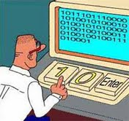
Questions?

Slide 21
Interoperability Levels
Social engineering – throughout all steps
Registration of “resources” -search for “resources”. OGC or not OGC (GeoPortal)
Resources have some standard metadata (Dublin Core); otherwise they are managed by individual software; services are different. OGC services; each with GetCapabilities
Resources have additional levels of registration: spatial, temporal and semantic + some derived info (spatio-temporal frequency/resolution)
Resources have internal content, which is returned via services – services have compatible interfaces (e.g. SOS): all are WFS/SOS
Compatible semantic and spatial tagging at the level of service content (i.e. individual observations). – different models, but time is in UTC, projection is specified, semantics is tagged (e.g. with IGSN)
Compatibility at the level of generic data models (i.e. everything follows a model of observation, like O&M)
Compatibility at the level of domain schemas/object models (e.g. WaterML/WaterML 2)
Compatibility at the level of databases (i.e. everything in ODM)

