Slide 1
Towards CZO data interoperability:
- across CZO sites
- for wide variety of CZO data
- supporting data synthesis and modeling

Slide 2
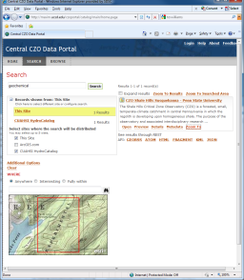
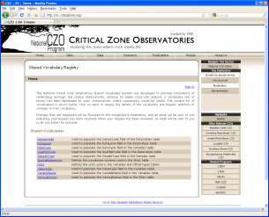
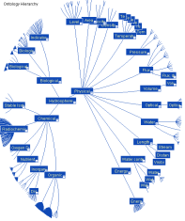
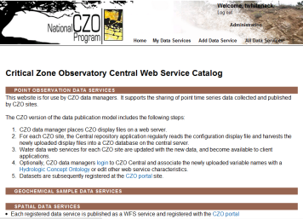
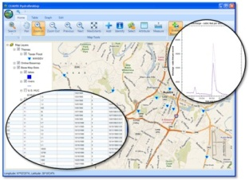
CZO data interoperability: what does it mean
System components
Levels of interoperability
Data
discovery
portal
Find and download CZO resources: files and file collections, services, documents – organized by CZO thematic category and by type
Data available in compatible semantics: ontologies, controlled vocabularies
Data available via the same service interfaces (e.g. WFS, SOS) but different information models
Compatibility at the level of domain information models and databases
Different types of data
collected by CZOs
Shared vocabularies
and ontology management
Deeper integration
Wider variety of data
Service
administration (CZOCentral)
Well-understood data with
formal information models
available via standard services
CZO
desktop,
others

Slide 3

CZO Data Management Web Administration Interface
CZO data managers use this web-based system to register display files, edit service metadata, initiate data retrieval, validate the data against shared vocabularies, and update hydrologic time series services
The administration system will be extended to geochemical samples and other data
http://central.criticalzone.org

Slide 4
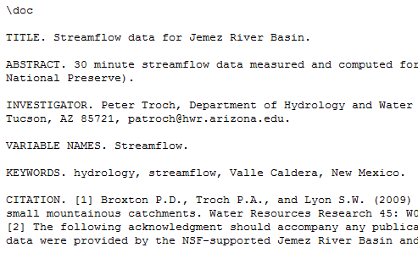
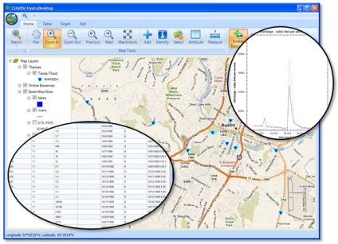
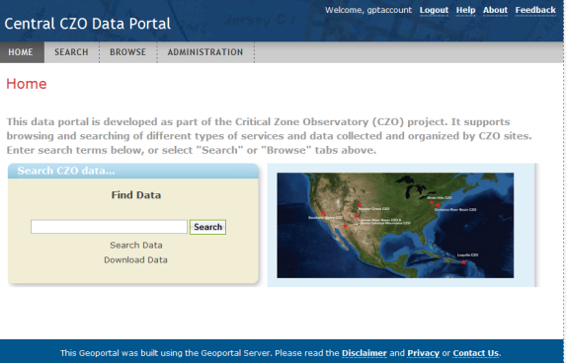
Data Publication Process
(for hydrologic time series)
CZO Desktop
CZO Display File
ODM
WaterML Service
CZO Central Catalog
Catalog Search Service
Raw Display file metadata
Is registered with the CZO
data portal, to assure original data is discoverable and downloadable.
WFS Service Is registered with the CZO data portal
OGC WFS Service
Broader internet community accessing data using standard protocols.
OGC CSW Service
CZO Portal utilizes the OGC CSW (catalog services for the web)

Slide 5
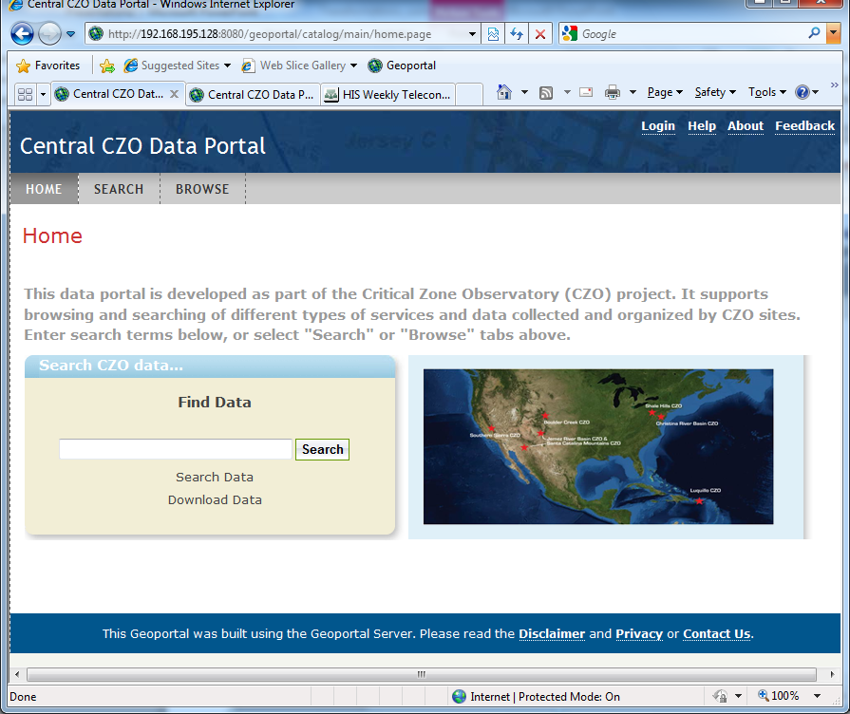
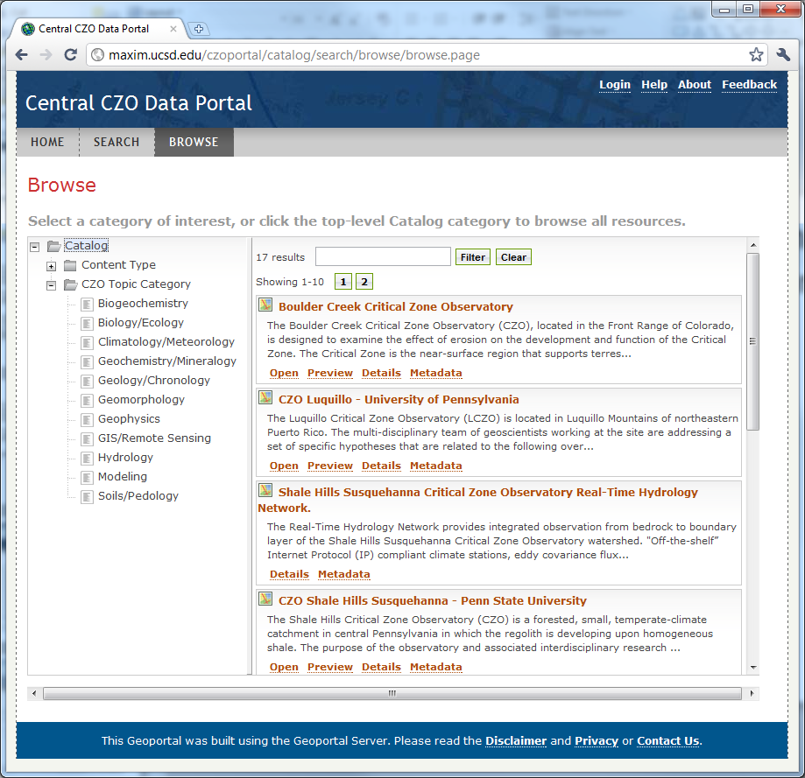
New Development: Central CZO Data Discovery Portal
Registered data are organized
by CZO thematic categories

Slide 6
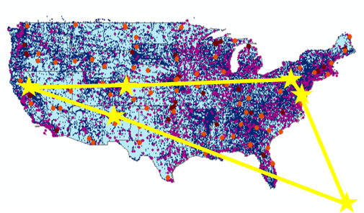

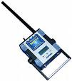
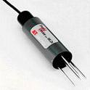
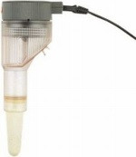
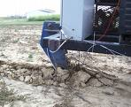
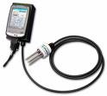



CZO Data Publication System
CZO Data Repository and Indexing (CZO Central)
External cross-project registries
CZO
Data Products
Standard CZO Services
DataNet
CZO Desktop
Applications
CZO Web-based
Data Discovery
System
CZO Metadata
Ontology
Shared vocabularies
Archive
Harvester
CZO
Desktop
Matlab
Standard CZO data display formats
R
Web site
Web site
Web site
Excel
ArcGIS
Local CZO DB
Local CZO DB
Local CZO DB
Modeling
Spatial, hydrologic, geophysical, geochemical, imagery, spectral…
Notes:
Hydrologic Information System Service Oriented Architecture

Slide 7
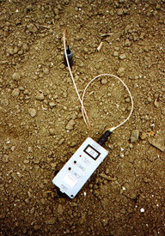
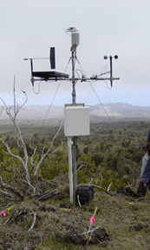
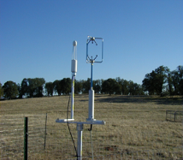
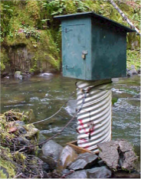
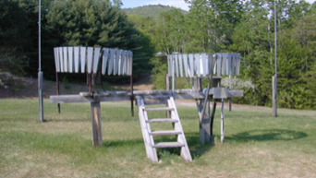
Status of the
prototype
Hydrologic and meteorological time series
CUAHSI HydroCatalog
Water data services
WaterML 1.x/2.0
CZO hydrologic themes
CZO Desktop
Applications
CZO Web-based
Data Discovery
System
CZO Metadata
Hydrologic Ontology
Shared vocabularies
Archive
Harvester
Hydro
Desktop
Matlab
Standard CZO data display formats
R
Web site
Web site
Web site
Excel
ArcGIS
Local CZO DB
Local CZO DB
Local CZO DB
OpenMI
Hydrologic and meteorological stations
Notes:
Hydrologic Information System Service Oriented Architecture

Slide 8
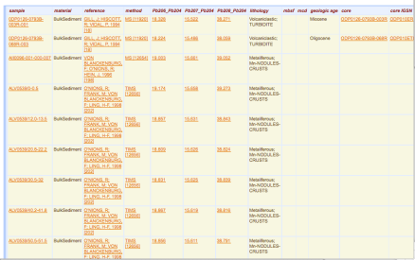
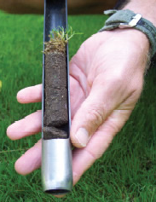
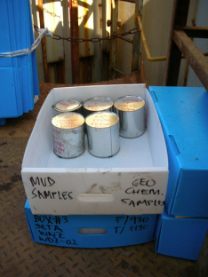
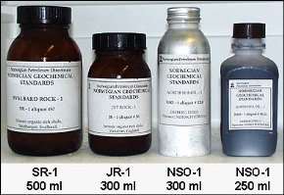

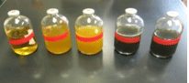
Geochemical Samples
EarthChem Data Engine & Portal
Geochemical web services, EarthChemML
Depth-resolved geochemistry
CZO Desktop
Applications
Metadata
IGSN management
Shared vocabularies
Archive
Harvester
CZO Web-based
Geochemical DB
CZO
Desktop
Matlab
Standard CZO data display formats
R
Web site
Web site
Web site
Excel
ArcGIS
Local CZO DB
Local CZO DB
Local CZO DB
Modeling
Geochemical samples
Notes:
Hydrologic Information System Service Oriented Architecture

Slide 9
CZO Web Services Model
CZO Web Services
Time Series Service
CZO Catalog Service
CZO Ontology Service
Spatial Data Services
Geochemical
Geophysical…
Processing Services
. . .
REST/SOAP
WFS (Features)
WMS (Maps)
SOS (Sensor)
REST/SOAP
WFS (Features)
WMS (Maps)
Catalog
REST
WPS
REST
WFS (Features)
WMS (Maps)
SOS (Sensor)
REST
WFS (Features)
WMS (Maps)
SOS (Sensor)
REST
WPS
WaterML 2.0
EarthChemML, EML,
GeoSciML

Slide 10


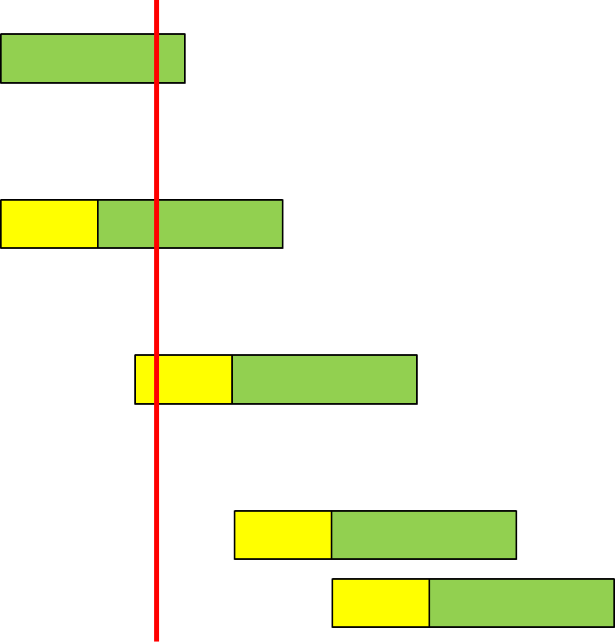
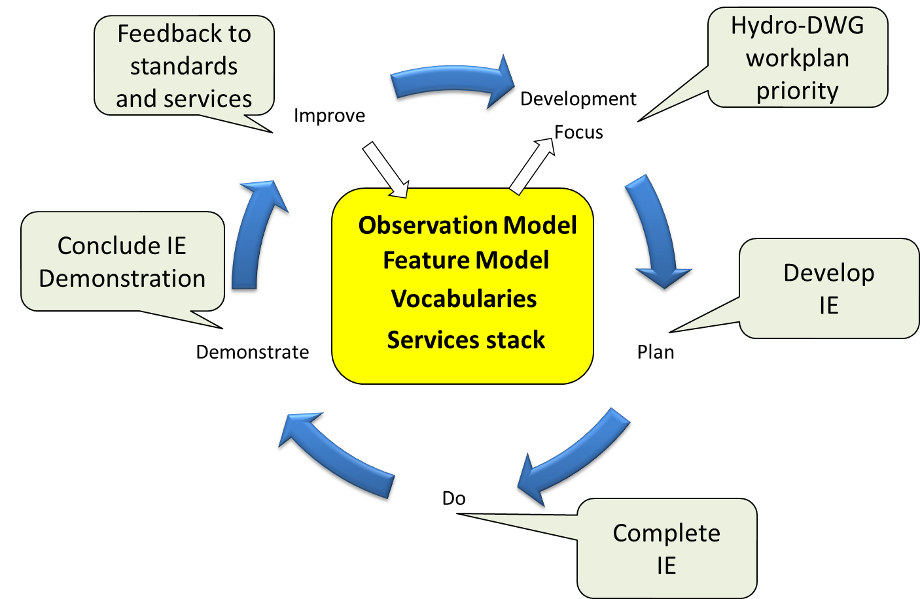
International Standardization of WaterML
Hydrology Domain Working Group
- working on WaterML 2.0
- organizing Interoperability Experiments focused
on different sub-domains of water
- towards an agreed upon feature model,
observation model, semantics and service stack
Timeline
WaterML 2 RFC
(Mar’11)
Iterative Development
Groundwater IE
  GSC+USGS
  Dec 09 – Dec 10
Surface Water IE
  CSIRO+many
  Jun 10 – Sep 11
Forecasting IE
  NWS+Deltares?
  Sep 11 – Sep 12?
Water Quality IE
Water Use IE
Nov’10
http://external.opengis.org/twiki_public/bin/view/HydrologyDWG/WebHome

Slide 11
What is the OGC?
The Open Geospatial Consortium, Inc. (OGC) is a non-profit, international voluntary consensus standards organization that is leading the development of standards for geospatial and location based services.
  The OGC facilitates a consensus process in which government, private industry, NGOs, and academia collaborate to create open and extensible software application programming interfaces for geospatial and other mainstream information technologies
Notes:
The OGC is a not for profit consortium dedicated to the development of specifications that enable geospatial technologies to “plug and play” across any device, platform or network. The OGC consists of 380+ members - geospatial technology software vendors, systems integrators, government agencies and universities - participating in a consensus process to develop, test, and document publicly available interface specifications and encodings for the geospatial industry. Open interfaces and protocols defined by OpenGIS® Specifications are designed to support interoperable solutions that "geo-enable" the Web, wireless and location-based services, and mainstream IT, and to empower technology developers to make complex spatial information and services accessible and useful to all kinds of applications.

Slide 12
History - Perspective
1969 – Internet “Invented”. Carl generates his first computer map ☺. Intergraph, LaserScan, and ESRI begin business.
1974 – Email Invented
1993 - First Web Mapping Application (Xerox)
1994 – OpenGIS Consortium Founded
1994 – Netscape formed
1996 – XML Developed Started.
1996 – Mapquest comes on-line.
1998 – First OpenGIS® Specification adopted.
1998 - Google Started Business
1999 – First OGC Web Mapping Test bed.
2000 – Web Map Service Interface Spec 1.0 approved
2005 – (June) Google Earth Launched
2005 - (July) MS Virtual Earth Launched
2007 – The “Neogeography” term coined
Notes:
Now life gets really interesting. Events really begin to accelerate. As far as I know, the first use of commercial GIS in a Web deployed application happened in 1994. Since then, every GIS vendor has a web solution for their software. There are now thousands of spatially enabled web sites. And possibly the most heavily used WebGIS application in the world, Mapquest, is not even thought of by many as even a GIS. Shades of things to come. As a point of interest, the Mapquest site is currently serving over 2800 maps per minute and the volume is growing.

Slide 13
Benefits of open standards
Prevents a single group from controlling a standard
Facilitates competition
Stimulates innovation
Customers benefit from not being locked into a particular supplier.
  Source: Open Standards, Open Source, and Open Innovation: Harnessing the Benefits of Openness, April 2006. Committee For Economic Development. www.ced.org
Integral part of CI;
Requirement for CI sustainability and extensibility, esp. with 3rd party components
AND - CI efforts are also a way to inform standards development
Notes:
Prevents a single, self-interested party from controlling a standard
Facilitates competition by lowering the cost of entry
Stimulates innovation beyond the standard by companies that seek to differentiate themselves.
Customers value the interoperability that open standards provide and generally benefit from not being locked into a particular supplier.

Slide 14
Hydrology Domain Working Group
A joint working group of the OGC and WMO constituted as an OGC Domain Working Group.
Brings together interested parties to develop and promote the technology for greatly improving the way in which water information is described and shared.
Co-chaired by representatives nominated by the OGC TC and the World Meteorological Organisation’s (WMO) Commission for Hydrology (CHy).
    Current Co-Chairs: Ilya Zaslavsky (SDSC), Ulrich Looser (GRDC) and David Lemon (CSIRO)
    > 50 Participants, > 30 Organisations
Public mailing list https://lists.opengeospatial.org/mailman/listinfo/hydro.dwg
Twiki http://external.opengis.org/twiki_public/bin/view/HydrologyDWG

Slide 15
Standards
O&M:
  Observation = act associated with a discrete time instant or period through which a number, term or other symbol is assigned to a phenomenon
  Phenomenon = property of an identifiable object, which is the feature of interest of the observation
  Observation uses a procedure (instrument, sensor, algorithm, etc.)
  Observation has a result = estimate of the value of some property of the feature of interest
Observation: featureOfInterest & observedProperty & procedure & result

Slide 16
SOS
Observation Offering: specified by instances of observation, observed property, procedure and feature of interest
Operations:
  getCapabilities (detailed info about Observation Offerings)
  describeSensor
  getObservation
  Also a few optional requests, incl. getFeatureOfInterest, getResult
There is an SOS Lite profile (Simon Jirka, Christoph Stasch)
Also: SOS Usage profile for the Hydrology Domain (Stefan Fuest)
Other:
  Sensor planning service; sensor alert service, sensor event service,

Slide 17
WaterML 2.0
WaterML 2.0 is an application schema of GML 3.2.1, which makes extensive use of the O&M specification (ISO 19156).
Describes:
  observations (what/when/where/how/results/context);
  time series (values/units/data types/data quality/accuracy/period of record/publisher and owner),
  observation processes (sensors/algorithms/models/manual methods),
  locations (stations and locations/operators/datums/types of observations/history/time zone/resources),
  grouping of measuring locations (i.e. networks),
  groupings of observations and time series.

Slide 18
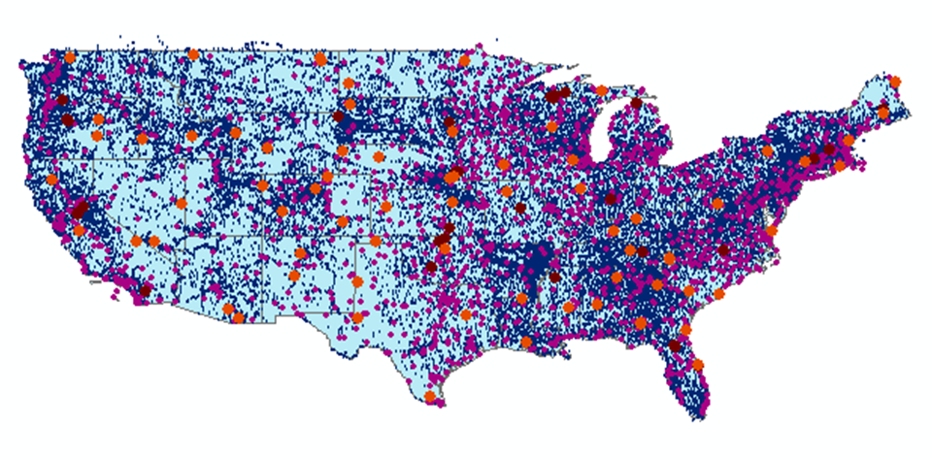
HISCentral Content
Map integrating NWIS, STORET, & Climatic Sites
71 public services
18,000+ variables
1.96+ million sites
23.3 million series
Referencing 5.2 billion data values
Available via HISCentral
discovery services
Available via GetValues requests

Slide 19
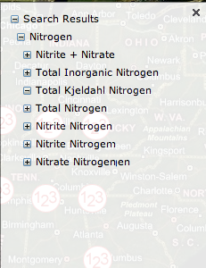
Managing Varying Semantics
In measurement units…
acre feet | acre-feet
micrograms per kilogram | micrograms per kilgram
FTU | NTU
mho | Siemens
ppm | mg/kg
In parameter names…
Nitrogen: e.g. NWIS parameter # 625 is labeled ‘ammonia + organic nitrogen‘, Kjeldahl method is used for determination but not mentioned in parameter description. In STORET this parameter is referred to as Kjeldahl Nitrogen.
And: Dissloved oxygen

Slide 20
Online available glossaries
online available vocabularies inspected in March 2011
UNESCO-WMO Glossary (Hydrology) | http://webworld.unesco.org/water/ihp/db/glossary/glu/aglu.htm
INSPIRE Glossary | http://inspire-registry.jrc.ec.europa.eu/registers/GLOSSARY/items
AMS Glossary (Meteorology) | http://amsglossary.allenpress.com/glossary
EMWIS Thesaurus | http://www.emwis.net/portal_thesaurus/
EEA GEMET Thesaurus | http://www.eionet.europa.eu/gemet/
USGS Hydrologic definitions | http://water.usgs.gov/wsc/glossary.html
IHD, International Hydrographic Dictionary | http://www.loria.fr/projets/MLIS/DHYDRO/outils/site_edition/dictframe.html
20

Slide 21
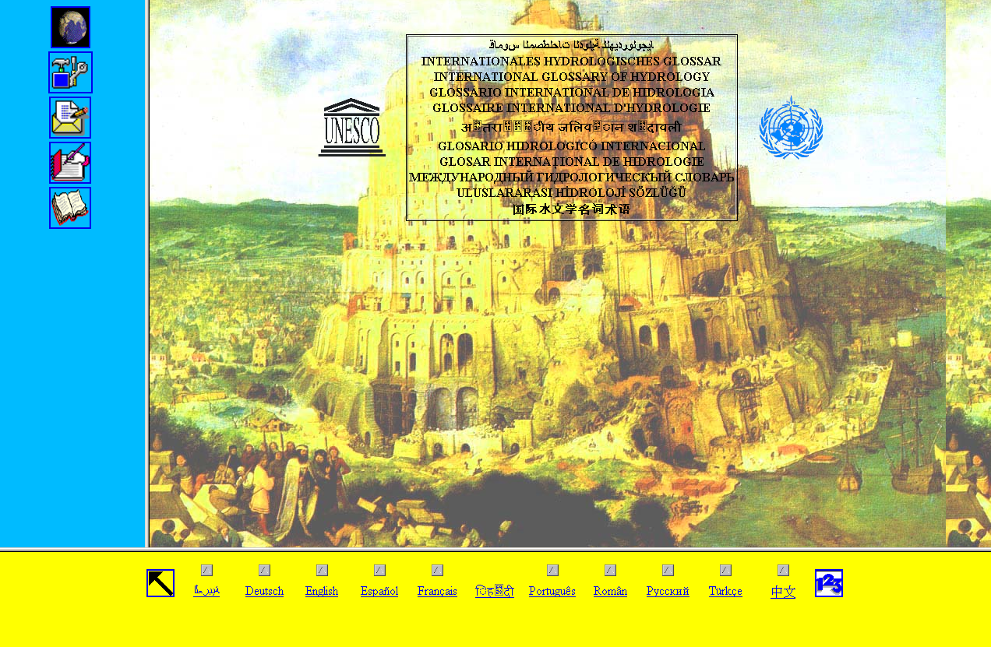
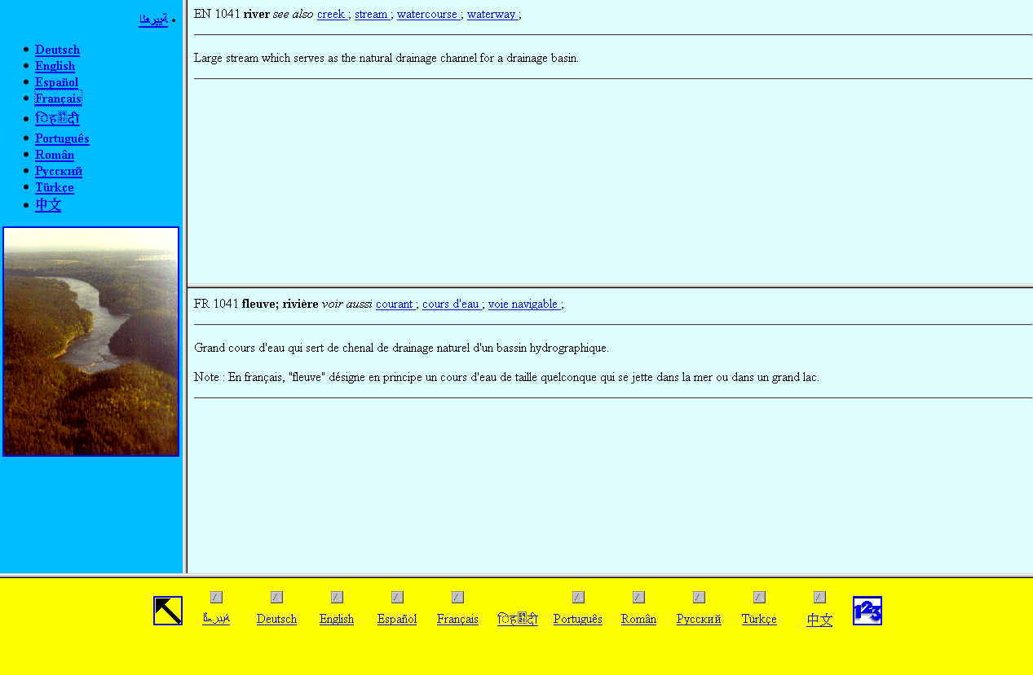
Example: UNESCO-WMO Glossary of Hydrology
Term: 1418 singularia, pluralia tantum
Scope: hydrology
Multilinguality: 13 (4) languages
Definition: WMO 1974, 1992, (2011)
Synonym: yes
Hypernym / Hyponym: in text
Associated term: a - b relation
21

Slide 22
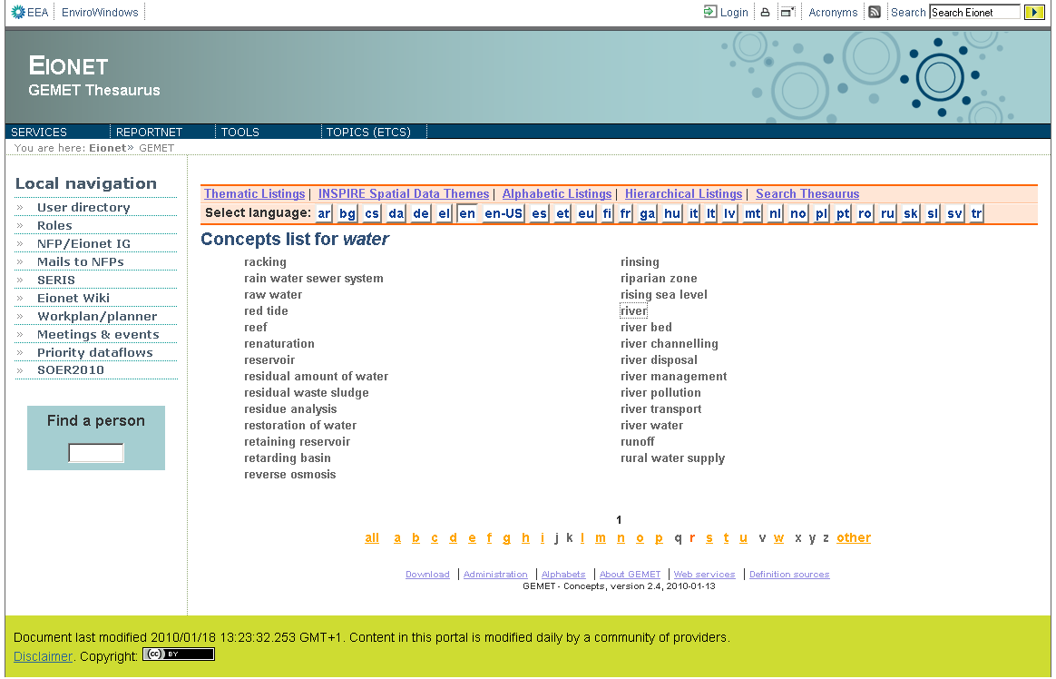
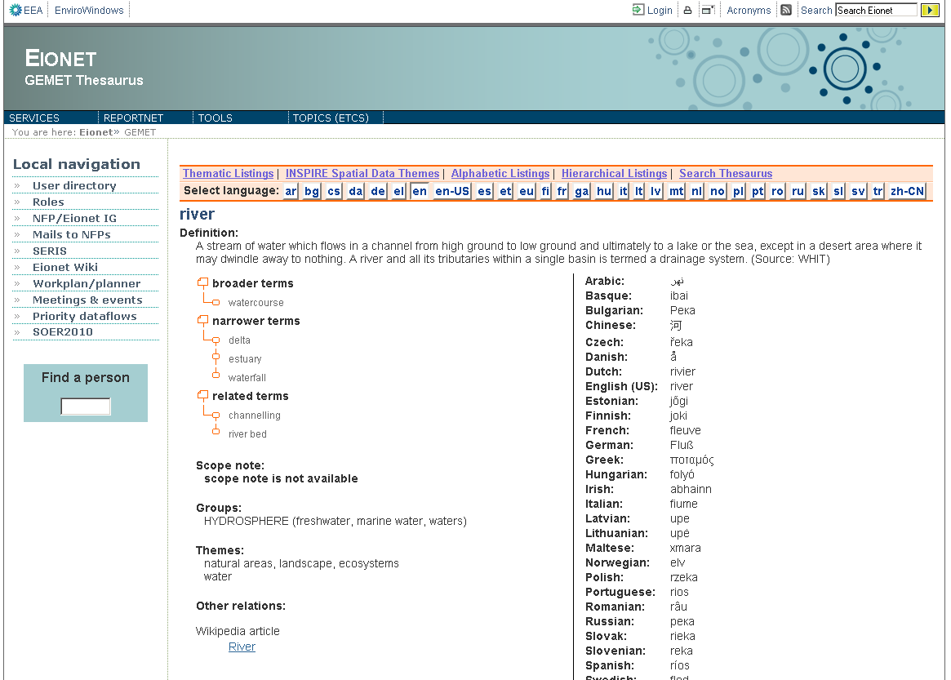
Example: EEA GEMET Thesaurus
Term: > 5000 singularia, pluralia tantum
Scope: hydrosphere, waste, waters
Multilinguality: 29 languages
Definition: from secondary sources
Synonym: no
Hypernym / Hyponym: yes
Associated terms: yes
22

Slide 23
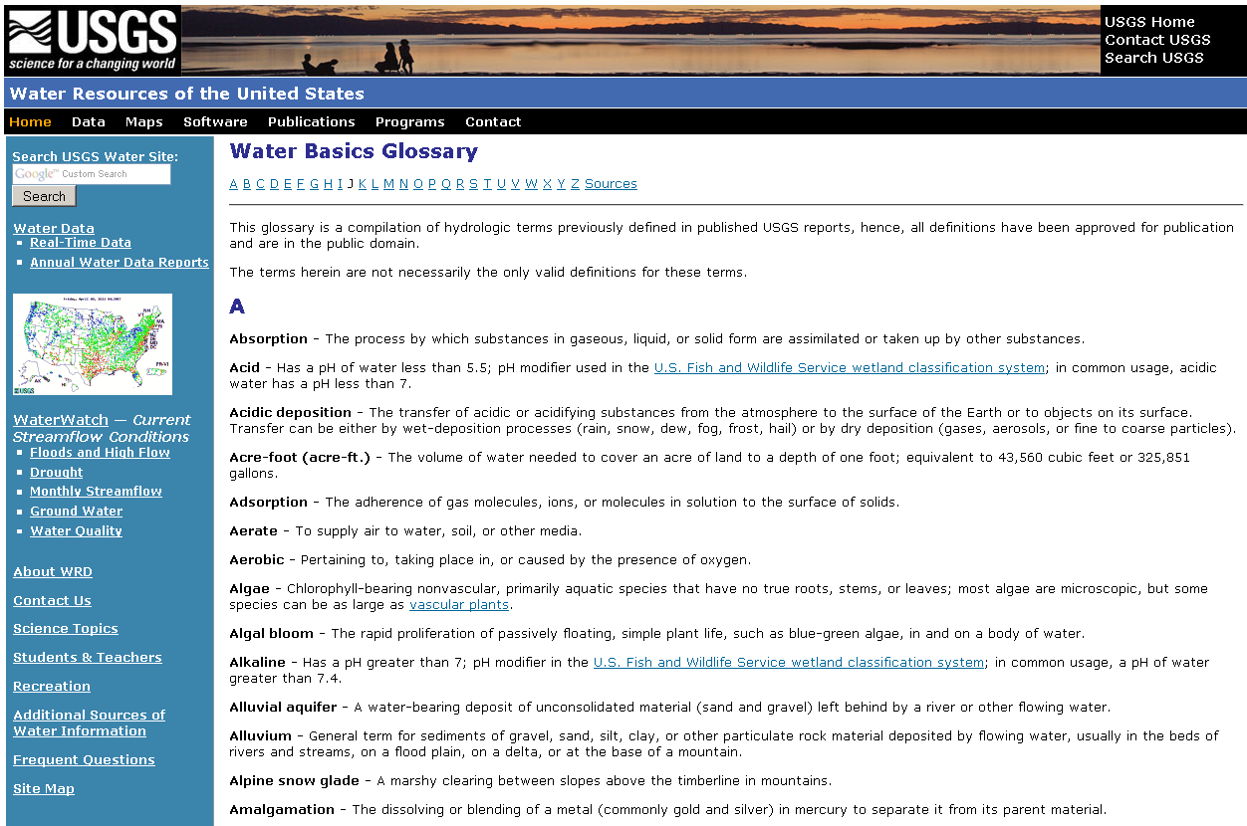
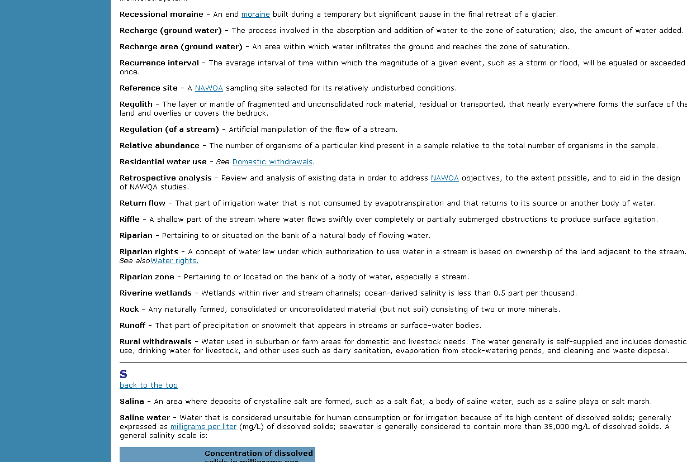
Example: USGS Water Basics Glossary
Term: ~ 300 singularia, pluralia tantum
Scope: ”Manual of Hydrology” terms
Multilinguality: no
Definition: USGS 1995
Synonym: no
Hypernym / Hyponym: in text
Associated term: in text
23

Slide 24
WMO Terminology recommended
Terminology recommended for use in the WMO community
International Glossary of Hydrology
  joint publication of UNESCO / WMO
  established in the WMO community
  printed and online version available (13 languages)
  http://webworld.unesco.org/water/ihp/db/glossary/glu/aglu.htm
Guide to Hydrological Practices
  Vol.I: Hydrology - From measurement to hydrological information
  6th edition. - WMO, 2009
  printed and digital version, not online
  not a vocabulary, provides definitions
24

Slide 25
